Slide 1
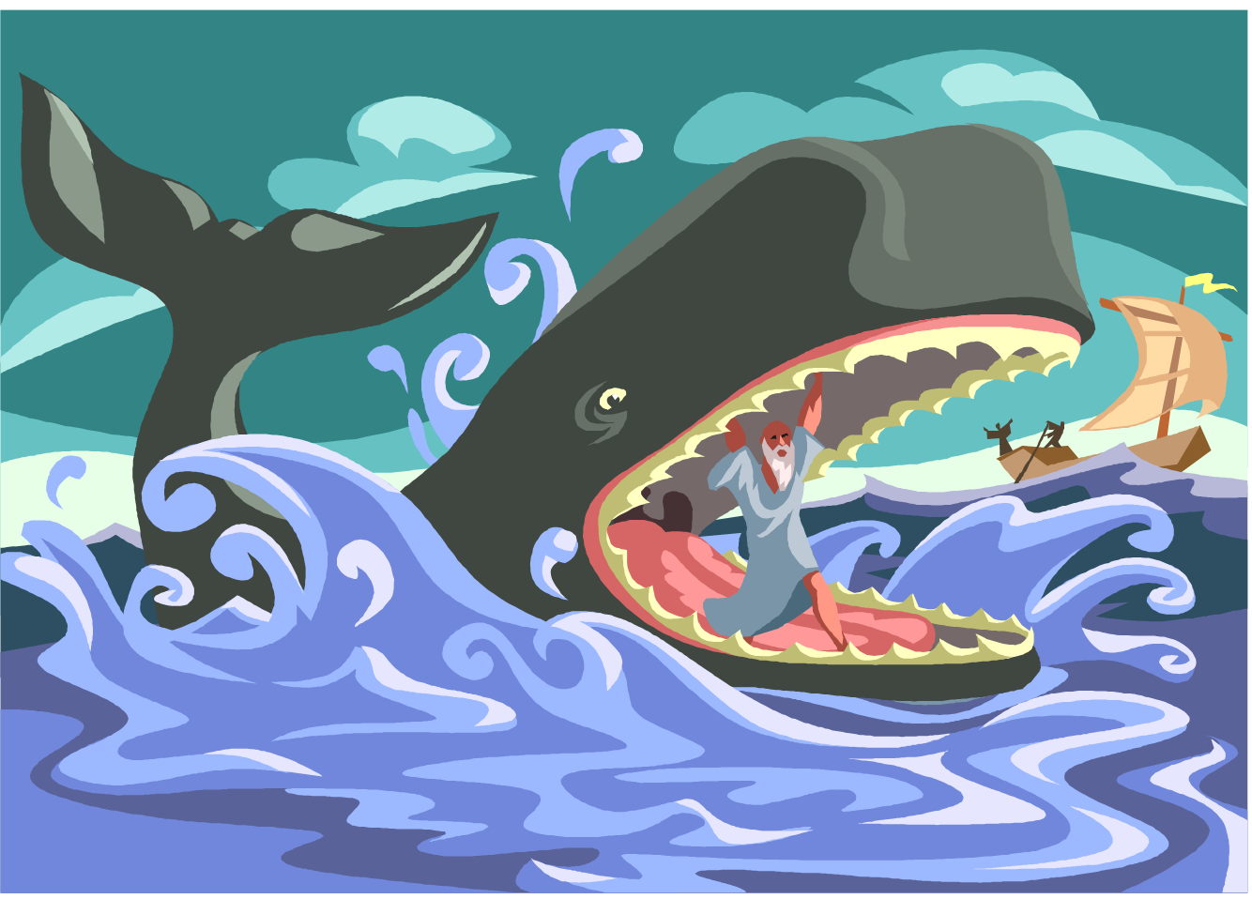
Lessons from the book of Jonah #2

Slide 2
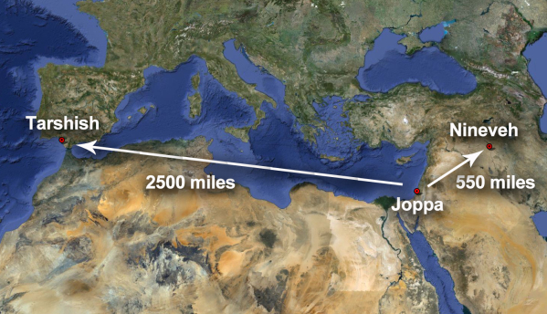
“Go to Nineveh and tell them to repent.”

Slide 3
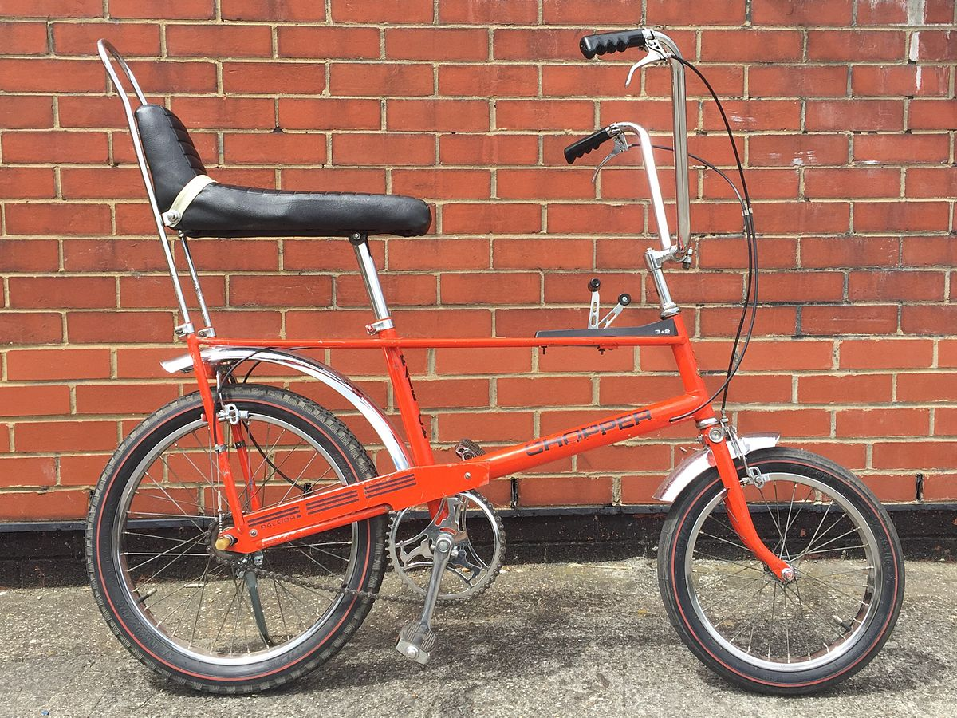
Then the word of the Lord came to Jonah a second time: ² “Go to the great city of Nineveh and proclaim to it the message I give you.” Jonah 3:1-2 (NIV)
A second chance

Slide 4
A second chance
^{I. It starts with Obedience}
³ Jonah obeyed the word of the Lord
and went to Nineveh.

Slide 5
^{II. Faithfulness} ^{and} ^{boldness} ^{are} ^{required}
…“Forty more days and Nineveh will be overthrown.”
Jonah 3:4 (NIV)
“overthrown.”
“overturned.”
=
destroyed and annihilated
“The Ninevites believed God. A fast was proclaimed, and all of them, from the greatest to the least, put on sackcloth.
Jonah 3:5 (NIV)

Slide 6
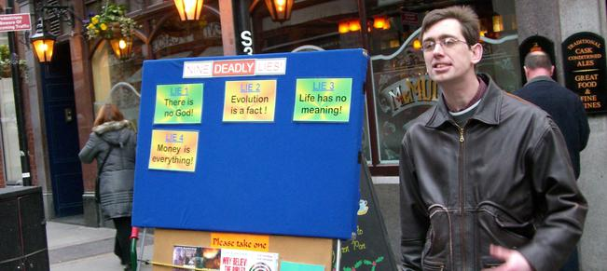
Manchester councillor:
Street preachers shouldn't talk about morality
"They're perfectly entitled to talk about the Jesus and the word of God, but not to make anyone feel insecure or threatened."

Slide 7
^{Faithfulness} ^{and} ^{boldness} ^{are} ^{required}
⁶ When Jonah’s warning reached the king of Nineveh, he rose from his throne, took off his royal robes, covered himself with sackcloth and sat down in the dust. ⁷ This is the proclamation he issued in Nineveh:
“By the decree of the king and his nobles:
Do not let people or animals, herds or flocks, taste anything; do not let them eat or drink. ⁸ But let people and animals be covered with sackcloth. Let everyone call urgently on God. Let them give up their evil ways and their violence. ⁹ Who knows? God may yet relent and with compassion turn from his fierce anger so that we will not perish.”
Jonah 3:6-9 (NIV)

Slide 8
^{III. It depends} ^{on} ^{God’s mercy and grace}
“When God saw what they did and how they turned from their evil ways, he relented and did not bring on them the destruction he had threatened.”
Jonah 3:10 (NIV)

Slide 9
Our Lord Jesus used Jonah story to warn us about repentance, about a second chance:
Matthew 12:41 (NIV)
The men of Nineveh will stand up at the judgment with this generation and condemn it; for they repented at the preaching of Jonah, and now something greater than Jonah is here.

Slide 10
A second chance
^{I. It starts with Obedience}
^{II. Faithfulness} ^{and} ^{boldness} ^{are} ^{required}
^{III. It depends} ^{on} ^{God’s mercy and grace}
My sacrifice, O God, is a broken spirit; a broken and contrite heart you, God, will not despise.
Psalm 51:17 (NIV)

