Slide 1
Jonah 2:1-9 (NIV)
From inside the fish Jonah prayed to the Lord his God. He said: “In my distress I called to the LORD, and he answered me. From the depths of the grave I called for help, and you listened to my cry. You hurled me into the deep, into the very heart of the seas, and the currents swirled about me; all your waves and breakers swept over me. I said, ‘I have been banished from your sight; yet I will look again toward your holy temple.’

Slide 2
Jonah 2:1-9 (NIV)
The engulfing waters threatened me, the deep surrounded me; seaweed was wrapped around my head. To the roots of the mountains I sank down; the earth beneath barred me in forever. But you brought my life up from the pit, O LORD my God. “When my life was ebbing away, I remembered you, LORD, and my prayer rose to you, to your holy temple. “Those who cling to worthless idols forfeit the grace that could be theirs. But I, with a song of thanksgiving, will sacrifice to you.

Slide 3
What I have vowed I will make good. Salvation comes from the LORD.”
Lessons from the book of Jonah #1
Let’s pray…

Slide 4
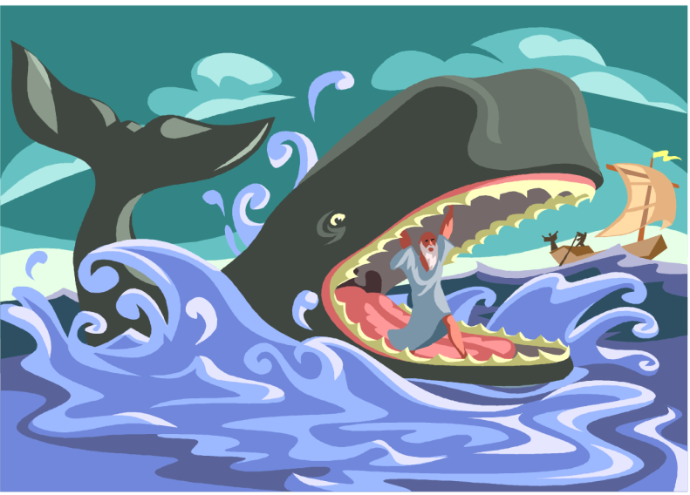
Lessons from the book of Jonah #1
“as Jonah was three days and three nights in the belly of a huge fish, so the Son of Man will be three days and three nights in the heart of the earth.”
Matthew 12:40 (NIV)

Slide 5
I. It starts by being thrown in the sea
“Pick me up and throw me into the sea,” he replied, “and it will become calm. I know that it is my fault that this great storm has come upon you.”
Jonah 1:12 (NIV)
I have been banished
SHAME has been described by one Christian Psychologist as the “haemorrhaging of the soul”

Slide 6
But he was pierced for our transgressions, he was crushed for our iniquities; the punishment that brought us peace was upon him, and by his wounds we are healed. We all, like sheep, have gone astray, each of us has turned to his own way; and the LORD has laid on him the iniquity of us all.
Isaiah 53:5-6 (NIV)

Slide 7
II. It continues with prayer
“He said: “In my distress I called to the Lord,…”
Jonah 2:2 (NIV)
“Those who cling to worthless idols forfeit the grace that could be theirs. But I, with a song of thanksgiving, will sacrifice to you. What I have vowed I will make good. Salvation comes from the LORD.”
Jonah 2:8-9 (NIV)

Slide 8
²¹ But now apart from the law the righteousness of God has been made known, to which the Law and the Prophets testify. ²² This righteousness is given through faith in Jesus Christ to all who believe. There is no difference between Jew and Gentile, ²³ for all have sinned and fall short of the glory of God, ²⁴ and all are justified freely by his grace through the redemption that came by Christ Jesus.
Romans 3:21-24 (NIV)

Slide 9
III. It concludes with HOPE in the belly
“He said: “In my distress I called to the Lord, and he answered me. From the depths of the grave I called for help, and you listened to my cry. . . . . But you brought my life up from the pit, O LORD my God.”
Jonah 2:2, 6b (NIV)

Slide 10
III. It concludes with HOPE in the belly
⁹ But I, with shouts of grateful praise, will sacrifice to you. What I have vowed I will make good. I will say, ‘Salvation comes from the Lord.’”
Jonah 2:2, 6b (NIV)
I will say, ‘Salvation comes from the Lord.’”

Slide 11
²⁰ But Christ has indeed been raised from the dead, the firstfruits of those who have fallen asleep. ²¹ For since death came through a man, the resurrection of the dead comes also through a man. ²² For as in Adam all die, so in Christ all will be made alive.
1 Corinthians 15:20-22 (NIV)
I will say, ‘Salvation comes from the Lord.’”

