Slide 1

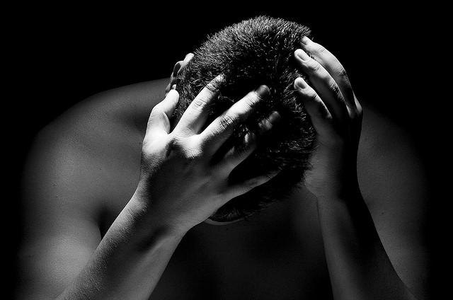
Essentials to grow in the spiritual life #4:
Anguish [Suffering] and Hope
Psalm 88

Slide 2
“O Lord, the God who saves me, day and night I cry out before you”
(Psalm 88:1a)
Let’s Pray…

Slide 3

Psalm 88
Anguish [Suffering] and Hope
DARKNESS SURROUNDS THE PSALMIST
‘the lowest pit’ or ‘darkest depths’

Slide 4
1) HE PRAYS IN THE DARK
“¹Lord, you are the God who saves me; day and night I cry out to you. ² My prayer comes before you; turn your ear to my cry”.
Psalm 88:1-2 (NIV)
“…I call to you, Lord, every day; I spread out my hands to you”.
Psalm 88:9 (NIV)

Slide 5
¹⁴ Why, Lord, do you reject me and hide your face from me?
Psalm 88:14 (NIV)
Heman has much to teach us here. God is certainly there even though this distressed man no longer enjoys the awareness of his presence.
Dr John Barry Dyer.

Slide 6
2) HE GRIEVES IN THE DARK
“You have put me in the lowest pit, in the darkest depths”
Psalm 88:6 (NIV)
“I am overwhelmed with troubles and my life draws near to death”
Psalm 88:3 (NIV)

Slide 7
“You have taken my closest friends and have made me repulsive to them. I am confined I cannot escape;”
Psalm 88:8 (NIV)
The psalmist is honest with God so we should be honest with Him.

Slide 8
3) HE THINKS IN THE DARK
¹⁰ Do you show your wonders to the dead? Do their spirits rise up and praise you? ¹¹ Is your love declared in the grave, your faithfulness in Destruction? ¹²Are your wonders known in the place of darkness. Or your righteous deeds in the land of oblivion?
Psalm 88:10-12 (NIV)

Slide 9
Heman is haunted by two perverse thoughts, and neither of them come anywhere near the truth.
a) God is angry with him.
“…I am angry with you and your two friends, because you have not spoken the truth about me, as my servant Job has”.
Job 42:7 (NIV)
Suffering is a mysterious inevitability in a fallen world

Slide 10
b) In his distress Heman wished he could die.
The psalmist’s reflection reminds us that not everything we think about in distress is true.
For believers, death is but a door.
Heaven is real.

Slide 11
4) HE TRUSTS IN THE DARK &
HE CONTINUES TO WAIT FOR GOD’S FUTURE
“Lord, you are the God who saves me; day and night I cry out to you.” Psalm 88:1 (NIV)
Good can come out of life’s worst experiences because he is looking to a God who helps.
“But I cry to you for help, Lord; in the morning my prayer comes before you”.
Psalm 88:13 (NIV)

Slide 12
“What is so wonderful about the psalms is the kind of companionship they offer. There is a rainbow of human emotion in the psalms. The psalms help you realize that no matter what happens, other people have been through this. The psalms are an incredible benefit to the human soul.”
James Schaap

Slide 13
Essentials to grow in the spiritual life #4:
Anguish [Suffering] and Hope
Psalm 88

