Slide 2
Proverbs 31:10-31 (NIV)
The Wife of Noble Character
¹⁰ A wife of noble character who can find? She is worth far more than rubies. ¹¹ Her husband has full confidence in her and lacks nothing of value. ¹² She brings him good, not harm, all the days of her life. ¹³ She selects wool and flax and works with eager hands. ¹⁴ She is like the merchant ships, bringing her food from afar.
¹⁵ She gets up while it is still night; she provides food for her family and portions for her female servants. ¹⁶ She considers a field and buys it; out of her earnings she plants a vineyard. ¹⁷ She sets about her work vigorously; her arms are strong for her tasks.

Slide 3
¹⁸ She sees that her trading is profitable, and her lamp does not go out at night. ¹⁹ In her hand she holds the distaff and grasps the spindle with her fingers. ²⁰ She opens her arms to the poor and extends her hands to the needy. ²¹ When it snows, she has no fear for her household; for all of them are clothed in scarlet. ²² She makes coverings for her bed; she is clothed in fine linen and purple. ²³ Her husband is respected at the city gate, where he takes his seat among the elders of the land. ²⁴ She makes linen garments and sells them, and supplies the merchants with sashes.

Slide 4
²⁵ She is clothed with strength and dignity; she can laugh at the days to come. ²⁶ She speaks with wisdom, and faithful instruction is on her tongue. ²⁷ She watches over the affairs of her household and does not eat the bread of idleness. ²⁸ Her children arise and call her blessed; her husband also, and he praises her: ²⁹ “Many women do noble things, but you surpass them all.” ³⁰ Charm is deceptive, and beauty is fleeting; but a woman who fears the Lord is to be praised. ³¹ Honour her for all that her hands have done, and let her works bring her praise at the city gate.

Slide 5
^{Let’s Pray….}

Slide 6
Proverbs 31:10-31 (NIV)
The description of the virtuous woman which is designed to show what wives the women should make (here we have a picture of this) and what wives the men should choose.
THE IDEAL WOMAN
So here’s the list - 10 qualities that are praise-worthy when you find them.

Slide 7
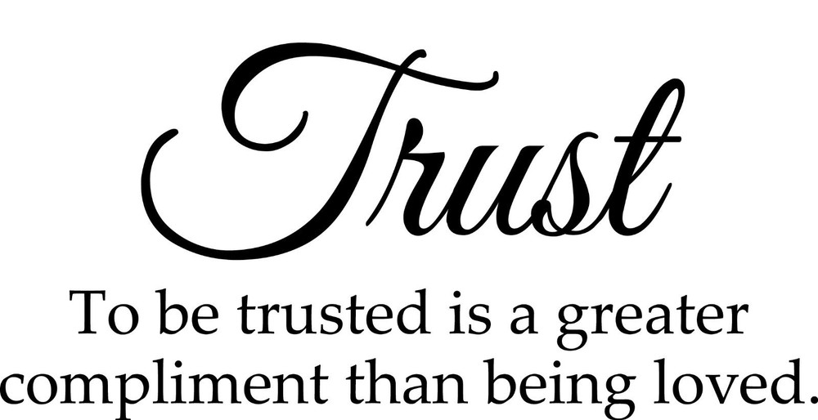
#1 - “She is trustworthy.”
“Her husband has full confidence in her and lacks nothing of value.”
Proverbs 31:11 (NIV)
Trust is vital to a good relationship.

Slide 8
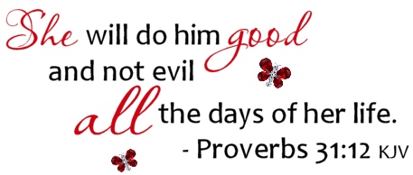
#2 - “She is a good friend.”
First, if a wife does you good, that means she builds you up.
Second, if a wife does you good all the days of her life, that means she is a close companion to you.

Slide 9
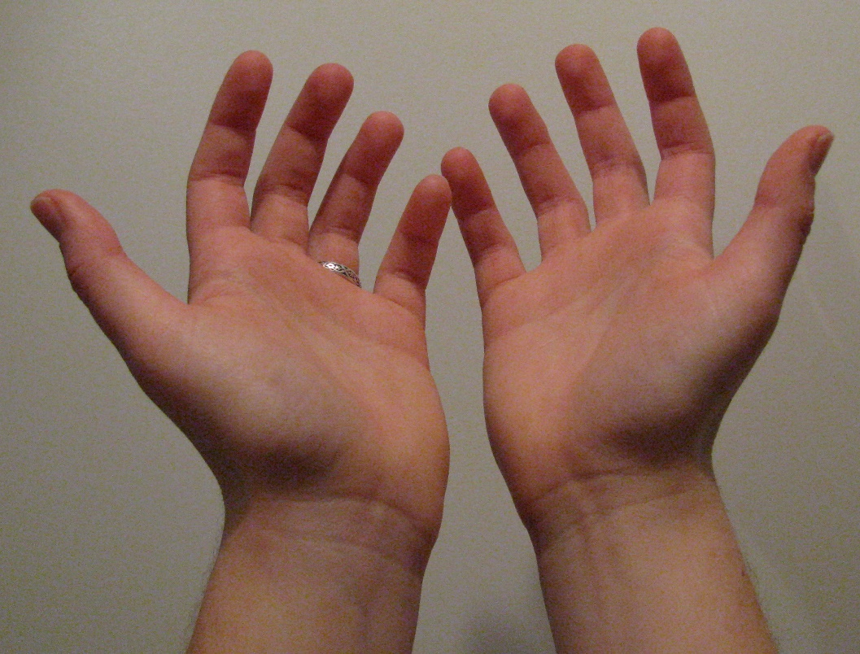
#3 - “She works with her hands.”
“She selects wool and flax and
works with eager hands.”
Proverbs 31:13 (NIV)
Praise the HARD WORKING woman who goes the extra mile.

Slide 10
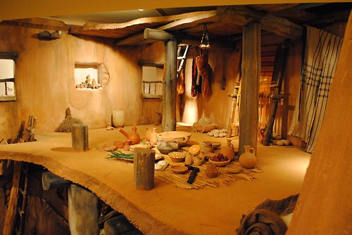
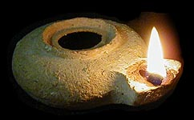
#4 - “She is diligent.”
“She gets up while it is still night;…”
Proverbs 31:15 (NIV)
verse 27 says, “She looks well to the ways of her household.”

Slide 11
#5 - “She is wise”
“She considers a field and buys it; out of her earnings she plants a vineyard”
Proverbs 31:16 (NIV)
Verse 26 says, “She speaks with wisdom, and faithful instruction is on her tongue.
Praise a woman for her WISDOM that she imparts to her family.

Slide 12
#6 - “She is Compassionate.
“She opens her arms to the poor and extends her hands to the needy.”
Proverbs 31:20 (NIV)
If the woman in your house is COMPASSIONATE, you should feel doubly blessed.

Slide 13
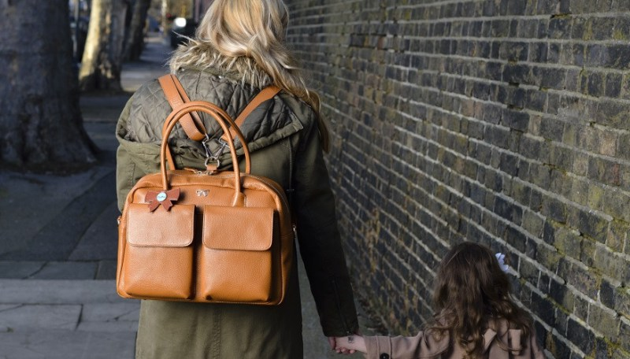
#7 - “She is always prepared”
“When it snows, she has no fear for her household; for all of them are clothed in scarlet.”
Proverbs 31:20 (NIV)
Scarlet
=
Red Colour
The Church fears not the severity of temptation or the chill of unbelief, when her children take refuge in the blood of Christ.
Praise the woman who is always PREPARED when no one else seems to be.

Slide 14
#8 - “Her integrity will make her husband look good”
“Her husband is respected at the city gate, where he takes his seat among the elders of the land.”
Proverbs 31:23
A wife of noble character is her husband’s crown, but a disgraceful wife is like decay in his bones.
Proverbs 12:4
She is indeed “a crown to her husband.”

Slide 15
#9 - “She is optimistic.”
“She is clothed with strength and dignity; she can laugh at the days to come.”
Proverbs 31:23 (NIV)
She is not disquieted by any fear of what may happen, knowing in whom she trusts, and having done her duty to the utmost of her ability.
Pulpit Commentary

Slide 16
The true servant of God is not afraid of any evil tidings, his heart being fixed, trusting in the Lord.
“They will have no fear of bad news; their hearts are steadfast, trusting in the Lord.”
Psalm 112:4 (NIV)

Slide 17
#10 - “A virtuous woman fears the Lord.
“Charm is deceptive, and beauty is fleeting; but a woman who fears the Lord is to be praised.”
Proverbs 31:30
“Many women do noble things, but you surpass them all.”
Proverbs 31:29 (NIV)

Slide 18
Proverbs 1:7 says…The fear of the Lord is the beginning of knowledge, but fools despise wisdom and instruction.
“Charm is deceptive, and beauty is fleeting; but a woman who fears the Lord is to be praised.”
Proverbs 31:30

