Slide 1
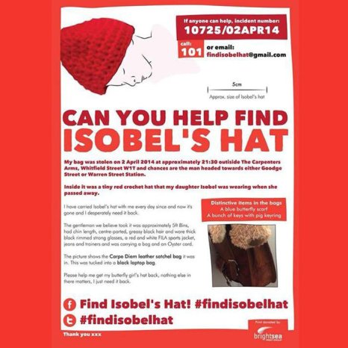
Her daughter died on 26th January
2013 after being born prematurely
at just 22 weeks.
"Nothing else matters – the laptop, phones, everything else they can have, just please please give me my angel’s hat back."
“I can’t explain
how much it means to me."

Slide 2
“He took bread, gave thanks and broke it, and gave it to them, saying, “This is my body given for you; do this in remembrance of me”
(Luke 22:19 NIV).
The Master’s Memorial
Let’s Pray…

Slide 3
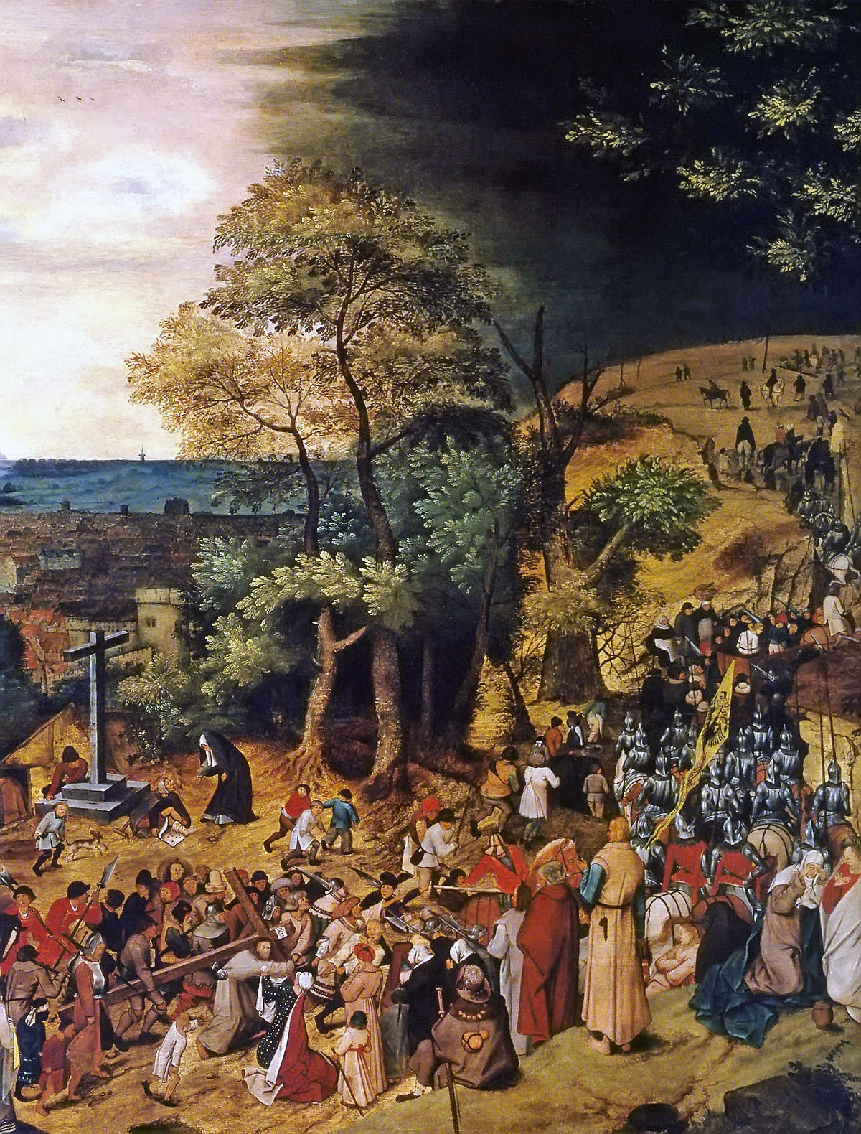
I. Remember Calvary.
a) Its atoning power.
“The blood of Jesus, [God’s] Son, purifies us from all sin” (1 John 1:7 NIV).

Slide 4
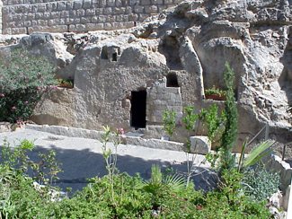
II. Remember the tomb.
“He was assigned a grave with the wicked, and with the rich in his death, though he had done no violence, nor was any deceit in his mouth”. (Isaiah 53:9)
Death loses its sting and terror in the redemptive work of Christ on the cross. He has gone before us.
Jesus “tasted death for every man.”

Slide 5
III. Remember the first Easter.
“Because you will not abandon me to the realm of the dead, nor will you let your faithful one see decay. (Psalm 16:10)
a) A great fact of history
“In their fright the women bowed down with their faces to the ground, but the men said to them, “Why do you look for the living among the dead?
He is not here; he has risen! Remember how he told you, while he was still with you in Galilee:” (Luke 24:5 – 6).

Slide 6
III. Remember the first Easter.
b) A splendid word of promise.
“Jesus said to her, “I am the resurrection and the life. The one who believes in me will live, even though they die;
and whoever lives by believing in me will never die”. (John 11:25 – 26).
^{Do you believe this?”}

Slide 7
IV. Remember his Ascension.
¹⁶ Then the eleven disciples went to Galilee, to the mountain where Jesus had told them to go. ¹⁷ When they saw him, they worshiped him; but some doubted. ¹⁸ Then Jesus came to them and said, “All authority in heaven and on earth has been given to me. ¹⁹ Therefore go and make disciples of all nations, baptizing them in the name of the Father and of the Son and of the Holy Spirit, ²⁰ and teaching them to obey everything I have commanded you. And surely I am with you always, to the very end of the age.”
Matthew 28:16-20 (NIV)

Slide 8
V. Remember his promised return.
Our Lord is coming back:
He said, “I will come again. . . .”
The parousia (second coming of Christ) was promised

Slide 9
V. Remember his promised return.
This promise is renewed with every observance of this memorial.
“For whenever you eat this bread and drink this cup, you proclaim the Lord’s death until he comes.”
(1 Corinthians 11:26)
“the blessed hope.”

Slide 10
Speaking with The Metro, heartbroken Katie added: "It’s everything to me, it’s a link to my daughter and it reminds me of her."

Slide 11
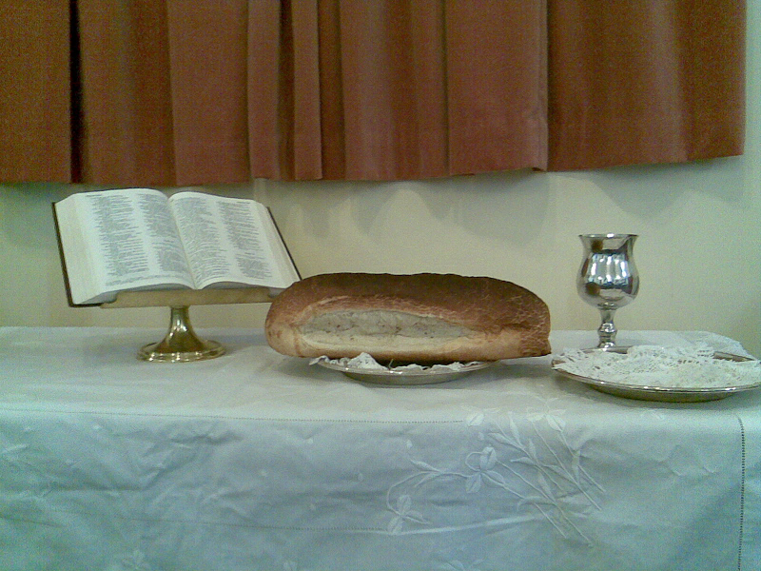
Let us come to our Lord’s Table remembering all that he has done for us.

