Slide 1

Essentials to grow in the spiritual life #1:
A life of praise
Psalm 22

Slide 2

Psalm 22
This Psalm is a prayer of complaint
Whatever the circumstances, the true worshipper praises God for WHO HE IS.
We grow as Christians when we deliberately focus not, primarily, on our failures, needs, troubles, hopes, desires, or aspirations but on God’s unchanging nature, character and attributes.

Slide 3
I. There will be times when we will feel alone.
¹ My God, my God, why have you forsaken me?
Why are you so far from saving me,
so far from my cries of anguish?
² My God, I cry out by day, but you do not answer,
by night, but I find no rest.
God said several times that David was
“A man after his own heart”

Slide 4
The book of Job
‘When Job faced the reality of his situation and how he really felt, then he was ready for God to speak. But we can notice that God did not give any answers to Job’s questions. He gave himself. Job had an encounter with God. He could live without answers when Job knew that God was there’.
Selwyn Hughes

Slide 5
II. We need to remember his faithfulness in his Word.
³ Yet you are enthroned as the Holy One;
you are the one Israel praises.
⁴ In you our ancestors put their trust;
they trusted and you delivered them.
⁵ To you they cried out and were saved;
in you they trusted and were not put to shame.

Slide 6
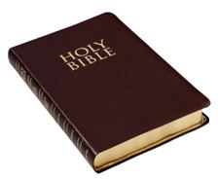
We need to remember his faithfulness in his Word.
We have this beautiful record of God’s faithfulness (The Bible)

Slide 7
III. We need to remember God’s faithfulness in our
own story (verses 6-11).
Yet you brought me out of the womb;
you made me trust in you, even at my mother’s breast.
¹⁰ From birth I was cast on you;
from my mother’s womb you have been my God.
¹¹ Do not be far from me,
King David recognizes that God has always been with him, from the very beginning he was trained to trust in the Lord.

Slide 8
IV. We can remember the truth we know about God
and declare our trust in him. (Verses 12-21.)
Lord what can I do?
Many bulls surround me; Roaring lions that tear their prey open their mouths wide against me… My heart has turned to wax; it has melted within me.
Lord what can I do?
Dogs surround me,
a pack of villains encircles me;… Lord what can I do?

Slide 9
David declares that God is his strength.
¹⁹ But you, Lord, do not be far from me.
You are my strength; come quickly to help me.
²⁰ Deliver me from the sword,
my precious life from the power of the dogs.
²¹ Rescue me from the mouth of the lions;
save me from the horns of the wild oxen.
²² I will declare your name to my people;
in the assembly I will praise you.

Slide 10
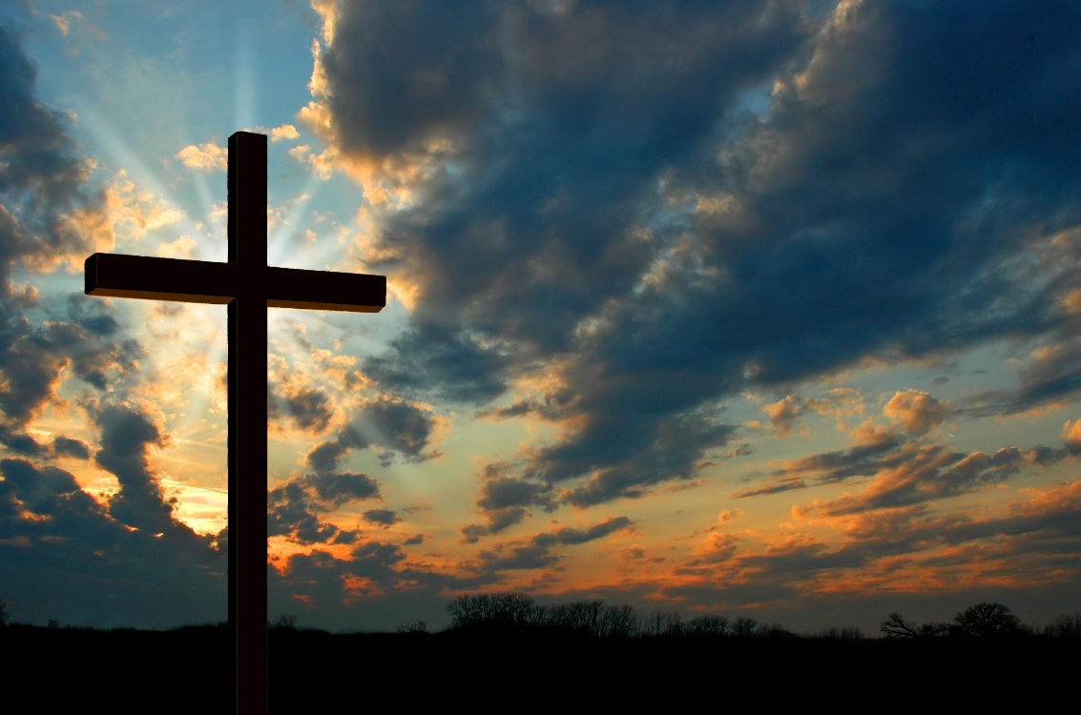
Lord what can I do?
I will Praise you.
My God, my God, why have you forsaken me?

Slide 11
¹⁰ that at the name of Jesus every knee should bow,
in heaven and on earth and under the earth,
¹¹ and every tongue acknowledge that Jesus Christ is Lord, to the glory of God the Father.
Philippians 2:10-11 (NIV)
We may never get to know why God allows us to experience hardship and loss but we do know that God has a plan.

Slide 12
Lord what can I do?
I will Praise you.
The person who grows spiritually, the person who goes on to know God in a deep and intimate way, is the one who can affirm that God is good even though there may be many or hundreds appearances to the contrary.

Slide 13
The Shorter Westminster Catechism ask the question, ‘What is the chief end of man?
And answers it in this way:
“The chief end of man is to glorify (Praise) God and enjoy Him for ever”.
A. W. Tozer suggested that ‘worship was the missing jewel of the Evangelical Church’.

Slide 14
Blessed Be Your Name
In the land that is plentiful
Where Your streams of abundance flow
Blessed be Your name
Blessed be Your name
When the sun's shining down on me
When the world's 'all as it should be'
Blessed be Your name

Slide 15
Blessed be Your name
On the road marked with suffering
Though there's pain in the offering
Blessed be Your name
God you give and take away
Oh you give and take away
My heart will choose to say
Lord, blessed be Your name

Slide 16
I. There will be times when we will feel alone.
II. We need to remember his faithfulness in his Word.
III. We need to remember God’s faithfulness in our
own story.
IV. We need to remember the truth we know about God
and declare our trust in him.

Slide 17
Essentials to grow in the spiritual life #1:
A life of praise
Lord what can I do?
I will Praise you.

