Slide 1
Mark 8:31-36 (NIV)
³¹ He then began to teach them that the Son of Man must suffer many things and be rejected by the elders, the chief priests and the teachers of the law, and that he must be killed and after three days rise again.³² He spoke plainly about this, and Peter took him aside and began to rebuke him.
³³ But when Jesus turned and looked at his disciples, he rebuked Peter. “Get behind me, Satan!” he said. “You do not have in mind the concerns of God, but merely human concerns.”

Slide 2
Mark 8:31-36 (NIV)
³⁴ Then he called the crowd to him along with his disciples and said: “Whoever wants to be my disciple must deny themselves and take up their cross and follow me. ³⁵ For whoever wants to save their life will lose it, but whoever loses their life for me and for the gospel will save it.³⁶ What good is it for someone to gain the whole world, yet forfeit their soul?

Slide 3
Let’s Pray…

Slide 4
What is your most precious possession?
Your house…
Your family…

Slide 5

1962 Ferrari 250 GTO hits record £22,843,63 sale at Bonhams' Monterey auction.

Slide 6
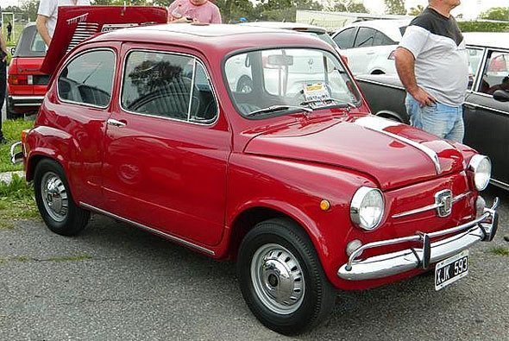
What is your most precious possession?
According to the words of Jesus, your most precious possession is your soul.

Slide 7
Jesus said, “What shall it profit a man (or a woman) if he or she gains the whole world and loses his or her soul? And what shall a man or woman give in exchange for his or her soul?”
(Matthew 16:26)
This message is all about discipleship.
There is a calling to be “Faithful disciples”.

Slide 8

I. We need to believe and confess that Jesus is Lord.
²⁷ Jesus and his disciples went on to the villages around Caesarea Philippi. On the way he asked them, “Who do people say I am?” ²⁸ They replied, “Some say John the Baptist; others say Elijah; and still others, one of the prophets.” ²⁹ “But what about you?” he asked. “Who do you say I am?”
Mark 8:27-29 (NIV)

Slide 9
“Who do YOU say I am.”
⁹ If you declare with your mouth, “Jesus is Lord,” and believe in your heart that God raised him from the dead, you will be saved. ¹⁰ For it is with your heart that you believe and are justified, and it is with your mouth that you profess your faith and are saved.
Romans 10:9-10 (NIV)

Slide 10
“Who do YOU say I am.”
Peter’s answer; “You are the Messiah” the Son of God the Saviour of the world…
Is the first principle
of the Christian faith.

Slide 11
Every year a Roman citizen was required to pay an annual tax and confess,
“Caesar is Lord.”
These radical disciples refused and instead they confessed,
“Jesus is Lord.”

Slide 12
II. We need to remove our ego from the throne of our lives.
³³ But when Jesus turned and looked at his disciples, he rebuked Peter. “Get behind me, Satan!” he said. “You do not have in mind the concerns of God, but merely human concerns.”

Slide 13
³⁴ Then he called the crowd to him along with his disciples and said: “Whoever wants to be my disciple must deny themselves…
He said, “If anyone would come after me he must DENY HIMSELF.”
A disciple of Jesus says;
“It’s not about me. It’s all about Jesus.”

Slide 14
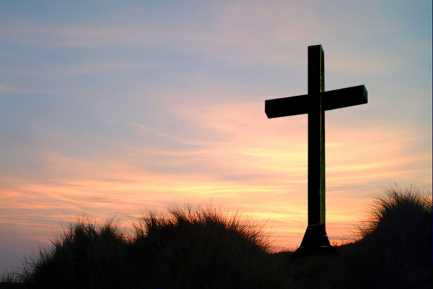
III. We need to apply the invariable law of Christian life.
‘Whoever desires to come after Me, let him deny himself, and take up his cross, and follow Me.’
“The invariable law of Christian life”

Slide 15
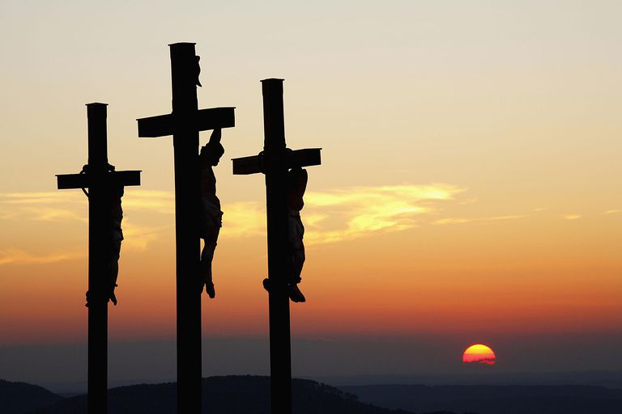
To “deny himself/herself doesn’t mean to deny something to himself/herself, but to renounce to self.
“The invariable law of Christian life”

Slide 16
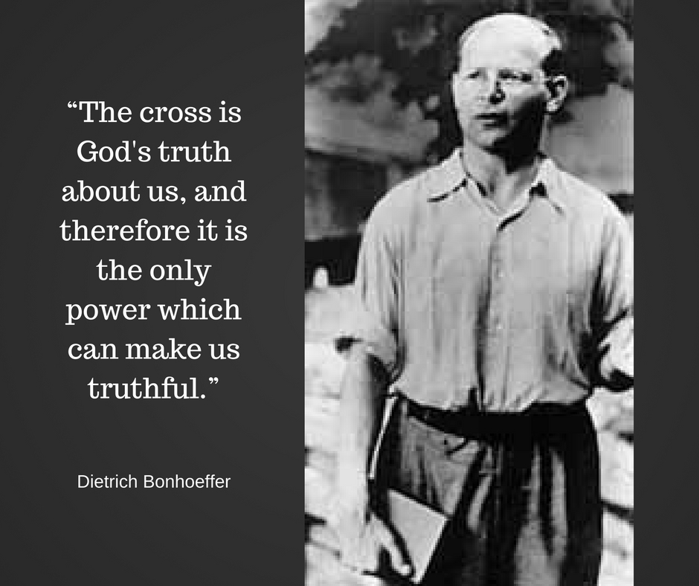
“The invariable law of Christian life”

Slide 17
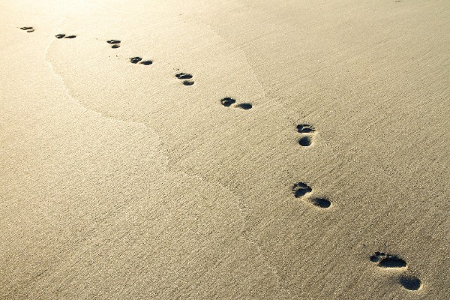
“If anyone would come after me, he must deny himself and take up his cross and FOLLOW ME.” (Mark 8:34)
Faith is not merely you holding on to God—it is God holding on to you. He will not let you go!
E. Stanley Jones

Slide 18
IV. A warning:
We need to set our priorities right.
Jesus is saying that we need to take an extra care of our souls.
We need to examine ourselves
We need to set our priorities right.

Slide 19
Charles Spurgeon said;
‘Consider how precious a soul must be, when both God and the devil are after it. You never heard that God was seeking after a crown, did you! No, he thinks little of dominions; but He is after souls every day: His Holy Spirit is seeking His children; and Christ came to save souls…the soul is precious…we know, by the price Christ paid for it. “Not with silver and gold,” but with His own flesh and blood did He redeem it.”

Slide 20
What is your most precious possession?
Where do you put your values in life?
Jesus said, “What good is it for a man to gain the whole world, yet forfeit his soul?” (Mark 8:36).
Your soul

Slide 21
The real question, the question every person in the end will have to face, is not, “What did people think of this?”
“What does God think of it”
“The test of eternity, the test of seeking to see the things as God sees it, is the realest test of all.”
William Barclay

Slide 22
The person who sees things as God sees them will never spend his life on the things that lose his/her soul.
Are you a faithful disciple of Jesus?
Do you believe and have you confessed that Jesus is Lord?
Have you removed your EGO from the throne of your life?

Slide 23
What is your most precious possession?
Remember Jesus’ warning:
We need to set our priorities right.
Your soul
There is a calling to be “Faithful disciples”.

