Slide 1
1 Peter 2:1-10 (NIV)
Therefore, rid yourselves of all malice and all deceit, hypocrisy, envy, and slander of every kind. ² Like new-born babies, crave pure spiritual milk, so that by it you may grow up in your salvation, ³ now that you have tasted that the Lord is good.
⁴ As you come to him, the living Stone—rejected by humans but chosen by God and precious to him— ⁵ you also, like living stones, are being built into a spiritual house to be a holy priesthood, offering spiritual sacrifices acceptable to God through Jesus Christ.

Slide 2
⁶ For in Scripture it says:
“See, I lay a stone in Zion, a chosen and precious cornerstone, and the one who trusts in him will never be put to shame.”
⁷ Now to you who believe, this stone is precious. But to those who do not believe,
“The stone the builders rejected has become the cornerstone,”

Slide 3
⁸ and,
“A stone that causes people to stumble and a rock that makes them fall.”
They stumble because they disobey the message—which is also what they were destined for.
⁹ But you are a chosen people, a royal priesthood, a holy nation, God’s special possession, that you may declare the praises of him who called you out of darkness into his wonderful light.¹⁰ Once you were not a people, but now you are the people of God; once you had not received mercy, but now you have received mercy.

Slide 4
^{Let’s Pray…}

Slide 5
The challenge to grow

Slide 6
First Christians are regarded as children
Verse 2 says; “Like new-born babies, crave pure spiritual milk so that by it you may grow up …”
Therefore, rid yourselves of all malice and all deceit, hypocrisy, envy, and slander of every kind. ² Like new-born babies, crave pure spiritual milk, so that by it you may grow up.

Slide 7
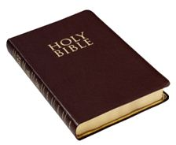
“spiritual milk” often translated “milk of the word”
so that by it
you may grow up in your salvation

Slide 8
God has placed within us a heart that pants after Him.
As the deer pants for streams of water, so my soul pants for you, my God.
Psalm 42:1 (NIV)
Let God and let go.
‘I am the master of my fate. The captain of my soul’.
W. E. Henley
A longing for “milk of the word” is the sure proof that we have been “born anew”

Slide 9
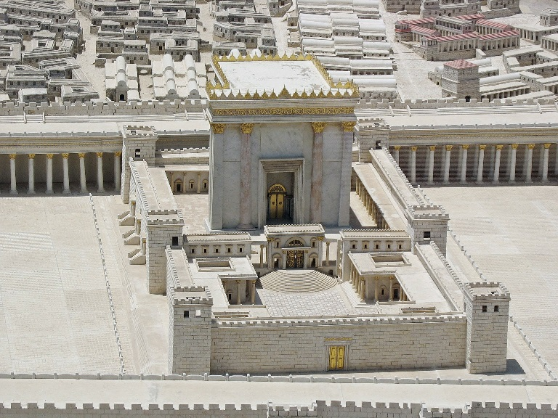
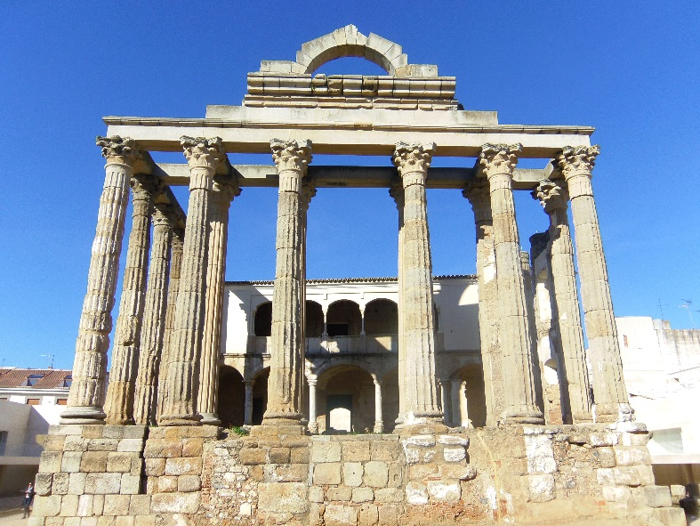
II. Peter next refers to believers as forming a temple
Verse 5 says; “you also, like living stones, are being built into a spiritual house (TEMPLE)…”
our God “does not dwell in temples made with hands.” Acts 7:48 (NIV)
Rather his temple is found in the hearts of his people.

Slide 10
“Christ is the cornerstone”
Paul wrote in I Corinthians 3:10-11;
“According to the grace of God which was given to me, as a wise master builder I have laid the foundation, and another builds on it. But let each one take heed how he builds on it. For no other foundation can anyone lay than that which is laid, which is Jesus Christ.”
For in Scripture it says: “See, I lay a stone in Zion, a chosen and
precious cornerstone, and the one who trusts in him will never
be put to shame.” ⁷ Now to you who believe, this stone is precious.
But to those who do not believe,
“The stone the builders rejected has become the cornerstone,”
1 Peter 2:6-7 (NIV)

Slide 11
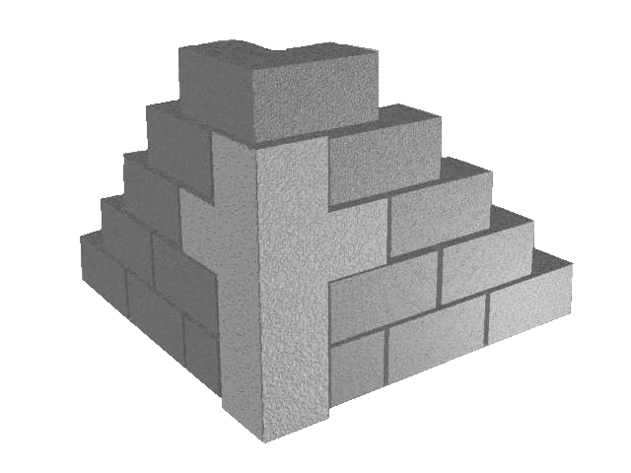
“Christ is the cornerstone”
Jesus said, “No man comes to the Father except through me.”
John 14:6 (NIV)
So it is that everything is built on Jesus Christ. He is the great cornerstone of our faith.

Slide 12
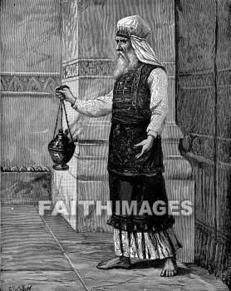
III. Chosen for a purpose: we are a royal priesthood
1 Peter 2 verse 9 says; “But you are a chosen generation, a royal priesthood…”
²⁷ Unlike the other high priests, he does not need to offer sacrifices
day after day, first for his own sins, and then for the sins of the people.
He sacrificed for their sins once for all when he offered himself.
²⁸ For the law appoints as high priests men in all their weakness;
but the oath, which came after the law, appointed the Son,
who has been made perfect forever. Hebrews 7:27-28 (NIV)

Slide 13
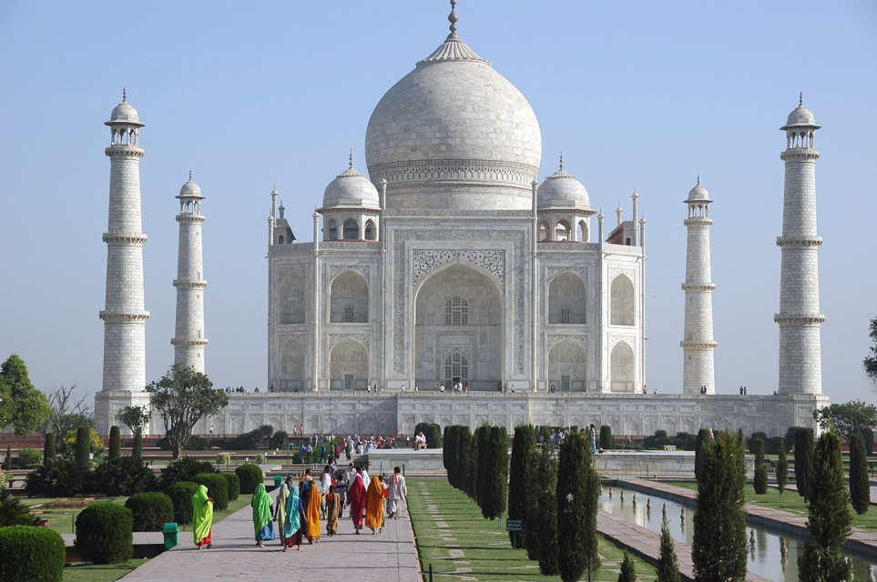
Pastor Phillip Rice wrote this—“Believers are called out from the impurities of human cultures and sent back into the world as agents of change and transformation.”
It’s important that we don’t forget the purpose for which we’ve been built.
The Taj Mahal
If we’re not careful, we can forget the purpose for which we were constructed.

Slide 14
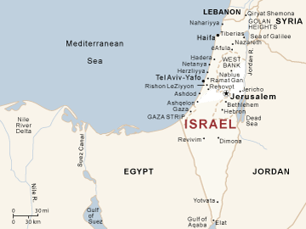
IV. Christians are the true “Israel of God”
“But you are an elect race”, ‘chosen’ as was the Hebrew people, and a “race”, because possessing a common life resulting from the new birth.
¹¹ In him we were also chosen, having been predestined according to the plan of him who works out everything in conformity with the purpose of his will,
Ephesians 1:11 (NIV)

Slide 15
“Christians are expected to show forth by life and word, “the excellences,” “the virtues,” “the goodness,” the wisdom of Him who called them by his Spirit and providence, ‘out of darkness’ into His marvelous light, as revealed in His son Jesus Christ.
Charles R. Erdman
The challenge to grow

Slide 16
The challenge to grow
Father, I place into Your hands, The things I cannot do. Father, I place into Your hands The things that I've been through. Father, I place into Your hands The way that I should go, For I know I always can trust You.
To let God and to let go.

Slide 17
The challenge to grow
Christians are children that need spiritual milk
II. We are a temple: Jesus is the Cornerstone
III. Chosen for a purpose: we are a royal priesthood
IV. Christians are the true “Israel of God”
To let God and to let go.

