Slide 1
διηκόνει

Slide 2
Instead, whoever wants to become great among you must be your servant, ⁴⁴ and whoever wants to be first must be slave of all. ⁴⁵ For even the Son of Man did not come to be served, but to serve, and to give his life as a ransom for many.’

Slide 3
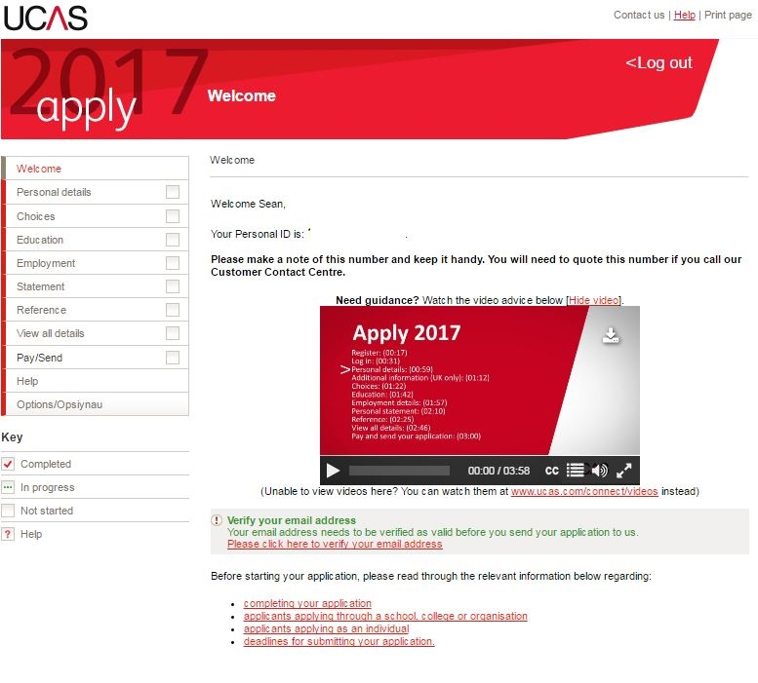

Slide 4
In the same way, the Spirit helps us in our weakness. We do not know what we ought to pray for, but the Spirit himself intercedes for us through wordless groans. ²⁷ And he who searches our hearts knows the mind of the Spirit, because the Spirit intercedes for God’s people in accordance with the will of God.

Slide 6
What am I going to do differently this week?

