Slide 1
“As I urged you when I went into Macedonia, stay there in Ephesus so that you may command certain men not to teach false doctrines any longer nor to devote themselves to myths and endless genealogies. These promote controversies rather than God's work-which is by faith. The goal of this command is love, which comes from a pure heart and a good conscience and a sincere faith. Some have wandered away from these and turned to meaningless talk. They want to be teachers of the law, but they do not know what they are talking about or what they so confidently affirm.”
1 Timothy 1:3-7 (NIV)

Slide 2
“He came to Derbe and then to Lystra, where a disciple named Timothy lived, whose mother was a Jewess and a believer, but whose father was a Greek. The brothers at Lystra and Iconium spoke well of him. Paul wanted to take him along on the journey, so he circumcised him because of the Jews who lived in that area, for they all knew that his father was a Greek.”
Acts 16:1-3 (NIV)

Slide 3
“… we sent Timothy, our brother and God's co-worker in the gospel of Christ, to establish and exhort you in your faith”
1 Thessalonians 3:2 (NIV)
“That is why I sent you Timothy, my beloved and faithful child in the Lord, to remind you of my ways in Christ, as I teach them everywhere in every church.”
1 Corinthians 4:17 (NIV)

Slide 4
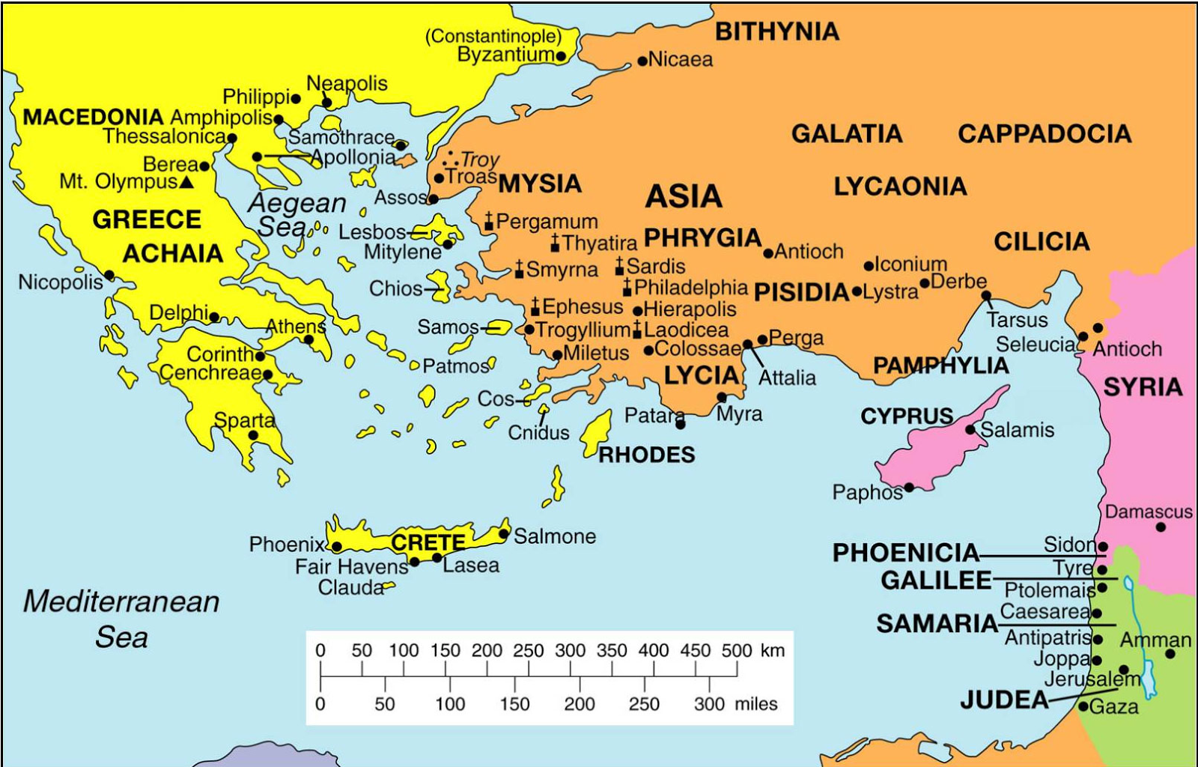

Slide 5
“As I urged you when I went into Macedonia, stay there in Ephesus so that you may command certain people not to teach false doctrines any longer or to devote themselves to myths and endless genealogies.”
1 Timothy 1:3-4a (NIV)

Slide 6
“Don’t let anyone look down on you because you are young.”
1 Timothy 4:12a (NIV)
“God did not give us a spirit of timidity…”
2 Timothy 1:7a (NIV)
“Stop drinking only water and use a little wine because of your stomach and your frequent illnesses”
1 Timothy 5:23 (NIV)

Slide 7
“... the gospel is not good advice, but good news. It is not a code of laws, nor is it merely a system of ethics, but the proclamation of the redeeming work of God, our Saviour. It is a message of the infinite grace offered in Christ who is “our hope.”
Charles R. Erdman, “The Pastoral Epistles of Paul”, Westminster Press, Philadelphia (no date given)

Slide 8
“I am the way and the truth and the life. No one comes to the Father except through me.”
John 14:6 (NIV)

Slide 9
1. Sometimes you have to stick at a tough job

Slide 10
“He is no fool who gives up what he cannot keep to gain that which he cannot lose.”
Jim Elliott

Slide 11
“God grant me the serenity to accept the things I cannot change;
courage to change the things I can;
and wisdom to know the difference.”
Reinhold Niebuhr’s Serenity Prayer

Slide 12
2. Learn to detect the false by knowing the true

Slide 13
“There is no God”
Psalm 14:1 (NIV)

Slide 14
“The fool says in his heart ‘There is no God’”
Psalm 14:1 (NIV)

Slide 15
“The fool says in his heart ‘There is no God’. They are corrupt, their deeds are vile; there is no-one who does good.”
Psalm 14:1 (NIV)

Slide 16
Here are two practical tests for us to apply to all teaching. The first is the test of faith: does it come from God, being in agreement with apostolic doctrine (so that it may be received by faith), or is it the product of fertile human imagination? The second is the test of love: does it promote unity in the body of Christ, or if not (since truth itself can divide), is it irresponsibly divisive? ‘Faith’ means that we receive it from God; ‘love’ means that it builds up the church. “He judges doctrine by fruit” [John Calvin]. The ultimate criteria by which to judge any teaching are whether it promotes the glory of God and the good of the church.”
John Stott
“1 Timothy and Titus (BST)”
IVP, 1996, p 46

Slide 17
“The goal of this command is love, which comes from a pure heart and a good conscience and a sincere faith.”
1 Timothy 1:5 (NIV)
“The whole point of what we’re urging is simply love—love uncontaminated by self-interest and counterfeit faith, a life open to God.” 1 Timothy 1:5 (MSG)

Slide 18
3. It’s all about love

Slide 19
“...I give you this instruction…
so that … you may fight the good fight, holding on to faith and a good conscience. Some have rejected these and so have shipwrecked their faith.”
1 Timothy 1:18,19 (NIV)

Slide 20
Hypocrite (n.):
“a person who puts on a false appearance of virtue or religion”
or
“a person who acts in contradiction to his or her stated beliefs or feelings”
www.merriam-webster.com/dictionary/hypocrite

Slide 21
“Cleanse me with hyssop and I shall be clean; wash me and I shall be whiter than snow… Create in me a pure heart, O God, and renew a steadfast spirit in me… Save me from bloodguilt, O God, the God who saves me...”
Psalm 51:7,10,14a (NIV)

Slide 22
“If we confess our sins, he is faithful and just and will forgive us our sins and purify us from all unrighteousness.”
1 John 1:9 (NIV)

Slide 23
“If we say we have no sin, we deceive ourselves and the truth is not in us. If we confess our sins, he is faithful and just and will forgive us our sins and purify us from all unrighteousness.”
1 John 1:8-9 (NIV)

Slide 24
1. Sometimes you have to stick at a tough job
2. Learn to detect the false by knowing the true
3. It’s all about love

