Slide 1
Brown/Browne
Smith/Smythe
Borlase/Borlace

Slide 2
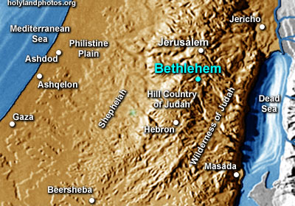

Slide 3
Jesus
Joshua
The LORD saves

Slide 5
Presentation
Purification

Slide 6
After the LORD brings you into the land of the Canaanites and gives it to you, as he promised on oath to you and your ancestors, you are to give over to the LORD the first offspring of every womb. All the firstborn males of your livestock belong to the LORD. Redeem with a lamb every firstborn donkey, but if you do not redeem it, break its neck. Redeem every firstborn among your sons. In days to come, when your son asks you, ‘What does this mean?’ say to him, ‘With a mighty hand the LORD brought us out of Egypt, out of the land of slavery. When Pharaoh stubbornly refused to let us go, the LORD killed the firstborn of both people and animals in Egypt. This is why I sacrifice to the LORD the first male offspring of every womb and redeem each of my firstborn sons.’ (Ex.13:11-15)

Slide 7
For you know that it was not with perishable things such as silver or gold that you were redeemed from the empty way of life handed down to you from your ancestors, but with the precious blood of Christ, a lamb without blemish or defect (1 Pet.1:18,19)

Slide 8
When the days of her purification for a son or daughter are over, she is to bring to the priest at the entrance to the tent of meeting a year-old lamb for a burnt offering and a young pigeon or a dove for a sin offering. He shall offer them before the LORD to make atonement for her, and then she will be ceremonially clean from her flow of blood. These are the regulations for the woman who gives birth to a boy or a girl. But if she cannot afford a lamb, she is to bring two doves or two young pigeons, one for a burnt offering and the other for a sin offering. In this way the priest will make atonement for her, and she will be clean (Lev.12:6-8)

Slide 9
Simeon
Anna

Slide 10
Now there was a man in Jerusalem called Simeon, who was righteous and devout. He was waiting for the consolation of Israel, and the Holy Spirit was on him. It had been revealed to him by the Holy Spirit that he would not die before he had seen the Lord’s Messiah (vv.25,26)

Slide 11
Moved by the Spirit, he went into the temple courts. When the parents brought in the child Jesus to do for him what the custom of the Law required, Simeon took him in his arms and praised God, saying: “Sovereign Lord, as you have promised, you may now dismiss your servant in peace. For my eyes have seen your salvation, which you have prepared in the sight of all nations: a light for revelation to the Gentiles, and the glory of your people Israel.” (vv.27-32)

Slide 12
The child’s father and mother marvelled at what was said about him. Then Simeon blessed them and said to Mary, his mother: “This child is destined to cause the falling and rising of many in Israel, and to be a sign that will be spoken against, so that the thoughts of many hearts will be revealed. And a sword will pierce your own soul too.” (vv.33-35)

Slide 13
To all who received him, to those who believed in his name, he gave the right to become children of God. (John 1:12)

