Slide 2
God’s love
Health
Relationships
Finances.
"The challenge of sharing God's love".

Slide 3
I. Love is based on power and authority, not on feelings
It was just before the Passover Festival. Jesus knew that the hour had come for him to leave this world and go to the Father. Having loved his own who were in the world, he loved them to the end. ² The evening meal was in progress, and the devil had already prompted Judas, the son of Simon Iscariot, to betray Jesus. ³ Jesus knew that the Father had put all things under his power, and that he had come from God and was returning to God;
John 13:1-3 (NIV)
To Love like Jesus loved we need to take notice of who we are, not what we feel.

Slide 4
II. Love is not reserved for people just like us!
Love is for everyone
The evening meal was in progress, and the devil had already prompted Judas, the son of Simon Iscariot, to betray Jesus
John 13:2 (NIV)
“You have heard that it was said, ‘Love your neighbour and hate your enemy.’ ⁴⁴ But I tell you, love your enemies and pray for those who persecute you,
Matthew 5:43-44 (NIV)
True love is loving the unlovable

Slide 5
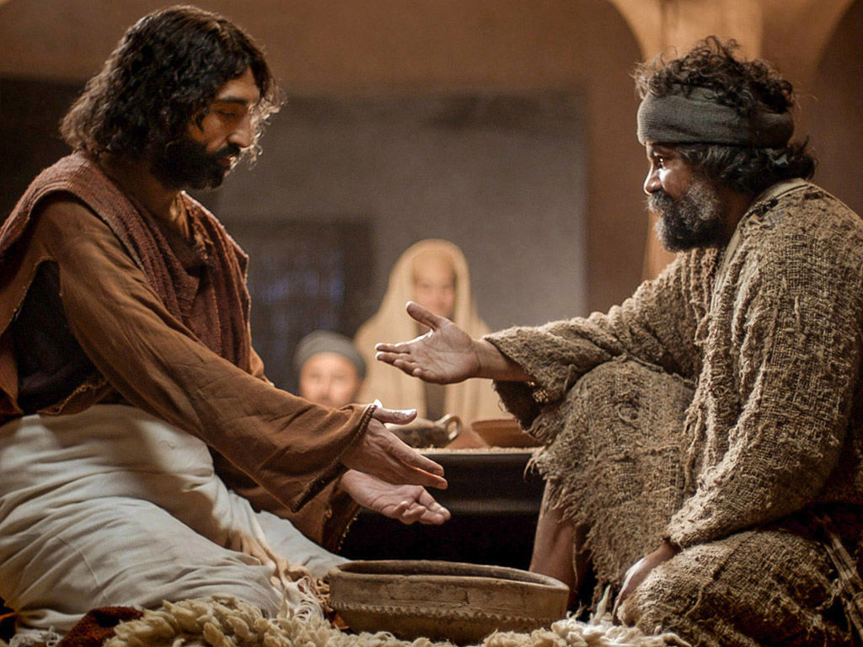
III. Being loved leads us to love and serve
⁶ He came to Simon Peter, who said to him,
“Lord, are you going to wash my feet?”
⁷ Jesus replied, “You do not realize
now what I am doing, but
later you will understand.”
⁸ “No,” said Peter, “
you shall never wash my feet.”
John 13:6-8 (NIV)
Humility?
NO!
Pride

Slide 6
IV. Love always demands action - obedience
“Christianity is a system of thought to be learned – the knowing of which will heal people of their moral and spiritual ailments”.
“You call me ‘Teacher’ and ‘Lord,’ and rightly so, for that is what I am. John 13:13 (NIV)
Now that I, your Lord and Teacher, have washed your feet, you also should wash one another’s feet. John 13:14 (NIV)
Which comes first?
Lordship

Slide 7
IV. Love always demands action - obedience
Mark 10:17-22 (NIV)
¹⁷ As Jesus started on his way, a man ran up to him and fell on his knees before him. “Good teacher,” he asked, “what must I do to inherit eternal life?”
¹⁸ “Why do you call me good?” Jesus answered. “No one is good—except God alone. ¹⁹ You know the commandments: ‘You shall not murder, you shall not commit adultery, you shall not steal, you shall not give false testimony, you shall not defraud, honour your father and mother.’”
²⁰ “Teacher,” he declared, “all these I have kept since I was a boy.”
²¹ Jesus looked at him and loved him. “One thing you lack,” he said. “Go, sell everything you have and give to the poor, and you will have treasure in heaven. Then come, follow me.”
²² At this the man’s face fell. He went away sad, because he had great wealth.

Slide 8
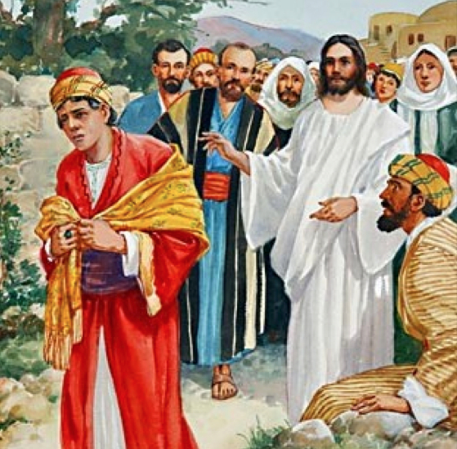
First to surrender
Then to gain knowledge
to serve.

Slide 9
Health
Relationships
Finances.
God’s love

Slide 10
God’s love
I. Love is based on power and authority, not on feelings
II. Love is not reserved for people just like us!
Love is for everyone
III. Being loved leads us to love and serve
IV. Love always demands action - obedience
Now that I, your Lord and Teacher, have washed your feet, you also should wash one another’s feet. John 13:14 (NIV)

