Slide 1


But as for me, it is good to be near God.
I have made the Sovereign Lord my refuge;
I will tell of all your deeds.
Psalm 73:28 (NIV)

Slide 2

"Being real with God".
Let’s pray…

Slide 3
Surely God is good to Israel, to those who are pure in heart.
Psalm 73:1 (NIV)
But as for me, my feet had almost slipped;
I had nearly lost my foothold.
Psalm 73:2 (NIV)
But, …God, I am struggling, I almost stopped following you.

Slide 4
What causes us to stumble in our journey of Life?
For I envied the arrogant when I saw the prosperity of the wicked.
Psalm 73:3 (NIV)
Viewing life through the eyes of sin
We start Viewing Life from the perspective of Satan

Slide 5
They have no struggles; their bodies are healthy and strong. ⁵ They are free from common human burdens; they are not plagued by human ills.
Psalm 73:4-5 (NIV)
When sin creeps into our lives, we now open ourselves to the deceptions of Satan to believe the lies that he tells us.

Slide 6
⁶ Therefore pride is their necklace; they clothe themselves with violence. ⁷ From their callous hearts comes iniquity; their evil imaginations have no limits. ⁸ They scoff, and speak with malice;
with arrogance they threaten oppression.
Psalm 73:6-8 (NIV)

Slide 7
Their mouths lay claim to heaven,
and their tongues take possession of the earth.
¹⁰ Therefore their people turn to them
and drink up waters in abundance.
¹¹ They say, “How would God know?
Does the Most High know anything?”
¹² This is what the wicked are like—
always free of care, they go on amassing wealth.
Psalm 73:9-12 (NIV)

Slide 8
¹³ Surely in vain I have kept my heart pure
and have washed my hands in innocence.
¹⁴ All day long I have been afflicted,
and every morning brings new punishments.
¹⁵ If I had spoken out like that,
I would have betrayed your children.
¹⁶ When I tried to understand all this,
it troubled me deeply
Psalm 73:13-16 (NIV)

Slide 9
What causes us to stand firm in our journey of Life?
¹⁶ When I tried to understand all this,
it troubled me deeply
¹⁷ till I entered the sanctuary of God;…
Psalm 73:16-17 (NIV)
I. When we are viewing life from the perspective of God.
We understand the eternity of the wicked

Slide 10
¹⁷ till I entered the sanctuary of God;
then I understood their final destiny.
¹⁸ Surely you place them on slippery ground;
you cast them down to ruin.
¹⁹ How suddenly are they destroyed,
completely swept away by terrors!
²⁰ They are like a dream when one awakes;
when you arise, Lord,
you will despise them as fantasies.
Psalm 73:17-20 (NIV)

Slide 11
What causes us to stand firm in our journey of Life?
II. Understanding the sinfulness of ourselves
When my heart was grieved and my spirit embittered, ²² I was senseless and ignorant; I was a brute beast before you.
Psalm 73:21-22 (NIV)
Asaph saw his envy and repented.

Slide 12
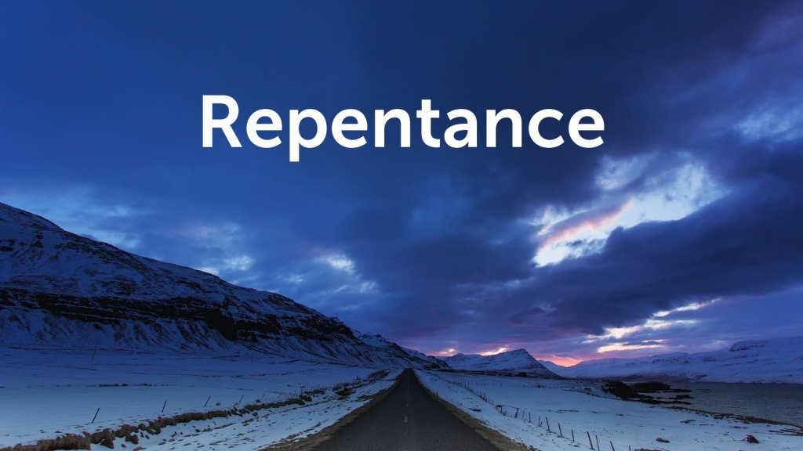
We need to get closer to God
1 John 1:9 (NIV)
If we confess our sins, he is faithful and just and will forgive us our sins and purify us from all unrighteousness.

Slide 13
²³ Yet I am always with you;
you hold me by my right hand.
²⁴ You guide me with your counsel,
and afterward you will take me into glory.
²⁵ Whom have I in heaven but you?
And earth has nothing I desire besides you.
²⁶ My flesh and my heart may fail,
but God is the strength of my heart
and my portion forever.
²⁷ Those who are far from you will perish;
you destroy all who are unfaithful to you.

Slide 14
How do we go about keeping close to God?
III. We need to consider, what will keep us going.
Firstly, we do it by PRAYER…
But as for me, it is good to be near God…
Psalm 73:28 (NIV)
Prayer is not trying to get God do our will;
it is getting our will into line with His will.

Slide 15
How do we go about keeping close to God?
III. We need to consider, what will keep us going.
Secondly, we do it by constantly reading, engaging with
And applying the BIBLE…
…I have made the Sovereign Lord my refuge;…
Psalm 73:28 (NIV)

Slide 16
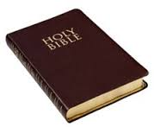
I would recommend you either believe God up to the hilt, or else not to believe at all. Believe this book of God, every letter of it, or else reject it. There is no logical standing place between the two. Be satisfied with nothing less than a faith that swims in the deeps of divine revelation; a faith that paddles about the edge of the water is poor faith at best. It is little better than a dry-land faith, and is not good for much.
C.H. Spurgeon.

Slide 17
How do we go about keeping close to God?
III. We need to consider, what will keep us going.
Thirdly, we do it by SHARING with others…
…I will tell of all your deeds.
Psalm 73:28 (NIV)
When we share, things go deeper inside us.

Slide 18

But as for me, it is good to be near God.
I have made the Sovereign Lord my refuge;
I will tell of all your deeds.
Psalm 73:28 (NIV)

Slide 20
Making and Renewing Covenant
Response to the Word
We are called to be a worshipping community,
offering all to God in prayer.
We are called to be a missionary community,
making known the redeeming love of God.
We are called to be a sacrificial community,
generously giving from all that God has given us.

Slide 21
Making and Renewing Covenant
We are called to be an inclusive community,
sharing the hospitality of God’s Kingdom with all.
We are called to be a prophetic community,
challenging powers that oppress and corrupt
As a Gospel people,
let us covenant together
before God and each other:

Slide 22
Making and Renewing Covenant
WE COVENANT
Creating and redeeming God,
we give you thanks and praise.
Your covenant of grace
was made for our salvation
in Jesus Christ our Lord.

Slide 23
WE COVENANT
We come this day
to covenant with you
and with our companions in discipleship:
to watch over each other
and to walk together before you
in ways known and still to be made known.

Slide 24
Pour down your Spirit on us.
Help us so to walk in your ways
that the promises we make this day,
and the life that we live together,
may become an offering of love,
our duty and delight,
truly glorifying to you,
Father, Son and Holy Spirit. Amen.

Slide 25
This day,
we give ourselves again
to the Lord and to each other,
to be bound together in fellowship.
and to work together
in the unity of the Spirit
for the sake of God’s mission.

Slide 26

A time of intercession for the needs of the world and the community.

Slide 27
Covenant Prayer
(John Wesley, 1703-1791)
I am no longer my own, but yours.
Put me to what you will,
rank me with whom you will.
Put me to doing, put me to suffering.
Let me be employed for you or laid aside for you,
exalted for you or brought low for you.
Let me be full, let me be empty.
Let me have all things, let me have nothing.

Slide 28
Covenant Prayer
(John Wesley, 1703-1791)
I freely and wholeheartedly yield all things
to your pleasure and disposal.
And now, glorious and blessed God,
Father, Son and Holy Spirit,
you are mine and I am yours.
So be it.
And the covenant now made on earth,
let it be ratified in heaven. Amen.

