Slide 1
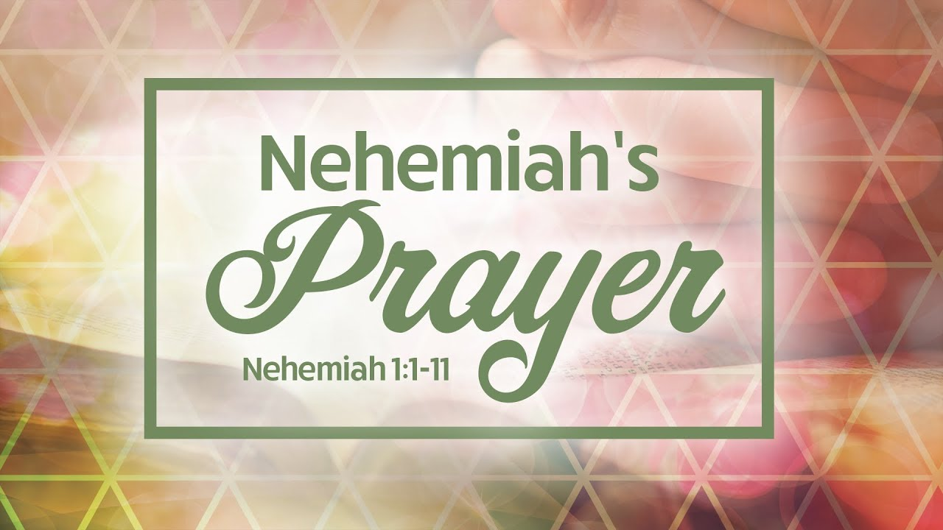

Slide 2
A Prayer for the New Year
⁵ Then I said:
“Lord, the God of heaven, the great and awesome God, who keeps his covenant of love with those who love him and keep his commandments,…”

Slide 3
Let’s pray…

Slide 4
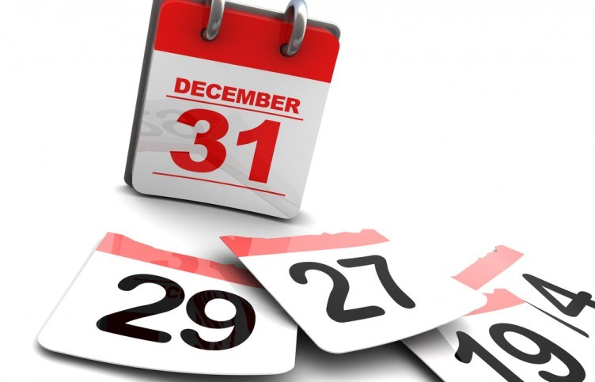

Slide 5


Slide 6
³ They said to me, “Those who survived the exile and are back in the province are in great trouble and disgrace. The wall of Jerusalem is broken down, and its gates have been burned with fire.”
Nehemiah is shocked

Slide 7
I. First, Nehemiah saw the great need.
⁴ When I heard these things, I sat down and wept. For some days I mourned and fasted and prayed before the God of heaven.
Nehemiah felt their need.

Slide 8
II. Nehemiah prayed.
…and I prayed before the God of heaven.
Invocation:
(Calling upon the name of the Lord) (Focusing in whom He is)
Confession,
Petition,

Slide 9
⁵ Then I said:
“Lord, the God of heaven, the great and awesome God, who keeps his covenant of love with those who love him and keep his commandments,

Slide 10
⁶ let your ear be attentive and your eyes open to hear the prayer your servant is praying before you day and night for your servants, the people of Israel. I confess the sins we Israelites, including myself and my father’s family, have committed against you.
Nehemiah said;
it is our fault, he goes to repentance.

Slide 11
⁷ We have acted very wickedly toward you. We have not obeyed the commands, decrees and laws you gave your servant Moses.
⁸ “Remember the instruction you gave your servant Moses, saying, ‘If you are unfaithful, I will scatter you among the nations, ⁹ but if you return to me and obey my commands, then even if your exiled people are at the farthest horizon, I will gather them from there and bring them to the place I have chosen as a dwelling for my Name.’

Slide 12
¹⁰ “They are your servants and your people, whom you redeemed by your great strength and your mighty hand. ¹¹ Lord, let your ear be attentive to the prayer of this your servant and to the prayer of your servants who delight in revering your name. Give your servant success today by granting him favour in the presence of this man.”
I was cupbearer to the king.

Slide 13
Nehemiah hears the news in the month of Kislev, which is November (1:1).
He doesn’t approach the king with his request until four months later in the month of Nisan, which is March (2:1).

Slide 14
III. Nehemiah waited.
This was all about God’s timing.
I was very much afraid, ³ but I said to the king, “May the king live forever! Why should my face not look sad when the city where my ancestors are buried lies in ruins, and its gates have been destroyed by fire?” ⁴ The king said to me, “What is it you want?”
Then I prayed to the God of heaven, ⁵ and I answered the king, “If it pleases the king and if your servant has found favour in his sight, let him send me to the city in Judah where my ancestors are buried so that I can rebuild it.”

Slide 15

He identified with the prosperity of the work of God.
He was ready to be used…

Slide 16
“He leads us on by paths we did not know; Upward He leads us, though our steps be slow, Though often we faint and falter on the way, Though storms and darkness often obscure the day; Yet when the clouds are gone, We know He leads us on.”

Slide 17
“He leads us on through all the unquiet years; Past all our dreamland hopes, and doubts and fears, He guides our steps, through all the tangled maze Of losses, sorrows, and over clouded days; We know His will is done; And still He leads us on.”
Nicolaus L. von Zinzendorf, 1700-1760

Slide 18
Jesus said in John 14:15,
“If you love me you will obey my commands.”
Love for God means obedience to God.

Slide 19
A Prayer for the New Year
⁵ Then I said:
“Lord, the God of heaven, the great and awesome God, who keeps his covenant of love with those who love him and keep his commandments,…”

