Slide 1
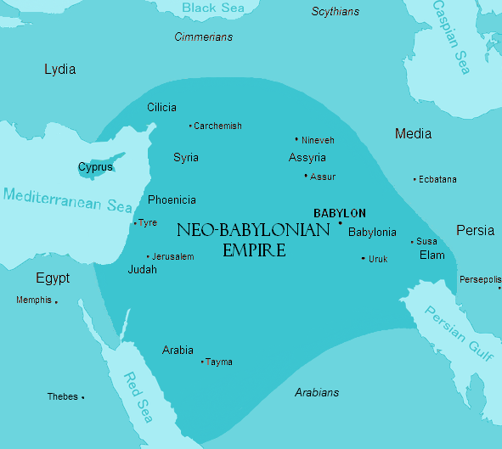

Slide 2
Jer.29:10 ‘This is what the Lord says: When seventy years are completed for Babylon, I will come to you and fulfil my gracious promise to bring you back to this place.’

Slide 3
Dan.9:1-3 In the first year of Darius son of Xerxes…, I, Daniel, understood from the Scriptures, according to the word of the Lord given to Jeremiah the prophet, that the desolation of Jerusalem would last seventy years. So I turned to the Lord God and pleaded with him in prayer and petition, in fasting, and in sackcloth and ashes.

Slide 5
Why do you complain, Jacob? Why do you say, Israel, “My way is hidden from the LORD; my cause is disregarded by my God”?
(Is.40:27)

Slide 6
Do you not know? Have you not heard? The LORD is the everlasting God, the Creator of the ends of the earth. He will not grow tired or weary, and his understanding no one can fathom. (Is.40:28)

Slide 7
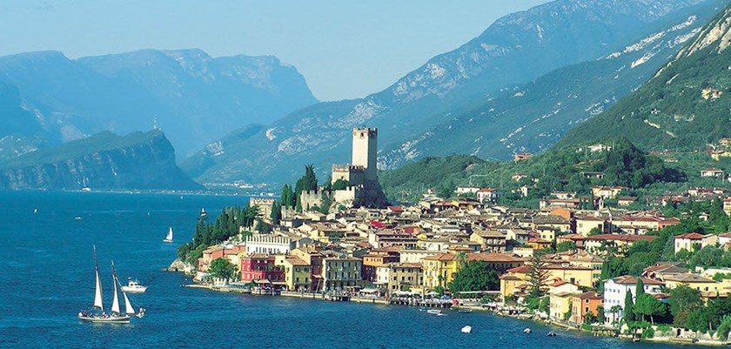

Slide 8
He gives strength to the weary and increases the power of the weak.
Even youths grow tired and weary, and young men stumble and fall;
but those who hope in the LORD will renew their strength. They will soar on wings like eagles; they will run and not grow weary, they will walk and not be faint. (Is.40:29-31)

Slide 9
What can we hope for in the coming year?
1. More people becoming Christians
2. All of us growing in our faith
3. in our understanding of God’s word
4. and in our usefulness in His service

Slide 10
He gives strength to the weary and increases the power of the weak.
Even youths grow tired and weary, and young men stumble and fall;
but those who hope in the LORD will renew their strength. They will soar on wings like eagles; they will run and not grow weary, they will walk and not be faint. (Is.40:29-31)

