Slide 1
Galatians 5: 22-23 (NRSV)
By contrast, the fruit of the Spirit is love, joy, peace, patience, kindness, generosity, faithfulness, ²³ gentleness, and self-control. Again such things there is no law.

Slide 2
Galatians 5:23
But the fruit of the Spirit is SELF-CONTROL.

Slide 3
Prayer
Notes:
Isaiah 40.31
Those who wait for the Lord shall renew
their strength,
they shall mount up with wings like eagles,
they shall run and not be weary
they shall walk and not faint.

Slide 4
Self-control is the quality that allows you to stop yourself from doing things you want to do but that might not be in your best interest.

Slide 5
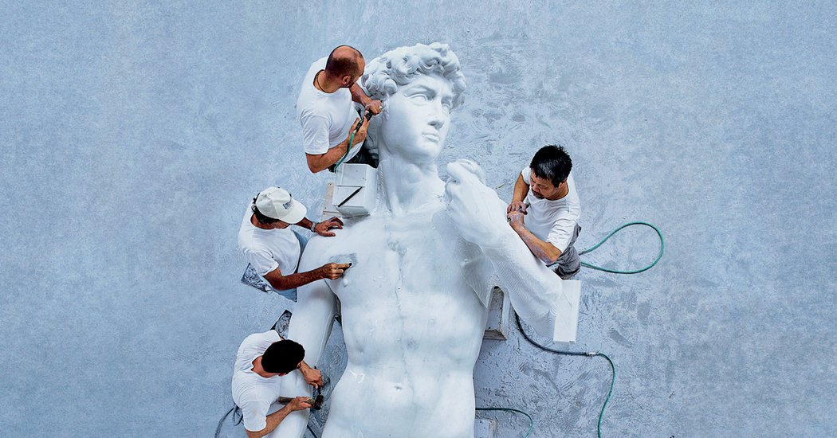
I. WHAT IS SELF-CONTROL
When the Greeks wanted to illustrate self-control, they built a statue of a man or a woman in perfect proportion.

Slide 6
I. WHAT IS SELF-CONTROL
A self-controlled person is “one who holds himself in.”
Brian Bill
“Self-control” in the NIV
“Temperance”
“Self-control” in the KJV
“one who holds himself in.”

Slide 7
Romans 7:18 (NIV)
“For I know that good itself does not dwell in me, that is, in my sinful nature. For I have the desire to do what is good, but I cannot carry it out.”
1 Corinthians 9:1-3
Am I not free? Am I not an apostle? Have I not seen Jesus our Lord? Are you not the result of my work in the Lord? ² Even though I may not be an apostle to others, surely I am to you! For you are the seal of my apostleship in the Lord.

Slide 8
1 Corinthians 9:26-27 (NIV)
²⁶ Therefore I do not run like someone running aimlessly; I do not fight like a boxer beating the air. ²⁷ No, I strike a blow to my body and make it my slave so that after I have preached to others, I myself will not be disqualified for the prize.
The “control of the self by the
Holy Spirit for the sake of the gospel.”

Slide 9
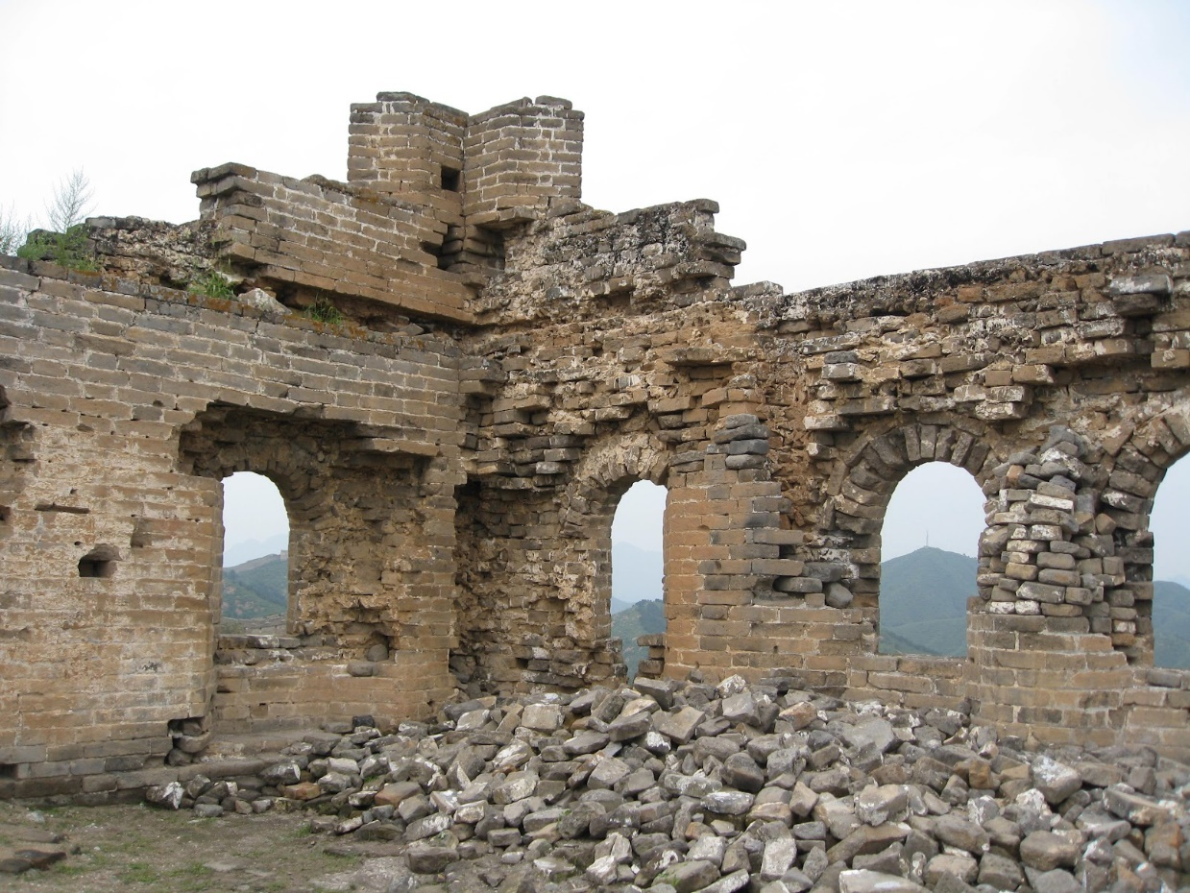
What happens when self-control is not in our lives?
Proverbs 25:28 (NIV)
Like a city whose walls are broken through is a person who lacks self-control.
A city with walls in disrepair was
a city with a shameful reputation.

Slide 10
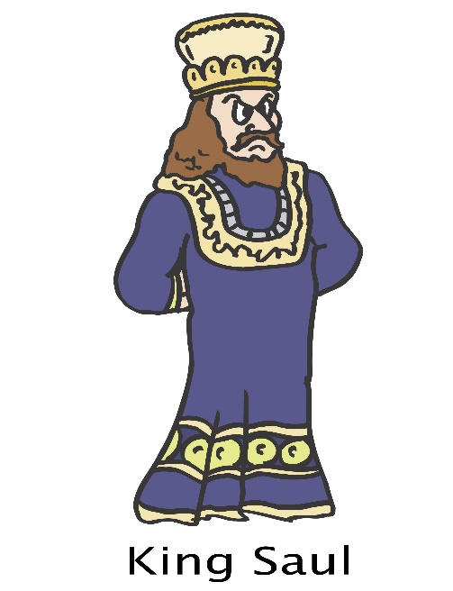
People who lived out-of-control lives.
Judges 14-16
1 Samuel 21-23

Slide 11
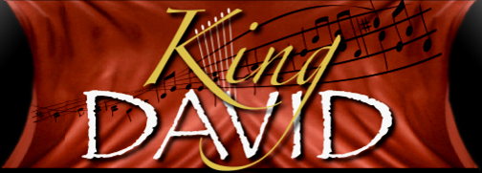
People who lived out-of-control lives.
1 Samuel 24:6 (NIV)
He said to his men, “The Lord forbid that I should do such a thing to my master, the Lord’s anointed, or lay my hand on him; for he is the anointed of the Lord.”

Slide 12
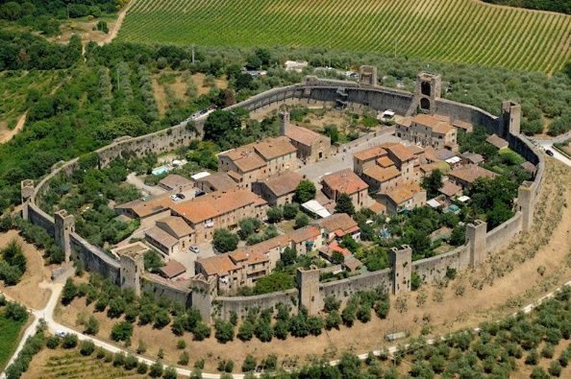
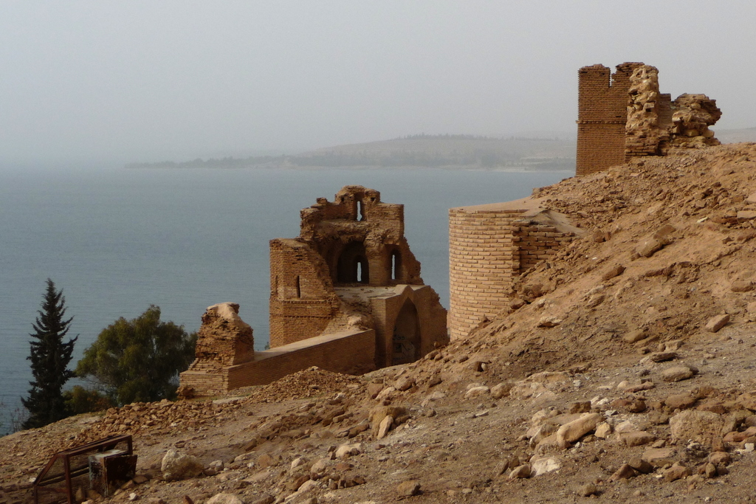
“He is a governor that governs his passions, and he is a servant that serves them.”
Benjamin Franklin

Slide 13
II. What to do?
1. We are to guard our hearts.
Proverbs 4:23
“Above all else, guard your heart, for everything you do flows from it.”
Proverbs 6:24-26 (NIV)
keeping you from your neighbour's wife, from the smooth talk of a wayward woman. ²⁵ Do not lust in your heart after her beauty or let her captivate you with her eyes. ²⁶ For a prostitute can be had for a loaf of bread, but another man’s wife preys on your very life.

Slide 14
Proverbs 21:20 (NIV)
“The wise store up choice food and olive oil, but fools gulp theirs down.”
Proverbs 23:29-30 (NIV)
“Who has woe? Who has sorrow? Who has strife? Who has complaints? Who has needless bruises? Who has bloodshot eyes? ³⁰ Those who linger over wine, who go to sample bowls of mixed wine.”

Slide 15
What to do?
We are to guard our hearts.
Proverbs 29:11 (NIV)
“Fools give full vent to their rage, but the wise bring calm in the end.”
People with self-discipline master their temperament and control their tongue.

Slide 16
III. One example
Titus 2:1-3 (NIV)
You, however, must teach what is appropriate to sound doctrine. ² Teach the older men to be temperate, worthy of respect, self-controlled, and sound in faith, in love and in endurance.
³ Likewise, teach the older women to be reverent in the way they live, not to be slanderers or addicted to much wine, but to teach what is good.

Slide 17
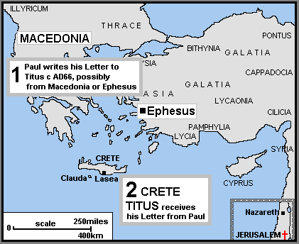
The context is the island of Crete.
The young pastor Titus did not have an easy assignment on the island of Crete.

Slide 18
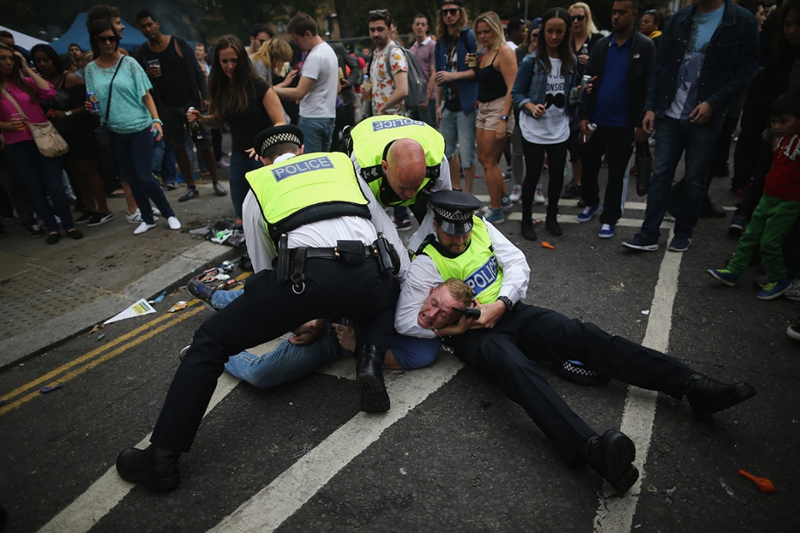
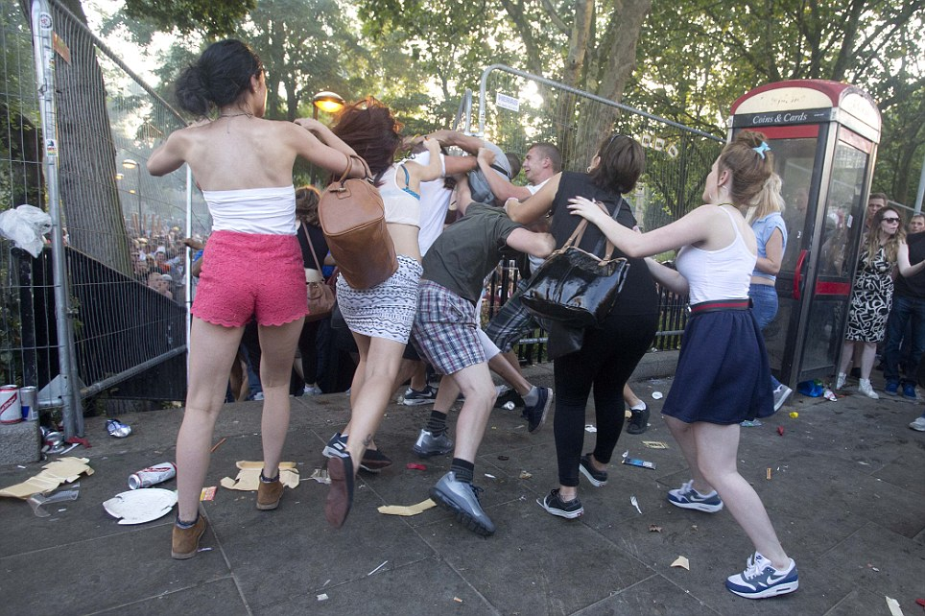
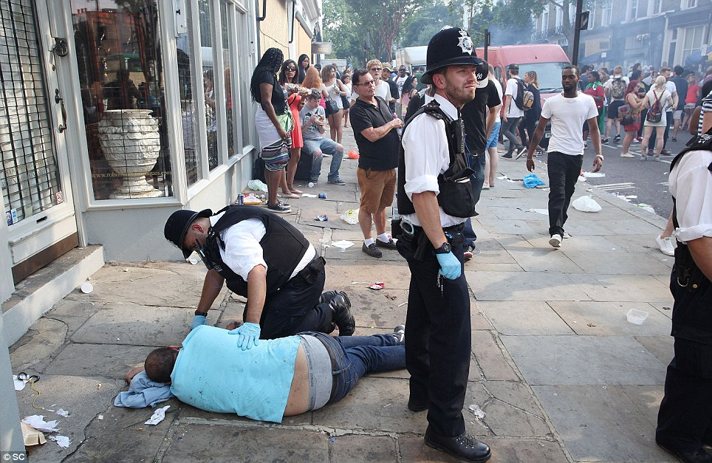
Crete was the first century “party place.”
Titus 1:12 (NIV)
One of Crete’s own prophets has said it: “Cretans are always liars, evil brutes, lazy gluttons.”

Slide 19
IV. How self-control is given?
Titus 2:11-14 (NIV)
¹¹ For the grace of God has appeared that offers salvation to all people. ¹² It teaches us to say “No” to ungodliness and worldly passions, and to live self-controlled, upright and godly lives in this present age, ¹³ while we wait for the blessed hope—the appearing of the glory of our great God and Saviour, Jesus Christ, ¹⁴ who gave himself for us to redeem us from all wickedness and to purify for himself a people that are his very own, eager to do what is good.

Slide 20
The emphasis in this passage and the key to seizing self-control is grace.
1. Grace redeems us (verse 11, and 14a).
2. Grace reforms us (verse 12, and 14b).
Notice in verse 12 that we can say “NO” to ungodliness and passions.
1 Corinthians 10:13 (NIV)
No temptation has overtaken you except what is common to mankind. And God is faithful; he will not let you be tempted beyond what you can bear. But when you are tempted, he will also provide a way out so that you can endure it.

Slide 21
Titus 2:12 (NIV)
“It teaches us to say ‘No’ to ungodliness and worldly passions, and to live self-controlled… lives”
• Admit you have a problem with self-control.
• Yield to the lordship of Christ.
• Cultivate the disciplines of Bible reading and prayer.
• Invest in spiritual friendships.
• Restrict bad influences. Avoid those things that tempt us.
• Practice good habits.
• Welcome gracious correction.

Slide 22
3. Grace rewards us (verse 13).
“Our ordinary method of dealing with ingrained sin is to launch a frontal attack. We rely on our willpower and determination. Whatever may be the issue for us – anger, fear, bitterness, gluttony, pride, lust, substance abuse –we determine never to do it again; we pray against it, fight against it, and set our will against it. But the struggle is all in vain, and we find ourselves once again morally bankrupt…”
Richard Foster
There is no way we can develop self-control on our own

Slide 23
Galatians 5:23 (NIV).
“…Against such things there is no law”
“While Christ’s work on the cross...was the only way to settle the problem of guilt, sin, and condemnation; the coming of the promised Holy Spirit was God’s way of changing human beings from the inside out. The law given to Moses had failed on this very point. It was in itself holy and just, but the problem was the sinful nature within people. Now the Holy Spirit dwelling in the hearts of believers would conquer the age-old dilemma of ‘I want to be different but can’t. I know what’s wrong, but I keep doing it anyway.’ This empowerment by the Spirit would be the dynamic source throughout time for all who live and labour for Jesus Christ”
Jim Cymbala, “Book Fresh Power” (Pages 16-17).

Slide 24
A self-controlled life means total submission to God.
Self-control is not when I control my “self”. Self-control is when the Holy Spirit controls my “self”.
Galatians 5:16 and 25 (NIV)
“So I say, walk by the Spirit, and you will not gratify the desires of the flesh… Since we live by the Spirit, let us keep in step with the Spirit.”

Slide 25
2 Timothy 3:1-5 (NIV)
But mark this: There will be terrible times in the last days. ² People will be lovers of themselves, lovers of money, boastful, proud, abusive, disobedient to their parents, ungrateful, unholy, ³ without love, unforgiving, slanderous, without self-control, brutal, not lovers of the good, ⁴ treacherous, rash, conceited, lovers of pleasure rather than lovers of God— ⁵ having a form of godliness but denying its power. Have nothing to do with such people.

