Slide 1
John 4:41-42 (NIV)
⁴¹ And because of his words many more became believers.
⁴² They said to the woman, “We no longer believe just because of what you said; now we have heard for ourselves, and we know that this man really is the Saviour of the world.”
The Saviour of the world

Slide 2
Let’s Pray…

Slide 3
The Saviour of the world
“All religions are the same.”
“All forms of religions are wrong.”
PRIDE

Slide 4
PRIDE
He guides the humble in what is right and teaches them his way.
Psalm 25:9 (NIV)
“I myself created the whole universe! I am pleased with those who are humble and repentant, who fear me and obey me.”
Isaiah 66:2 (GNT)

Slide 5
John 4:1-10 (NIV)
Now Jesus learned that the Pharisees had heard that he was gaining and baptizing more disciples than John— ² although in fact it was not Jesus who baptized, but his disciples. ³ So he left Judea and went back once more to Galilee. ⁴ Now he had to go through Samaria. ⁵ So he came to a town in Samaria called Sychar, near the plot of ground Jacob had given to his son Joseph.⁶ Jacob’s well was there, and Jesus, tired as he was from the journey, sat down by the well. It was about noon.

Slide 6
John 4:1-10 (NIV)
⁷ When a Samaritan woman came to draw water, Jesus said to her, “Will you give me a drink?” ⁸ (His disciples had gone into the town to buy food.)
⁹ The Samaritan woman said to him, “You are a Jew and I am a Samaritan woman. How can you ask me for a drink?” (For Jews do not associate with Samaritans.) ¹⁰ Jesus answered her, “If you knew the gift of God and who it is that asks you for a drink, you would have asked him and he would have given you living water.”

Slide 7
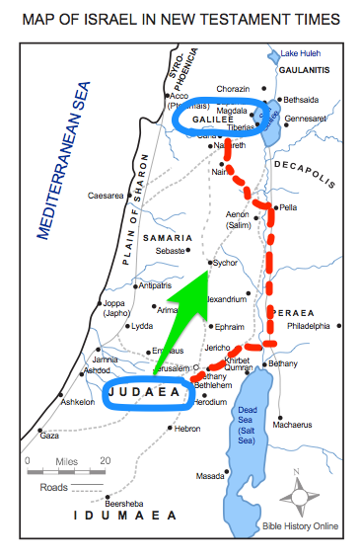
I. The Context.
The Jews who wanted to go from Judea to Galilee would take an indirect route in order to avoid going through Samaria.

Slide 8
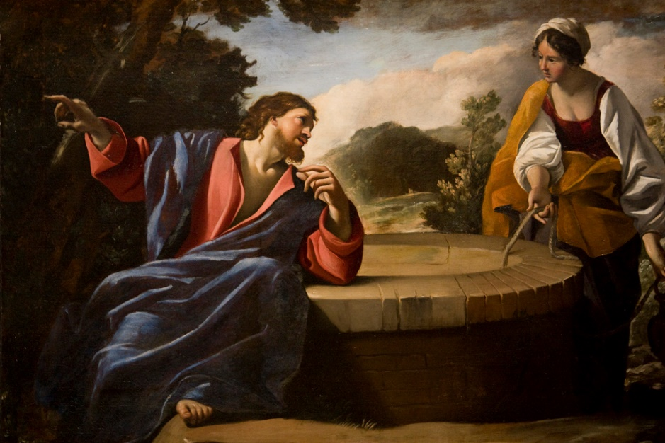
II. The Challenge
Jesus answered her, “If you knew the gift of God and who it is that asks you for a drink, you would have asked him and he would have given you living water.”
John 4:10 (NIV)

Slide 9
III. The first move “Humility”
¹¹ “Sir,” the woman said, “you have nothing to draw with and the well is deep. Where can you get this living water? ¹² Are you greater than our father Jacob, who gave us the well and drank from it himself, as did also his sons and his livestock?”
¹³ Jesus answered, “Everyone who drinks this water will be thirsty again, ¹⁴ but whoever drinks the water I give them will never thirst. Indeed, the water I give them will become in them a spring of water welling up to eternal life.”
John 4:11-14 (NIV)

Slide 10
III. The first move “Humility”
¹⁵ The woman said to him, “Sir, give me this water so that I won’t get thirsty and have to keep coming here to draw water.”
John 4:15 (NIV)

Slide 11
IV. The dilemma of facing the truth.
¹⁶ He told her, “Go, call your husband and come back.” ¹⁷ “I have no husband,” she replied.
Jesus said to her, “You are right when you say you have no husband. ¹⁸ The fact is, you have had five husbands, and the man you now have is not your husband. What you have just said is quite true.”
¹⁹ “Sir,” the woman said, “I can see that you are a prophet.
John 4:16-19 (NIV)

Slide 12

IV. The dilemma of facing the truth.
Do you know how the Lord Jesus began the gospel?

Slide 13
IV. The dilemma of facing the truth.
"Our ancestors worshipped on this mountain, but you Jews claim that the place where we must worship is in Jerusalem.”

Slide 14
IV. The dilemma of facing the truth.
²¹ “Woman,” Jesus replied, “believe me, a time is coming when you will worship the Father neither on this mountain nor in Jerusalem. ²² You Samaritans worship what you do not know; we worship what we do know, for salvation is from the Jews. ²³ Yet a time is coming and has now come when the true worshipers will worship the Father in the Spirit and in truth, for they are the kind of worshipers the Father seeks.

Slide 15
V. A changed life!
²⁵ The woman said, “I know that Messiah” (called Christ) “is coming. When he comes, he will explain everything to us.”
²⁶ Then Jesus declared, “I, the one speaking to you—I am he.”
²⁸ Then, leaving her water jar, the woman went back to the town and said to the people…

Slide 16
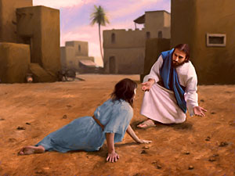
JESUS IS OUR EXAMPLE OF GENTLENESS
John 8:11 (NIV)
“…Then neither do I condemn you,” Jesus declared.
“Go now and leave your life of sin.”

Slide 17
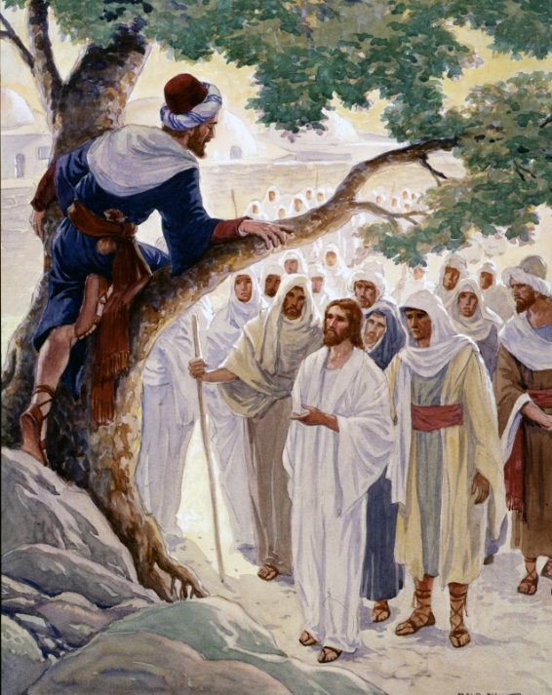

JESUS IS OUR EXAMPLE OF GENTLENESS
“Go now and leave your life of sin.”

Slide 18
John 4:41-42 (NIV)
⁴¹ And because of his words many more became believers.
⁴² They said to the woman, “We no longer believe just because of what you said; now we have heard for ourselves, and we know that this man really is the Saviour of the world.”
Jesus the Saviour of the world

