Slide 1
(Gal.5:22-23)
“But the fruit of the Spirit is love, joy, peace, patience, kindness, goodness, faithfulness, gentleness, and self-control. Against such things there is no law.”
But the fruit of the Spirit is gentleness

Slide 2
Let’s Pray…

Slide 3

I. What is "gentleness?"
Sensitivity of disposition and kindness of behaviour, founded on strength and prompted by love.
Dr J. Knox Chamblin

Slide 4

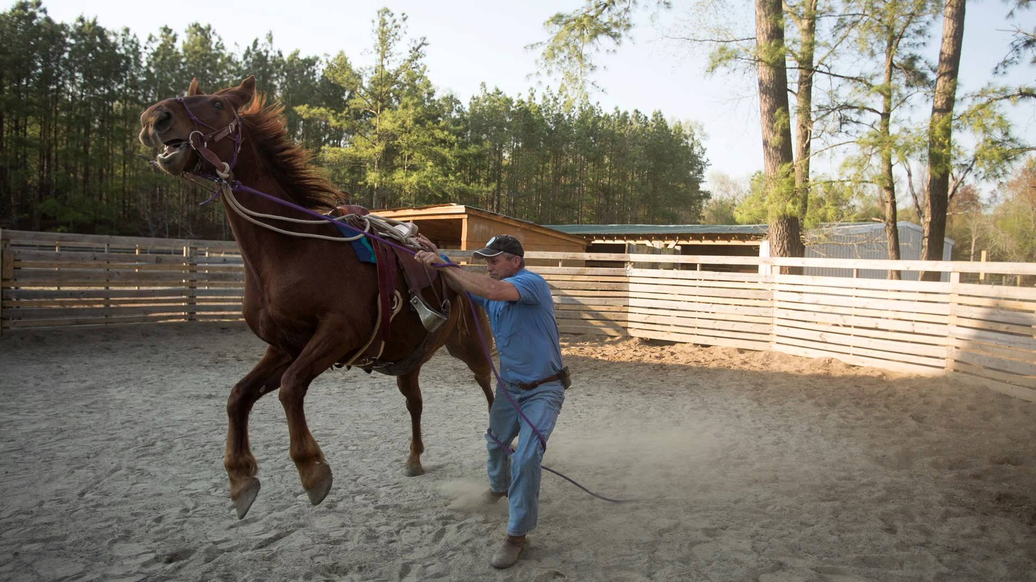
A horse that had been tamed
Power under control

Slide 5
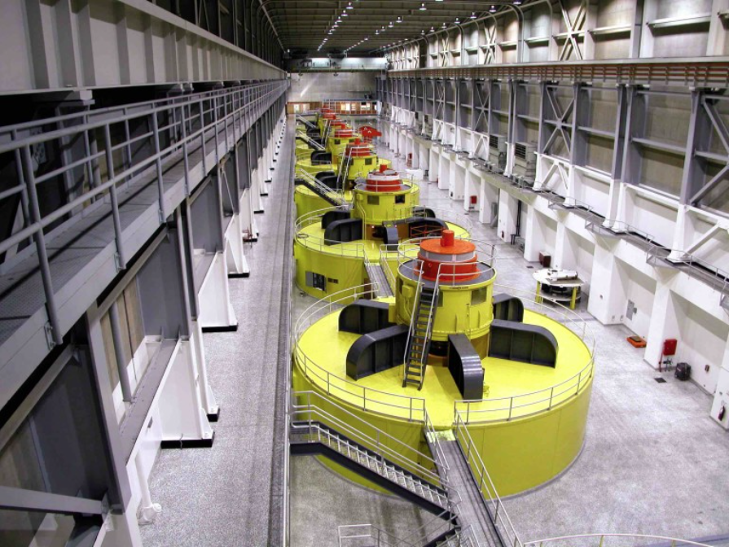
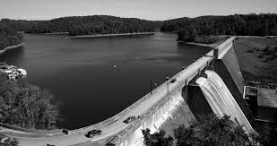
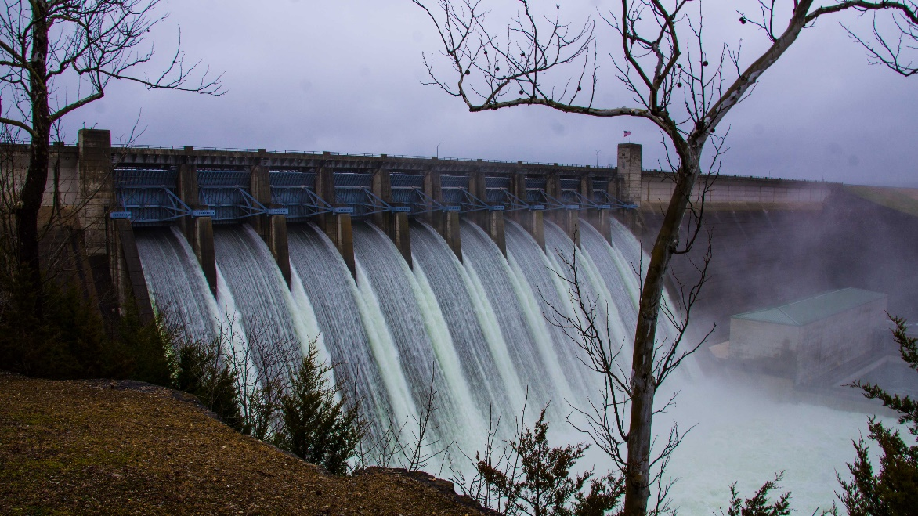

Slide 6


Anger under control
Power under control
Our emotions under God’s control.

Slide 7
II. JESUS IS OUR EXAMPLE OF GENTLENESS
"If we had people like these people in our church, how would we treat them?"

Slide 8
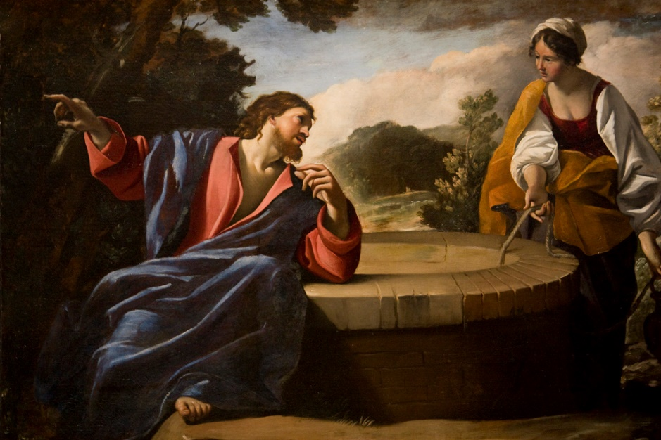
II. JESUS IS OUR EXAMPLE OF GENTLENESS
John 4:7-9 (NIV)
⁷ When a Samaritan woman came to draw water, Jesus said to her, “Will you give me a drink?” ⁸ (His disciples had gone into the town to buy food.)
⁹ The Samaritan woman said to him, “You are a Jew and I am a Samaritan woman. How can you ask me for a drink?” (For Jews do not associate with Samaritans.)

Slide 9
II. JESUS IS OUR EXAMPLE OF GENTLENESS
John 8:2-6 (NIV)
At dawn he appeared again in the temple courts, where all the people gathered around him, and he sat down to teach them. ³ The teachers of the law and the Pharisees brought in a woman caught in adultery. They made her stand before the group ⁴ and said to Jesus, “Teacher, this woman was caught in the act of adultery. ⁵ In the Law Moses commanded us to stone such women. Now what do you say?” ⁶ They were using this question as a trap, in order to have a basis for accusing him.

Slide 10
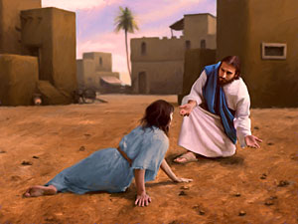
II. JESUS IS OUR EXAMPLE OF GENTLENESS
John 8:11 (NIV)
“…Then neither do I condemn you,” Jesus declared.
“Go now and leave your life of sin.”

Slide 11
II. JESUS IS OUR EXAMPLE OF GENTLENESS
Luke 19:5-9 (NIV)
⁵ When Jesus reached the spot, he looked up and said to him, “Zacchaeus, come down immediately. I must stay at your house today.” ⁶ So he came down at once and welcomed him gladly.
⁷ All the people saw this and began to mutter, “He has gone to be the guest of a sinner.”
⁸ But Zacchaeus stood up and said to the Lord, “Look, Lord! Here and now I give half of my possessions to the poor, and if I have cheated anybody out of anything, I will pay back four times the amount.”
⁹ Jesus said to him, “Today salvation has come to this house, because this man, too, is a son of Abraham.

Slide 12
How would you deal with people like that in our church
Would you judge them?
“Gentleness" is all about, dealing with people who have been broken and twisted and confused in life.
“For God so loved the world that he gave his one and only Son, that whoever believes in him shall not perish but have eternal life.”
John 3:16 (NIV)

Slide 13
III An example to avoid.
Luke 9:51-56 (NIV)
⁵¹ As the time approached for him to be taken up to heaven, Jesus resolutely set out for Jerusalem. ⁵² And he sent messengers on ahead, who went into a Samaritan village to get things ready for him; ⁵³ but the people there did not welcome him, because he was heading for Jerusalem. ⁵⁴ When the disciples James and John saw this, they asked, “Lord, do you want us to call fire down from heaven to destroy them?” ⁵⁵ But Jesus turned and rebuked them. ⁵⁶ Then he and his disciples went to another village.

Slide 14
Ezekiel 33:11 (NIV)
‘As surely as I live, declares the Sovereign Lord, I take no pleasure in the death of the wicked, but rather that they turn from their ways and live. Turn! Turn from your evil ways! Why will you die, people of Israel?’

Slide 15
III. HOW GENTLENESS IS TO BE USED
Galatians 6:1 (NIV)
“Brothers and sisters, if someone is caught in a sin, you who live by the Spirit should restore that person gently. But watch yourselves, or you also may be tempted.”
Restore that person gently.

Slide 16

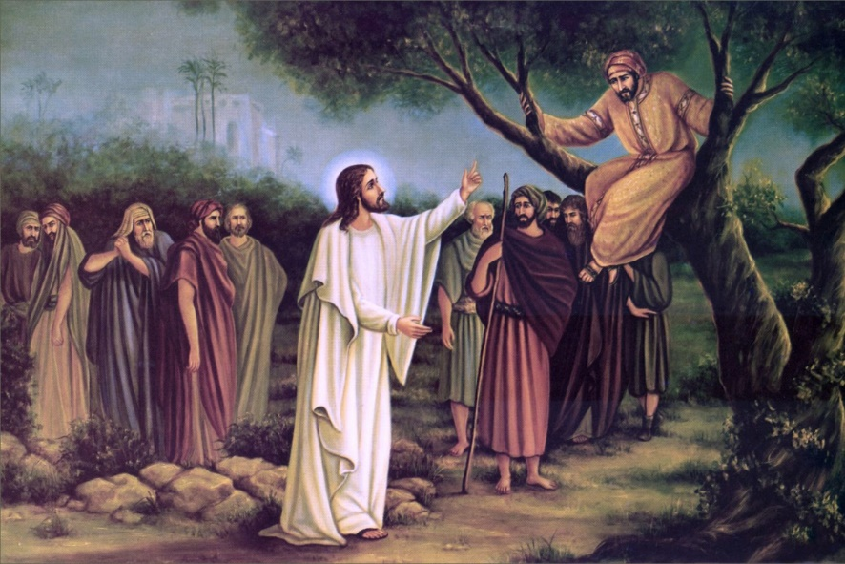
When you see people who are caught in sin
He says, “When you see people like that... Church, be gentle! Be careful.
Show them the way to repentance,
and the way back to me, because they are mine.”

Slide 17
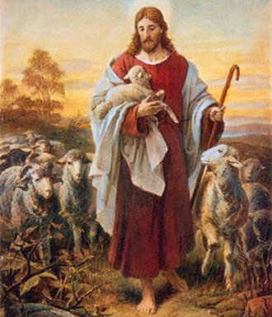
Isaiah 40:11 (NIV)
He tends his flock like a shepherd: He gathers the lambs in his arms and carries them close to his heart; he gently leads those that have young.

Slide 18
Proverbs 4:18 (NIV)
The path of the righteous is like the morning sun, shining ever brighter till the full light of day.
Galatians 6:1 (NIV)
“Brothers and sisters, if someone is caught in a sin, you who live by the Spirit should restore that person gently. But watch yourselves, or you also may be tempted.”

Slide 19
Anger under control
Power under control
Emotions under control
Our lives under God’s control.

Slide 20
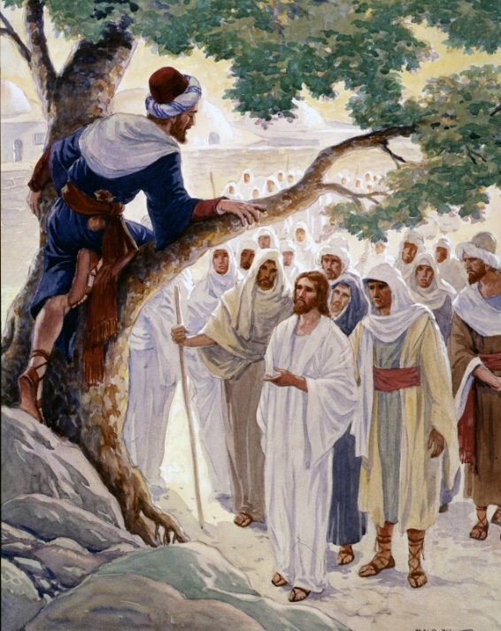

Sensitivity of disposition and kindness of behaviour, founded on strength and prompted by love.
Dr J. Knox Chamblin
JESUS IS OUR EXAMPLE OF GENTLENESS

Slide 21
How Gentleness is to be used
Perhaps Jesus is asking: “Show them the way to repentance, the way back to me, because they are mine. I created them, I want them back. More than anything else, I want them back because I love them.”
“Go now and leave your life of sin.”
Are you a gentle person?
But the fruit of the Spirit is gentleness

