Slide 1
Galatians 5: 22-23 (NRSV)
By contrast, the fruit of the Spirit is love, joy, peace, patience, kindness, generosity, faithfulness, ²³ gentleness, and self-control. There is no law against such things.

Slide 2
Galatians 5:22
But the fruit of the Spirit is FAITHFULNESS.

Slide 3
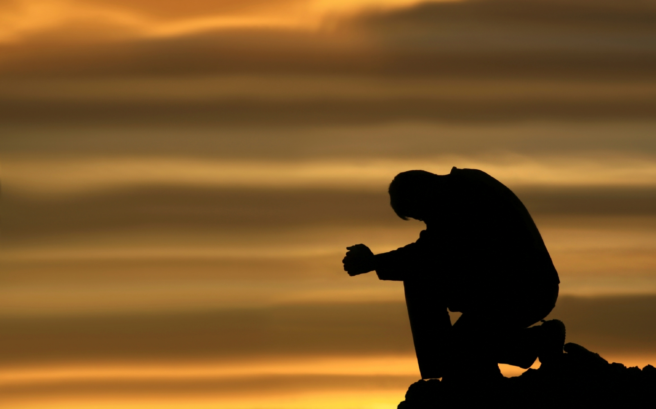
Prayer
Notes:
Isaiah 40.31
Those who wait for the Lord shall renew
their strength,
they shall mount up with wings like eagles,
they shall run and not be weary
they shall walk and not faint.

Slide 4
I. WHAT IS FAITHFULNESS??
1. A conviction about something.
We believe something so we will do something.

Slide 5
Webster's New World Dictionary defines faithful as "maintaining allegiance; constant; loyal; marked by or showing a strong sense of duty or responsibility; conscientious; accurate; reliable; exact."
“Now faith is confidence in what we hope for and assurance about what we do not see”.
Hebrews 11:1

Slide 6
Every modern translation renders the word that the KJV translates into “FAITH” as "faithfulness," "fidelity" or "good faith."
William Barclay writes, "This word (pistis) is common in secular Greek for trustworthiness. It is the characteristic of the man who is reliable".

Slide 7
I. WHAT IS FAITHFULNESS?
2. Fidelity or trustworthiness.
James 1:6-8 (NIV)
⁶ But when you ask, you must believe and not doubt, because the one who doubts is like a wave of the sea, blown and tossed by the wind. ⁷ That person should not expect to receive anything from the Lord. ⁸ Such a person is double-minded and unstable in all they do.
Trustworthiness:
is the characteristic of the man who is reliable.

Slide 8
II. THE FOUNDATION OF FAITHFULNESS.
1. God is faithful.
1 Corinthians 1:9 (NIV)
⁹ God is faithful, who has called you into fellowship with his Son, Jesus Christ our Lord.
1 Corinthians 10:13 (NIV)
No temptation has overtaken you except what is common to mankind. And God is faithful; he will not let you be tempted beyond what you can bear. But when you are tempted, he will also provide a way out so that you can endure it.

Slide 9
2. Jesus is faithful.
Jesus was faithful to the end, He did not run from His calling when it got tough.
Hebrews 3:1-2 (NIV)
Therefore, holy brothers and sisters, who share in the heavenly calling, fix your thoughts on Jesus, whom we acknowledge as our apostle and high priest. ² He was faithful to the one who appointed him, just as Moses was faithful in all God’s house.

Slide 10
2. Jesus is faithful.
Philippians 2:7-9 (NIV)
rather, he made himself nothing by taking the very nature of a servant, being made in human likeness. ⁸ And being found in appearance as a man, he humbled himself by becoming obedient to death— even death on a cross!
⁹ Therefore God exalted him to the highest place and gave him the name that is above every name,

Slide 11
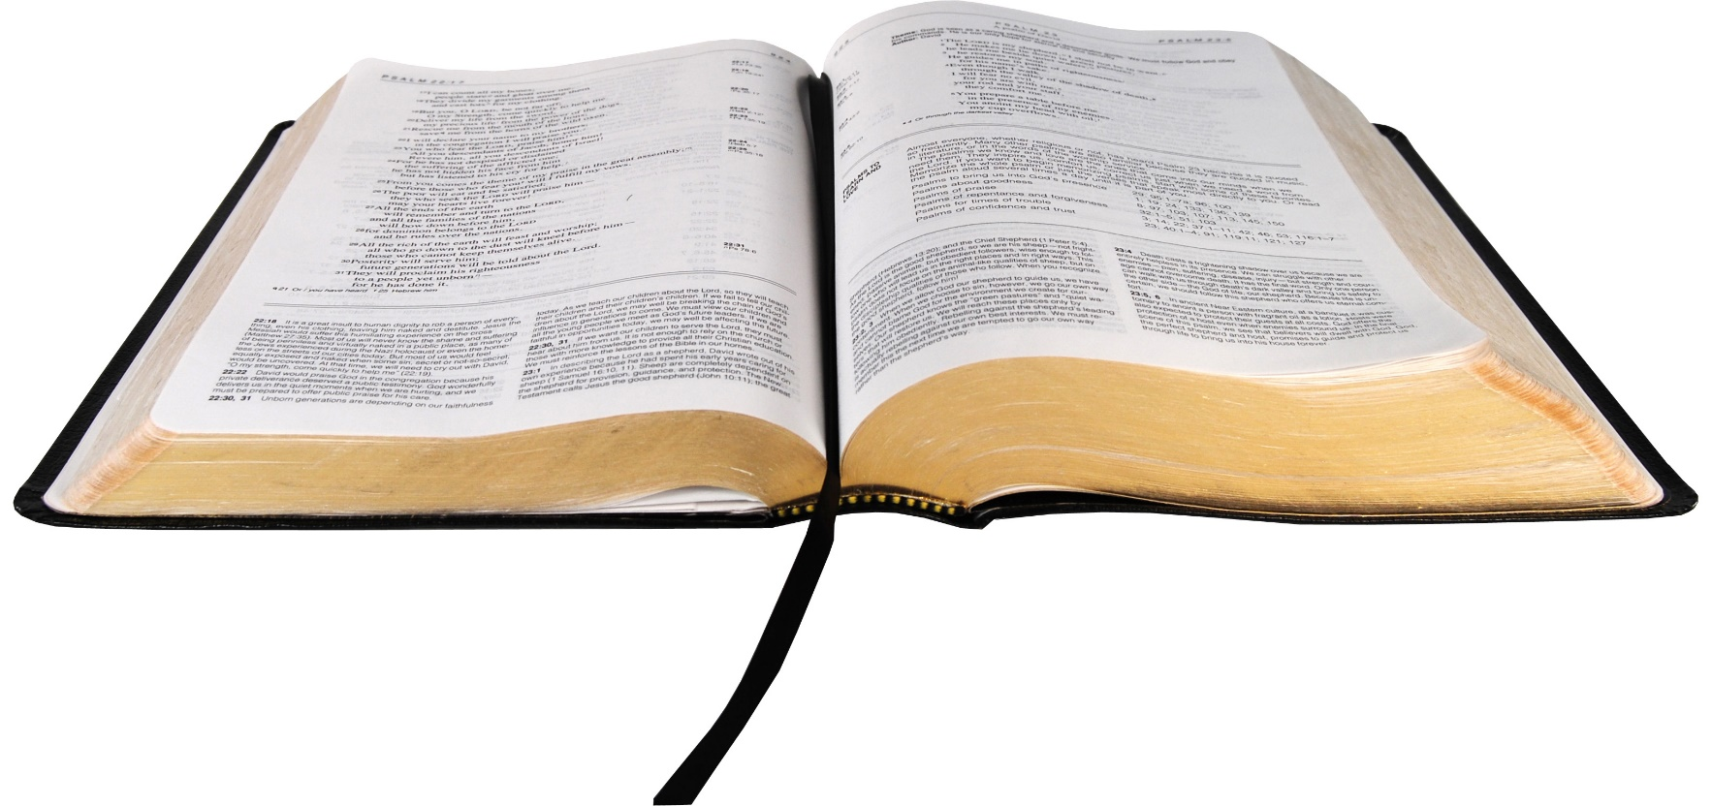
3. God’s word is trustworthy.
Psalm 119:105 (NIV)
Your word is a lamp for my feet, a light on my path.

Slide 12
III. TO WHOM TO BE FAITHFUL.
1. We are to be faithful to God.
Revelation 2:10 (NIV)
Do not be afraid of what you are about to suffer. I tell you, the devil will put some of you in prison to test you, and you will suffer persecution for ten days. Be faithful, even to the point of death, and I will give you life as your victor’s crown.
God expects faithfulness.

Slide 13
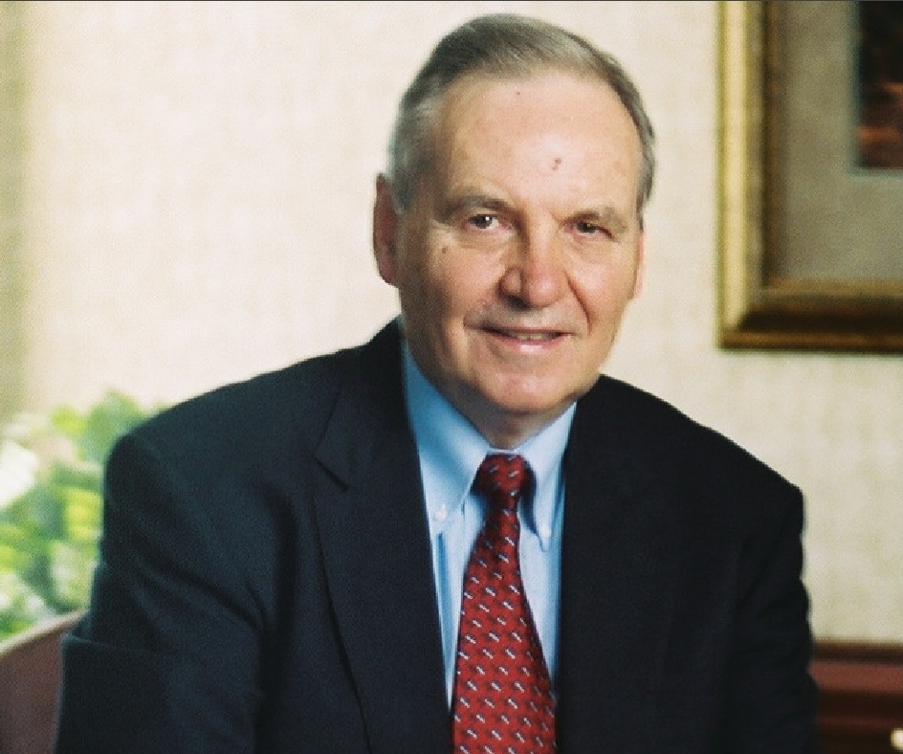
III. TO WHOM TO BE FAITHFUL.
2. We are to be faithful to others.
Dr Norman Geisler
Norman Leo Geisler (born July 21, 1932) is a Christian systematic theologian and philosopher. He is the co-founder of two non-denominational Evangelical seminaries Veritas Evangelical Seminary and Southern Evangelical Seminary.

Slide 14
3. We are to be faithful to the Church.

Slide 15
Haggai 1:1-5 (NIV)
In the second year of King Darius, on the first day of the sixth month, the word of the Lord came through the prophet Haggai to Zerubbabelson of Shealtiel, governor of Judah, and to Joshua son of Jozadak, the high priest:
² This is what the Lord Almighty says: “These people say, ‘The time has not yet come to rebuild the Lord’s house.’”
³ Then the word of the Lord came through the prophet Haggai: ⁴ “Is it a time for you yourselves to be living in your paneled houses, while this house remains a ruin?”
⁵ Now this is what the Lord Almighty says: “Give careful thought to your ways.

Slide 16
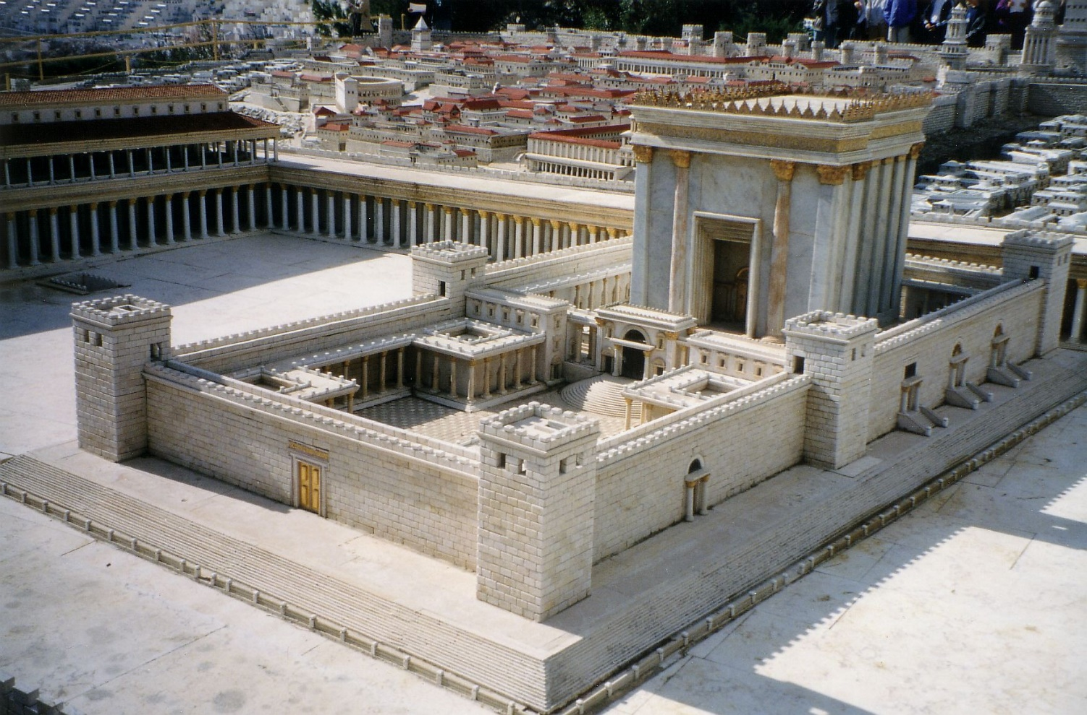
“…build the house of the LORD God of Israel, (he is the God,) which is in Jerusalem.”

Slide 17
Do not waste your time waiting and longing for large opportunities which may never come. But faithfully handle the little things that are always claiming your attention.
F.B. Meyer.

Slide 18
Our Lord warned His people in verse 5 “…Give careful thought to your ways”.
The importance of coming to Church
“the person who thinks all this can be done by reading, or by just looking at a television set, is missing the mysterious element in the life of the Church. What is it? It is what our Lord was suggesting, I think, when He said, ‘Where two or three gather together in My name, there I am in the midst’. It is not mere gathering of people; Christ is present. This is the great mystery of the Church. There is something in the very atmosphere of Christian people meeting together to worship God and to listen to the preaching of the Gospel.”
D. Martyn Lloyd - Jones

Slide 19
The people of Israel considered their ways, and they listened and obeyed Him.
“…They came and began to work on the house of the Lord Almighty, their God,”
Haggai 1:14 (NIV)
CONSIDER YOUR WAYS!!

Slide 20
1. We are to be faithful to God.
2. We are to be faithful to others.
3. We are to be faithful to the Church.
Galatians 5:22
But the fruit of the Spirit is FAITHFULNESS.
Are you a faithful person?

