Slide 1
The Challenge of Christianity
Jesus looked at them and said, “With man this is impossible, but not with God; all things are possible with God.”
Mark 10:27 (NIV)

Slide 2
Let’s pray…

Slide 3
The Challenge of Christianity
Britain really is ceasing to be a Christian country
“Christianity is Literally Dying”;
Islam to become biggest faith.

Slide 4
The Challenge of Christianity
²¹ Then Peter came to Jesus and asked, “Lord, how many times shall I forgive my brother or sister who sins against me? Up to seven times?”
²² Jesus answered, “I tell you, not seven times, but seventy-seven times.
Matthew 18:21-22 (NIV)
Impossible.

Slide 5
The Challenge of Christianity
⁸ Jesus replied, “Moses permitted you to divorce your wives because your hearts were hard. But it was not this way from the beginning. ⁹ I tell you that anyone who divorces his wife, except for sexual immorality, and marries another woman commits adultery.”
Matthew 19:8-9 (NIV)
That is Impossible.

Slide 6
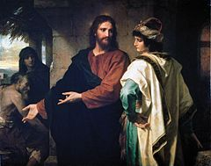
Mark 10:17-22
Matthew 19:16-22
Jesus and the rich young man
For the rich, young man his “other god” was wealth.

Slide 7
The disciples were even more amazed, and said to each other,
“Who then can be saved?”
Jesus looked at them and said, “With man this is impossible, but not with God; all things are possible with God.”
Mark 10:27 (NIV)

Slide 8
How is that possible?
It is impossible from the world’s perspective.
…but not with God; all things are possible with God.”
Mark 10:27 (NIV)

Slide 9
How is that possible?
It is impossible from the world’s perspective.
…but not with God; all things are possible with God.”
Mark 10:27 (NIV)

Slide 10
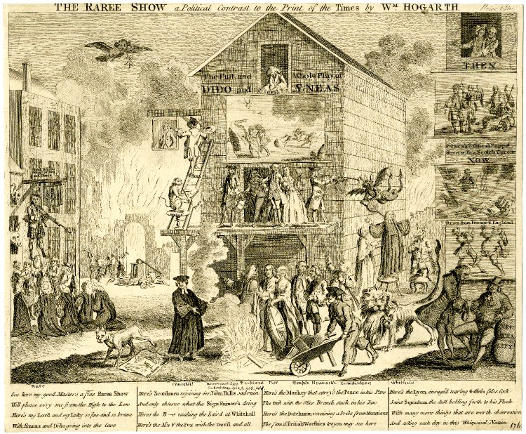
The Challenge of Christianity
Great Britain in 1740.

Slide 11
From our human perspective and abilities, we say IMPOSSIBLE.
Nothing is impossible with Jesus
Philippians 4:13
“I can do all things through Christ,
who strengthens me.”

Slide 12
… “With man this is impossible, but not with God; all things are possible with God.”
Mark 10:27 (NIV)

Slide 13
May the God of hope fill you with all joy and peace as you trust in him, so that you may overflow with hope by the power of the Holy Spirit.
Romans 15:13 (NIV)

