Slide 1
Galatians 5: 22-23 (NIV)
But the fruit of the Spirit is love, joy, peace, forbearance, kindness, goodness, faithfulness, ²³ gentleness and self-control. Against such things there is no law.

Slide 2
Galatians 5:22 (NIV)
But the fruit of the Spirit is GOODNESS.

Slide 3
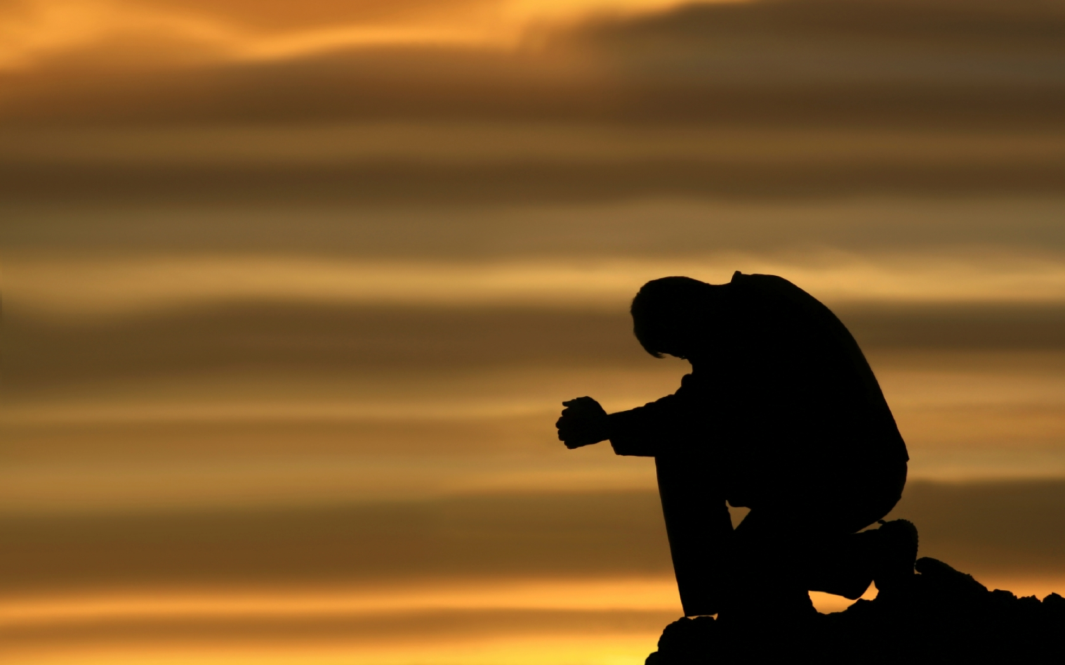
Prayer
Notes:
Isaiah 40.31
Those who wait for the Lord shall renew
their strength,
they shall mount up with wings like eagles,
they shall run and not be weary
they shall walk and not faint.

Slide 4
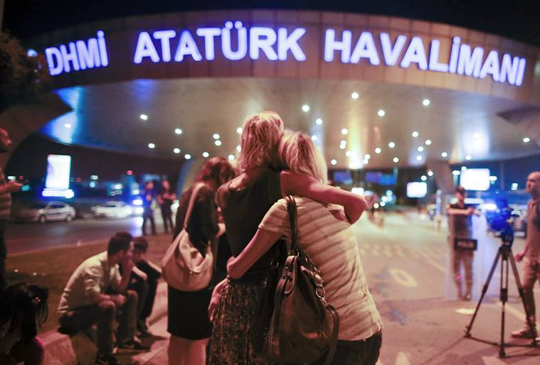
Dad murders wife, mother and SIX
Children after losing temper over
His son’s ‘parrot’ haircut

Slide 5
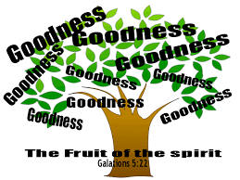
I. WHAT IS GOODNESS?
It is not just “doing” good things.

Slide 6
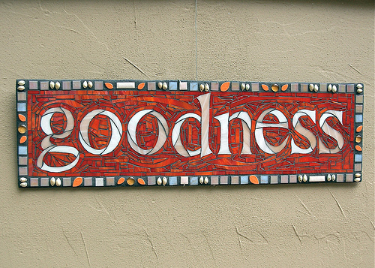
"Goodness means something that pleases God."
"A good person is a person who is pleasing to God."
The Bible also tells us that "God is good."

Slide 7
WHAT IS GOODNESS?
‘Goodness consists not just in the outward things we do but in the inward thing we are’.
Edwin Chaplin
It is not just “doing” good things.
"A good person is a person who is pleasing to God."

Slide 8
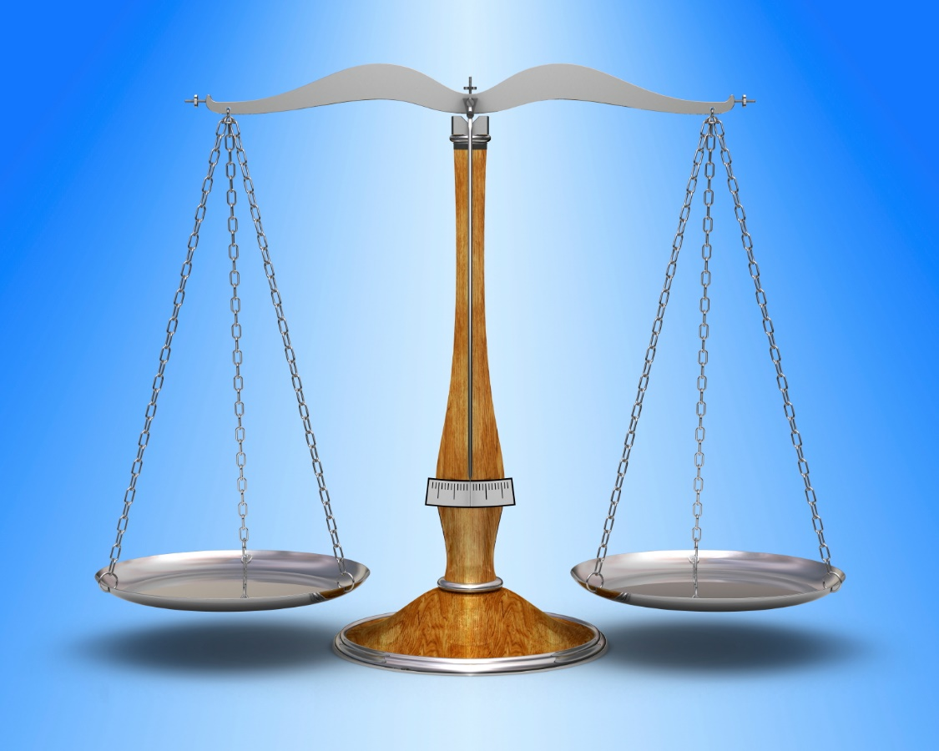
II. WHO DOES GOD CONSIDER GOOD?
It is all about the balance.
Where do I sit on the scales?

Slide 9
Matthew 19:16-22
God is the standard of goodness.
“Why do you call me good?” Jesus answered. “No one is good—except God alone.
Mark 10:18 (NIV)
Goodness is to be found not in our own resources, but in keeping God’s standards, and reflecting His character.

Slide 10
II. WHO DOES GOD CONSIDER GOOD?
The person who Obeys God’s commandments is good.
¹⁶ Just then a man came up to Jesus and asked, “Teacher, what good thing must I do to get eternal life?”
¹⁷ “Why do you ask me about what is good?” Jesus replied. “There is only One who is good. If you want to enter life, keep the commandments.”
Matthew 19:16-17 (NIV)

Slide 11
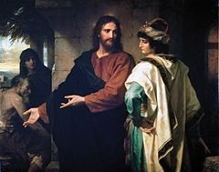
Jesus and the rich young man
For the rich, young man his “other god” was wealth.

Slide 12
Jesus and the rich young man
‘Goodness consists not just in the outward things we do but in the inward thing we are’.
Edwin Chaplin
Love of money is the evil hiding in his soul.

Slide 13
II. WHO DOES GOD CONSIDER GOOD?
b) The person who denies himself/herself is good.
²⁰ “All these I have kept,” the young man said. “What do I still lack?” ²¹ Jesus answered, “If you want to be perfect, go, sell your possessions and give to the poor, and you will have treasure in heaven. Then come, follow me.”
Matthew 19:20-21 (NIV)

Slide 14
The fruit of the Spirit is not achieved through self-effort.
We need surrender our lives to God in completely obedience and let Him work in our hearts so that the fruit of the Spirit can grow and then flow out from ourselves to others.

Slide 15
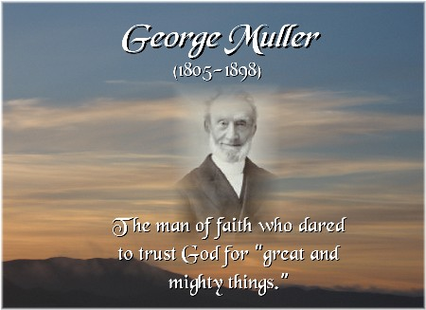
‘Secret death’
‘I died to George Muller, his opinions, preferences, tastes and will; died to the world, its approval or censure; died to the approval or blame even of my brethren and friends; and since then I have studied only to show myself approved of God’.
We need to deny ourselves to die every day to do the good works, he has prepared for us to do.

Slide 16
Ephesians 2:8-10
⁸ For it is by grace you have been saved, through faith—and this is not from yourselves, it is the gift of God— ⁹ not by works, so that no one can boast. ¹⁰ For we are God’s handiwork, created in Christ Jesus to do good works, which God prepared in advance for us to do.
“…all our righteous acts are like filthy rags;”
Isaiah 64:6
This fruit will be a reality not when we strain to be good but when we surrender to goodness.

Slide 17
II. WHO DOES GOD CONSIDER GOOD?
c) The person who uses his/her talents to glorify God is good.
‘Goodness is the impression a Christian makes as he or she moves on their way, happily unaware of the fact that in their conduct they remind people of Jesus Christ’.
Our biggest enemy is ourselves.
Paul often warned about “the flesh”

Slide 18
¹⁹ The acts of the flesh are obvious: sexual immorality, impurity and debauchery; ²⁰ idolatry and witchcraft; hatred, discord, jealousy, fits of rage, selfish ambition, dissensions, factions ²¹ and envy; drunkenness, orgies, and the like. I warn you, as I did before, that those who live like this will not inherit the kingdom of God.
Galatians 5:19-21 (NIV)
There is only one force that can defeat human nature—the power of God’s Spirit

Slide 19
c) The person who uses his/her talents to glorify God is good.
“His master replied, ‘Well done, good and faithful servant! You have been faithful with a few things; I will put you in charge of many things. Come and share your master’s happiness!’
²² “The man with two bags of gold also came. ‘Master,’ he said, ‘you entrusted me with two bags of gold; see, I have gained two more.’ ²³ “His master replied, ‘Well done, good and faithful servant! You have been faithful with a few things; I will put you in charge of many things. Come and share your master’s happiness!’
Matthew 25:21-23 (NIV)

Slide 20
Although the key to success is the power of God’s Spirit, we have our part to do.
So I say, walk by the Spirit, and you will not gratify the desires of the flesh.
Galatians 5:16 (NIV)
“For the flesh desires what is contrary to the Spirit, and the Spirit what is contrary to the flesh. They are in conflict with each other, so that you are not to do whatever you want.”
Galatians 5:17 (NIV)

Slide 21
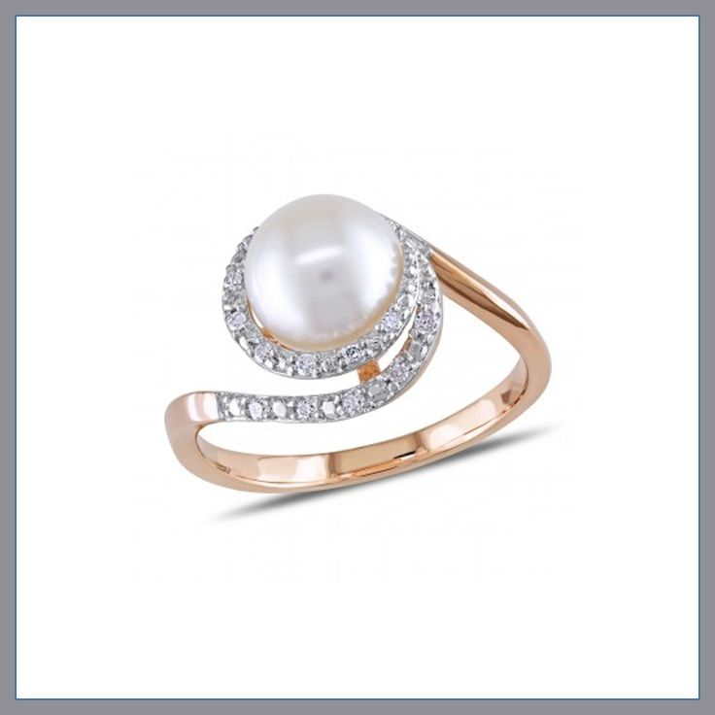
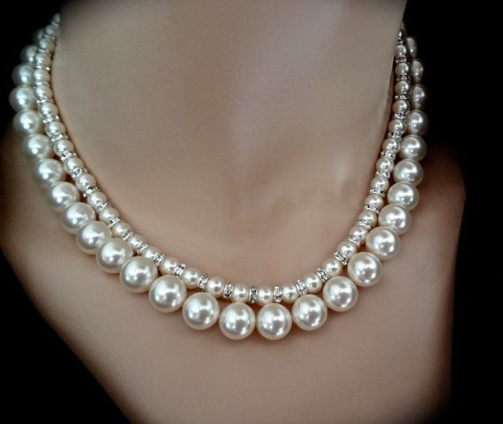
Pearls

Slide 22
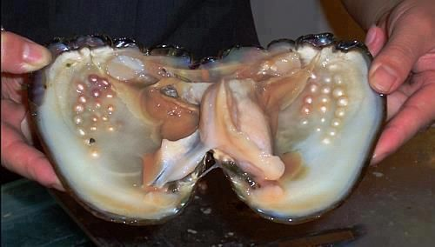
Do you know where pearls come from?
Oyster
Occasionally, a foreign substance (an infection), such as a grain of sand, may find its way into the oyster and get stuck between the mantle and the shell.
This irritates the mantle, kind of like you might get irritated skin if you get a splinter of wood in your finger.

Slide 23
“I myself am convinced, my brothers and sisters, that you yourselves are full of goodness, filled with knowledge and competent to instruct one another.”
Romans 15:14 (NIV)
“A person who is pleasing to God.”

Slide 24
Who does God consider good?
The person who Obeys God’s commandments is good.
b) The person who denies himself/herself is good.
c) The person who uses his/her talents to glorify God is good.
Goodness will never get us into heaven. We will never be good enough to get into heaven.
It’s only through the mercy and grace of God that we can be saved.

Slide 25
Are you ready to see what God can do with you?

