Slide 1
Psalm 96 - He is coming!

Slide 3
Declare his glory among the nations, his marvellous deeds among all peoples. Verse 3

Slide 4
Ascribe to the lord, o families of nations, ascribe to the lord glory and strength! Verse 7

Slide 5
Say among the nations, “the LORD reigns!” verse 10a

Slide 6
…and all peoples on earth will be blessed through you.
Genesis 12:3

Slide 7
Say among the nations, “The lord reigns.”
Verse 10a

Slide 8
From the west, people will fear the name of the lord, and from the rising of the sun, they will revere his glory.
Isaiah 59:19a

Slide 9
… my house will be called a house of prayer for all nations.
Isaiah 56:7B

Slide 10
Ascribe to the Lord, all you families of nations, ascribe to the Lord glory and strength. Ascribe to the Lord the glory due his name; Psalm 96 7-8a

Slide 11
Sing to the Lord a new song; sing to the Lord, all the earth.² Sing to the Lord, praise his name; proclaim his salvation day after day.
Psalm 96:1-2

Slide 12
…for he comes, he comes to judge the earth. He will judge the world in righteousness and the peoples in his truth. Psalm 96:13

Slide 13
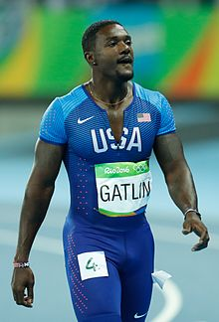

Slide 14
Let the heavens rejoice, let the earth be glad; let the sea resound, and all that is in it. ¹² Let the fields be jubilant, and everything in them; let all the trees of the forest sing for joy. ¹³ Let all creation rejoice before the Lord, for he comes,
Psalm 96:11-13

Slide 15
Joy to the world! The lord is come.

