Slide 1
Galatians 5: 22-23 (NRSV)
By contrast, the fruit of the Spirit is love, joy, peace, patience, kindness, generosity, faithfulness, ²³ gentleness, and self-control. There is no law against such things.

Slide 2
Galatians 5:22 (NRSV)
But the fruit of the Spirit is KINDNESS.

Slide 3
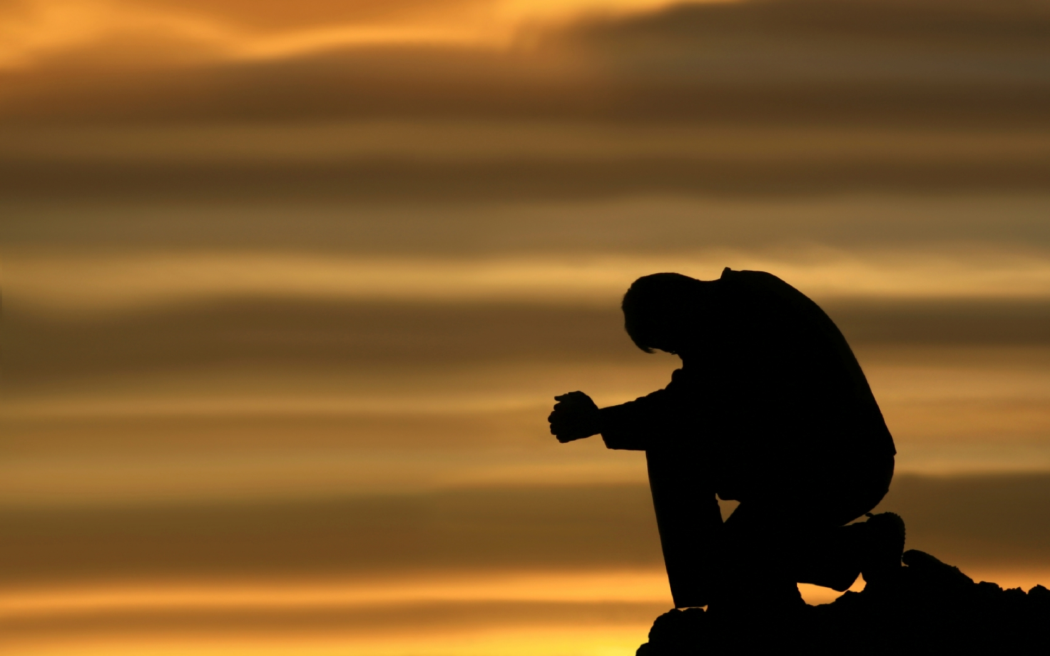
Prayer
Notes:
Isaiah 40.31
Those who wait for the Lord shall renew
their strength,
they shall mount up with wings like eagles,
they shall run and not be weary
they shall walk and not faint.

Slide 4
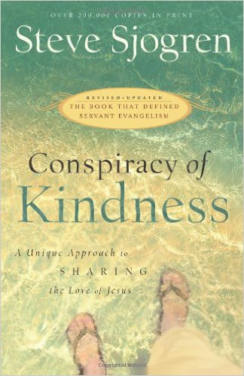

Slide 5
Theologian William Barclay once said;
“More people have been brought into the church by the kindness of real Christian love than by all theological arguments in the world”.

Slide 6
Do not let any unwholesome talk come out of your mouths, but only what is helpful for building others up according to their needs, that it may benefit those who listen. ³⁰ And do not grieve the Holy Spirit of God, with whom you were sealed for the day of redemption. ³¹ Get rid of all bitterness, rage and anger, brawling and slander, along with every form of malice.
Ephesians 4:29-31 (NIV)
These verses tell us how a Believer doesn’t behave.

Slide 7
Be kind and compassionate to one another, forgiving each other, just as in Christ God forgave you.
Ephesians 4:32 (NIV)

Slide 8
I. KINDNESS is our response to God’s Grace.
Why should we show kindness to others?
a) It is the command of God.
b) It is the character of God.
“God demonstrates his own love for us in this: while we were still sinners, Christ died for us.”
Romans 5:8

Slide 9
We don’t perform acts of kindness to earn God’s mercy and forgiveness; we perform good deeds because we have been forgiven.

Slide 10
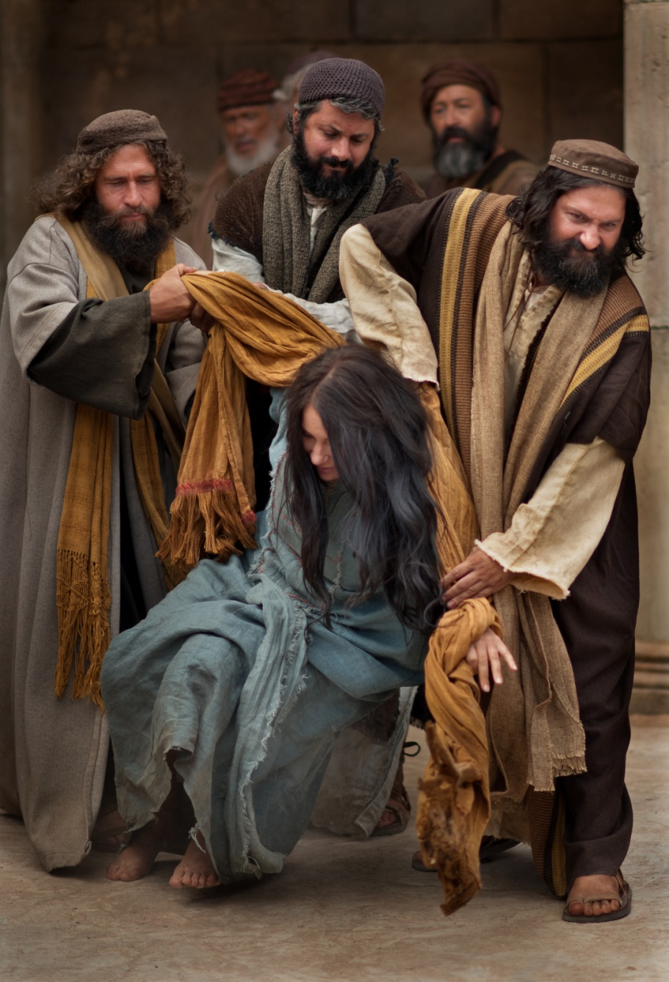
The woman caught in adultery.
“In the Law Moses commanded us to stone such women. Now what do you say?”
John 8:5 (NIV)

Slide 11
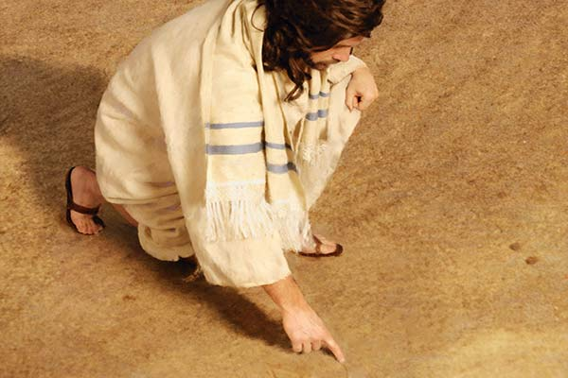
The woman caught in adultery.
“…Jesus said, “I do not condemn you either. Go, but do not sin again.”
John 8:11 (NIV)
Kindness aims to help those on whom it rests.

Slide 12
II. We should direct our KINDNESS toward strangers.
Ella Wheeler Wilcox says in her poem ‘The World’s Need’
So many gods, so many creeds,
So many paths that wind and wind,
When all that this sad world needs,
Is just the art of being kind.
“Love your neighbour as yourself,”

Slide 13
“Love your neighbour as yourself,”
If all you do is love the lovable, do you expect a bonus? Anybody can do that. If you simply say hello to those who greet you, do you expect a medal? Any run-of-the-mill sinner does that. Matthew 5:46-47 (The Message)

Slide 14
III. We should perform our KINDNESS in the name of JESUS
The whole point of kindness is
to give glory and honour to Jesus Christ.
Jesus said, “Let your light shine before men, that they may see your good deeds and praise your Father in heaven.”
Matthew 5:16

Slide 15
IV. KINDNESS is planting seeds of the GOSPEL
“Evangelism” means “sharing the message of good news.”
“For most Christians, doing evangelism is a lot like going to the dentist; no one really enjoys doing it, but it must done once in a while. But anyone can do simple acts of kindness...People don’t necessarily remember what they are TOLD of God’s love, but they never forget what they have EXPERIENCED of God’s love.”
(Conspiracy of Kindness, pp. 26,30)
God imparted KINDNESS

Slide 16
God imparted KINDNESS
Ella Wheeler Wilcox says in her poem ‘The World’s Need’
So many gods, so many creeds,
So many paths that wind and wind,
When all that this sad world needs,
Is just the art of being kind.

Slide 17
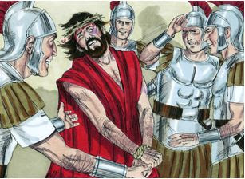
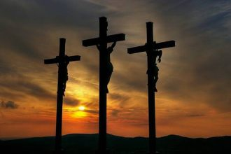
"Jesus, remember me when you come into your kingdom."
"Father, forgive them, for they do not know what they are doing."
"I tell you the truth, today you will be with me in paradise."

Slide 18
“…Jesus said, “I do not condemn you either. Go, but do not sin again.”
John 8:11 (NIV)
God shows kindness to those who do not deserve it. We are to do the same.

Slide 19
"Kindness is the attitude God has when he interacts with people. God has a right to insist on our immediate and total conformity to His will, and He could be quite harsh with us in getting us to conform. But He is not harsh. He treats us as a good father might treat a learning child. This is our pattern.
If Christians are to show kindness, they must act towards others as God has acted towards them”
James Montgomery Boice

Slide 20
God KINDNESS made provision for our salvation from sin.
³ At one time we too were foolish, disobedient, deceived and enslaved by all kinds of passions and pleasures. We lived in malice and envy, being hated and hating one another. ⁴ But when the kindness and love of God our Saviour appeared, ⁵ he saved us, not because of righteous things we had done, but because of his mercy.
Titus 3:3-5 (NIV)

Slide 21
“Kindness is treating others in the same way that God has treated you”
1) KINDNESS is our response to the Grace of God.
2) Let’s direct our KINDNESS toward strangers.
3) Let’s perform our KINDNESS in the name of JESUS.
4) Remember, KINDNESS is planting seed of the GOSPEL

Slide 22
“Or perhaps you despise his great kindness, tolerance, and patience. Surely you know that God is kind, because he is trying to lead you to repent.”
Romans 2:4 (GNT)
Are you willing to receive God’s kindness, today?

