Slide 1
Philippians 4:6-7, 10 (NIV)
⁶ Do not be anxious about anything, but in every situation, by prayer and petition, with thanksgiving, present your requests to God. ⁷ And the peace of God, which transcends all understanding, will guard your hearts and your minds in Christ Jesus… ¹⁰ I rejoiced greatly in the Lord that at last you renewed your concern for me. Indeed, you were concerned, but you had no opportunity to show it…

Slide 2
Philippians 4:11-13 (NIV)
¹¹ I am not saying this because I am in need, for I have learned to be content whatever the circumstances.¹² I know what it is to be in need, and I know what it is to have plenty. I have learned the secret of being content in any and every situation, whether well fed or hungry, whether living in plenty or in want. ¹³ I can do all this through him who gives me strength.

Slide 3
Let’s pray…

Slide 4
Learning to be content
Have you been content in all of the circumstances you have faced?
The answer lies in our position (Our Faith and Prayer life), our priorities, and our source of power.
a) in our position (Faith and Prayer life),
b) in our priorities,
c) And in our source of power.

Slide 5
I. Our position (Our faith and Prayer Life)
⁶ Do not be anxious about anything, but in every situation, by prayer and petition, with thanksgiving, present your requests to God.
Philippians 4:6 (NIV)
And the peace of God,
which transcends all understanding,
will guard your hearts
and your minds in Christ Jesus…

Slide 6
¹⁰ I rejoiced greatly in the Lord that at last you renewed your concern for me. Indeed, you were concerned, but you had no opportunity to show it.
Philippians 4:10 (NIV)
we multiply our problems and
we tend not to count our blessings…

Slide 7
II. Our priorities
¹² I know what it is to be in need, and I know what it is to have plenty. I have learned the secret of being content in any and every situation, whether well fed or hungry, whether living in plenty or in want.
Philippians 4:12 (NIV)
“I have been crucified with Christ and I no longer live, but Christ lives in me. The life I now live in the body, I live by faith in the Son of God, who loved me and gave himself for me.”
Galatians 2:20 (NIV)

Slide 8
Our priorities as believers should be
to “seek to please Jesus”
And to quit worrying about pleasing people.
Jesus said; “But seek first His kingdom and His righteousness, and all these things will be given to you as well.”
Matthew 6:33 (NIV)

Slide 9
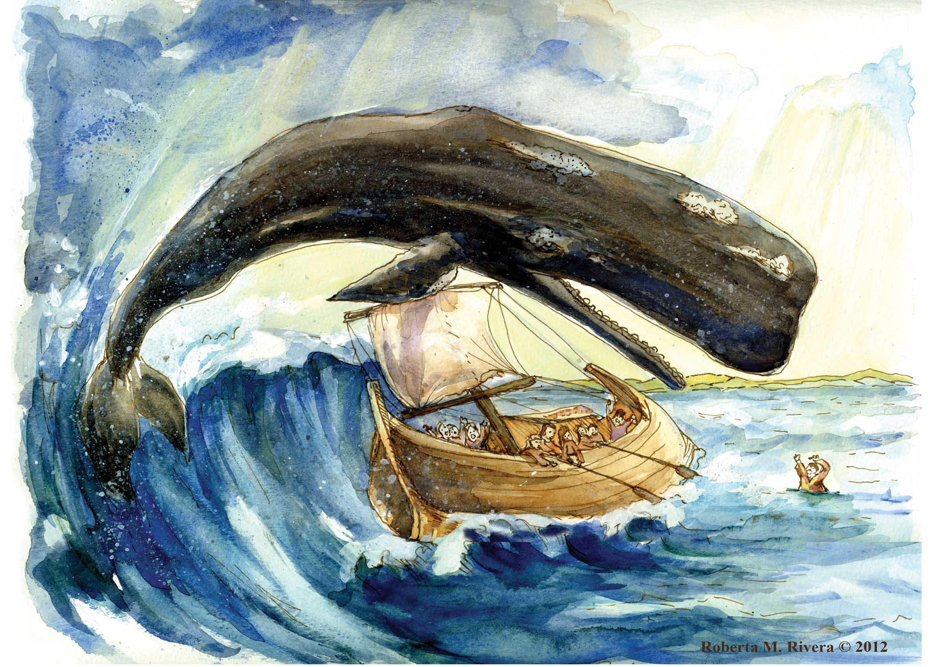
Jonah

Slide 10
“We are not always called to understand but to stand”
2 Peter 3:9 (NIV)
"The Lord is not slow in keeping His promise, as some understand slowness. He is patient with you, not wanting anyone to perish, but everyone to come to repentance."

Slide 11

What are our priorities in life?
In what place is God?
“We are not always called to understand but to stand”

Slide 12

"Day by day and with each passing moment, Strength I find to meet my trials here; Trusting in my Father's wise bestowment, I've no cause for worry or for fear.”
Swedish hymnist Lina Sandell Berg

Slide 13
III. Our source of power
“I can do all this through him who gives me strength.”
Philippians 4:13 (NIV)
How do you draw on the power of Christ?

Slide 14
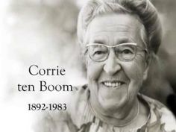
The Christian is the glove.
It is the Holy Spirit (the hand) in us who does the work.

Slide 15
Have you been content in all of circumstances you have faced?
Philippians 4:6-7 (NIV)
⁶ Do not be anxious about anything, but in every situation, by prayer and petition, with thanksgiving, present your requests to God. ⁷ And the peace of God, which transcends all understanding, will guard your hearts and your minds in Christ Jesus…
How can you find true contentment?

Slide 16
The answer lies in your faith (your position),
your priorities, and you source of power.
Isaiah 26:3(NIV)
You will keep in perfect peace those whose minds are steadfast, because they trust in you.

