Slide 1
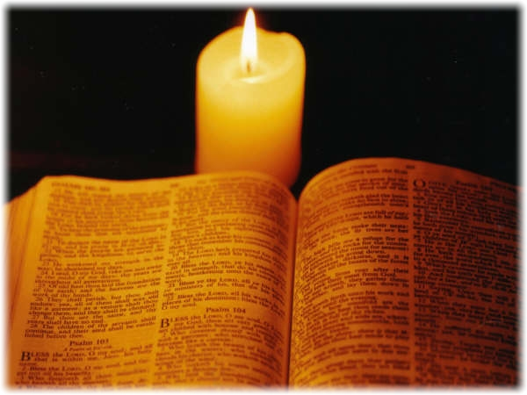
Notes:
Isaiah 40.31
Those who wait for the Lord shall renew
their strength,
they shall mount up with wings like eagles,
they shall run and not be weary
they shall walk and not faint.

Slide 2
Galatians 5: 22-23 (NRSV)
By contrast, the fruit of the Spirit is love, joy, peace, patience, kindness, generosity, faithfulness, ²³ gentleness, and self-control. There is no law against such things.
Notes:
Isaiah 40.31
Those who wait for the Lord shall renew
their strength,
they shall mount up with wings like eagles,
they shall run and not be weary
they shall walk and not faint.

Slide 3
Galatians 5:22 (NRSV)
But the fruit of the Spirit is PATIENCE.
Notes:
Isaiah 40.31
Those who wait for the Lord shall renew
their strength,
they shall mount up with wings like eagles,
they shall run and not be weary
they shall walk and not faint.

Slide 4
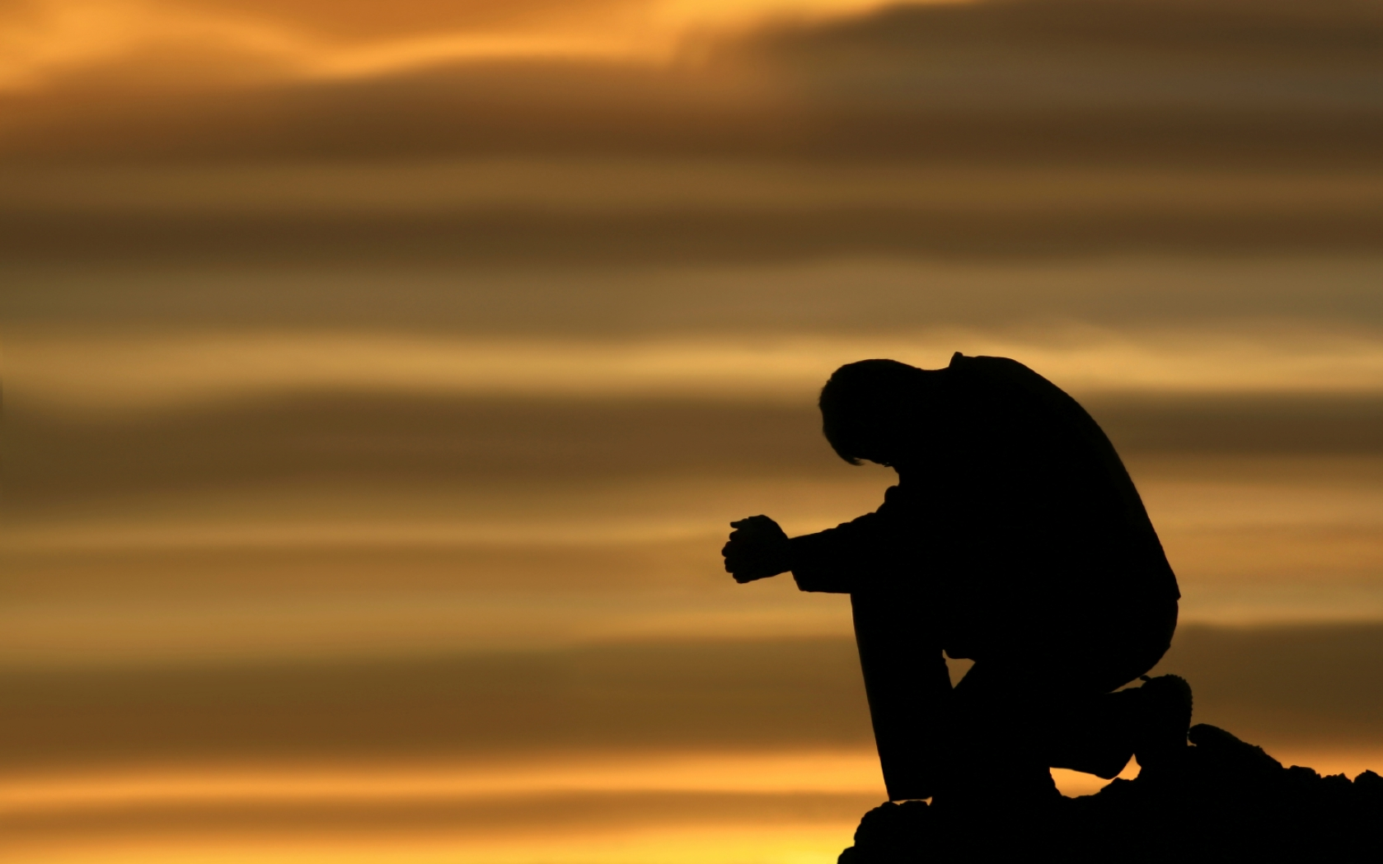
Prayer
Notes:
Isaiah 40.31
Those who wait for the Lord shall renew
their strength,
they shall mount up with wings like eagles,
they shall run and not be weary
they shall walk and not faint.

Slide 5
I. What Is Patience?
True patience is waiting without worrying.
C. Swindoll, Growing Strong, p. 124.
"Patience is the powerful attribute that enables a man or woman to remain steadfast under strain - and continue pressing on."
"Patience is a calm endurance based on the certain knowledge that God is in control."
Bill Gothard
Notes:
Offering: Great Is He

Slide 6
First word is Anecho:
(From 2 Greek words, "UP" & "HOLD" )
Ephesians 4:1-2 (NIV)
As a prisoner for the Lord, then, I urge you to live a life worthy of the calling you have received. ² Be completely humble and gentle; be patient, bearing with one another in love.
The idea is to sustain, or patiently bear with something or someone.

Slide 7
Hupomone:
(From 2 Greek words, "UNDER" & "ABIDE.")
James 1:3-4 (KJV)
³ Knowing this, that the trying of your faith worketh patience. ⁴ But let patience have her perfect work, that ye may be perfect and entire, wanting nothing.
The idea is that it’s the patience that bears up under a load and provides steadiness in the midst of life’s battles. It’s the patience that allows a person to endure.

Slide 8
Makrothumia:
(makros= SLOW, thumos= ANGER)
Galatians 5:22 (NRSV)
But the fruit of the Spirit is PATIENCE.
It means, slow to get mad. In other words it’s the opposite of a short temper.

Slide 9
II. IT IS DIFFICULT TO DEVELOP PATIENCE
a) Developing patience is difficult because it goes against human nature.
b) It’s difficult because there are weeds of pride, selfishness and anger that can choke out the fruit of patience.
c) Thirdly, patience is difficult to develop because it’s contrary to our culture.
Notes:
Isaiah 40.31
Those who wait for the Lord shall renew
their strength,
they shall mount up with wings like eagles,
they shall run and not be weary
they shall walk and not faint.

Slide 10
Proverbs 14:29 (NIV)
Whoever is patient has great understanding, but one who is quick-tempered displays folly.
Proverbs 15:18 (NIV)
A hot-tempered person stirs up conflict, but the one who is patient calms a quarrel.
Notes:
Isaiah 40.31
Those who wait for the Lord shall renew
their strength,
they shall mount up with wings like eagles,
they shall run and not be weary
they shall walk and not faint.

Slide 11
III. Where Does Patience Come From?
1. It comes from the Spirit of God, it is a fruit of the Holy Spirit.
2. The reason we can get patience from God is because God is patience.
Notes:
Isaiah 40.31
Those who wait for the Lord shall renew
their strength,
they shall mount up with wings like eagles,
they shall run and not be weary
they shall walk and not faint.

Slide 12
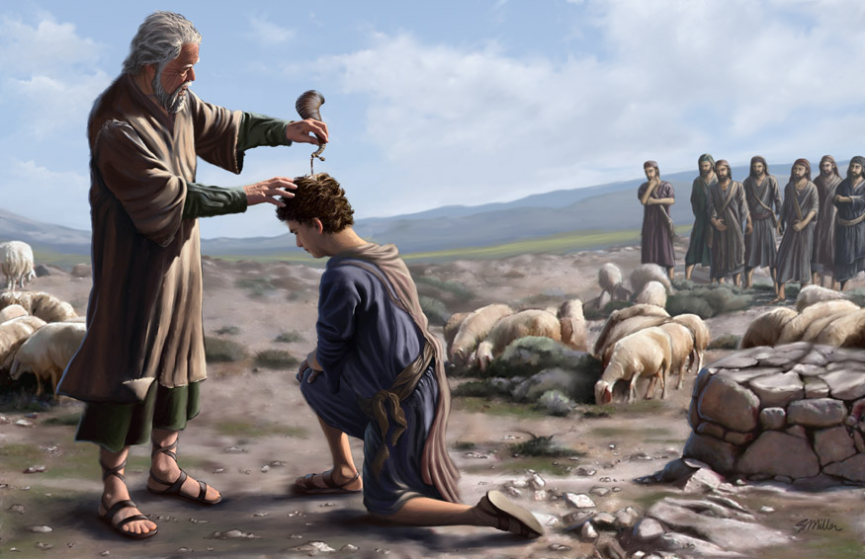
Notes:
Isaiah 40.31
Those who wait for the Lord shall renew
their strength,
they shall mount up with wings like eagles,
they shall run and not be weary
they shall walk and not faint.

Slide 13
Isaiah 40:31
But those who wait on the Lord Shall renew their strength;
They shall mount up with wings like eagles, They shall run and not be weary, They shall walk and not faint
If you want to FLY, RUN, and WALK you must learn to wait on God.
(Wade Hughes)
Notes:
Isaiah 40.31
Those who wait for the Lord shall renew
their strength,
they shall mount up with wings like eagles,
they shall run and not be weary
they shall walk and not faint.

Slide 14
IV. HOW DO WE DEVELOP PATIENCE?
1) "Abide in Christ."
"I am the vine; you are the branches. If a man abides in me and I in him, he will bear much fruit; apart from me you can do nothing.“
John 15:5
“God can show Himself as He really is only to…men[and women] who are united together in a body, loving one another, helping one another, showing Him to one another…consequently the only really adequate instrument for learning about God is the whole Christian community, waiting for Him together”
C.S. Lewis.
Notes:
Isaiah 40.31
Those who wait for the Lord shall renew
their strength,
they shall mount up with wings like eagles,
they shall run and not be weary
they shall walk and not faint.

Slide 15
There are other things that we can do. For example:
“We can slow down”.
“Trust in God”.
Exodus 14:13 (NIV)
Moses answered the people, “Do not be afraid. Stand firm and you will see the deliverance the Lord will bring you today. The Egyptians you see today you will never see again.
Exodus 14:14 (NIV)
The Lord will fight for you; you need only to be still.”
Notes:
Isaiah 40.31
Those who wait for the Lord shall renew
their strength,
they shall mount up with wings like eagles,
they shall run and not be weary
they shall walk and not faint.

Slide 16
JESUS IS THE PERFECT EXAMPLE OF PATIENCE
2 Peter 3:9 (NIV)
"The Lord is not slow in keeping His promise, as some understand slowness. He is patient with you, not wanting anyone to perish, but everyone to come to repentance."
Exodus 14:14 (NIV)
The Lord will fight for you; you need only to be still.”
Notes:
Isaiah 40.31
Those who wait for the Lord shall renew
their strength,
they shall mount up with wings like eagles,
they shall run and not be weary
they shall walk and not faint.

Slide 17
The door of salvation is open because the Lord is patient. The door to Jesus is open because the Lord is patient. Right now, the opportunity for us to be saved from our sins is still available, because the Lord is patient.
Galatians 5:22 (NIV)
But the fruit of the Spirit is PATIENCE...
Notes:
Isaiah 40.31
Those who wait for the Lord shall renew
their strength,
they shall mount up with wings like eagles,
they shall run and not be weary
they shall walk and not faint.

Slide 18
Prayer
Notes:
Isaiah 40.31
Those who wait for the Lord shall renew
their strength,
they shall mount up with wings like eagles,
they shall run and not be weary
they shall walk and not faint.

