Slide 1
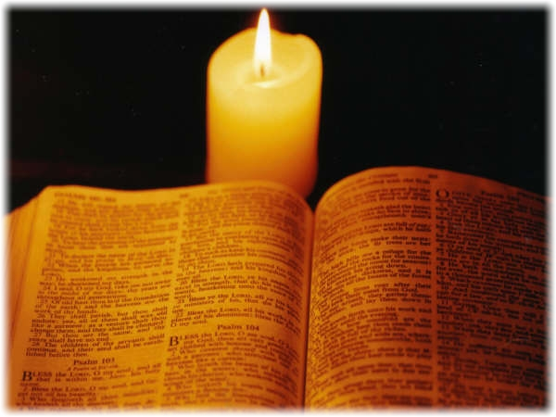
Notes:
Isaiah 40.31
Those who wait for the Lord shall renew
their strength,
they shall mount up with wings like eagles,
they shall run and not be weary
they shall walk and not faint.

Slide 2
Galatians 5: 22-23 (NIV)
²² But the fruit of the Spirit is love, joy, peace, forbearance, kindness, goodness, faithfulness, ²³ gentleness and self-control. Against such things there is no law.
Notes:
Isaiah 40.31
Those who wait for the Lord shall renew
their strength,
they shall mount up with wings like eagles,
they shall run and not be weary
they shall walk and not faint.

Slide 3
Galatians 5:22 (NIV)
But the fruit of the Spirit is PEACE.
Notes:
Isaiah 40.31
Those who wait for the Lord shall renew
their strength,
they shall mount up with wings like eagles,
they shall run and not be weary
they shall walk and not faint.

Slide 4
Prayer
Notes:
Isaiah 40.31
Those who wait for the Lord shall renew
their strength,
they shall mount up with wings like eagles,
they shall run and not be weary
they shall walk and not faint.

Slide 5
Society of International Law, in London, states that during the last 4,000 years there have been only 268 years of peace in spite of good peace treaties.
In the last 3 centuries there have been 286 wars on the continent of Europe alone.
J.K. Laney, Marching Orders, p 50.
Peace is not to be found outside of the human heart.
PEACE is to be found inside our hearts through a relationship with our Creator God.
Notes:
Offering: Great Is He

Slide 6
“Completeness and harmony.”
‘Is joy grown quiet and assured’.
PEACE is a fruit
of the Holy Spirit

Slide 7
I. UPWARD PEACE- PEACE WITH GOD.
“The God of peace will soon crush Satan under your feet. The grace of our Lord Jesus be with you.”
Romans 16:20 (NIV)
Isaiah 9:6 (NIV)
For to us a child is born, to us a son is given, and the government will be on his shoulders. And he will be called Wonderful Counselor, Mighty God, Everlasting Father, Prince of Peace.
Notes:
Isaiah 40.31
Those who wait for the Lord shall renew
their strength,
they shall mount up with wings like eagles,
they shall run and not be weary
they shall walk and not faint.

Slide 8
“Peace I leave with you; my peace I give you.
I do not give to you as the world gives. Do not let your hearts be troubled and do not be afraid.”
John 14:27 (NIV)
THIS IS AN UPWARD PEACE.
Notes:
Isaiah 40.31
Those who wait for the Lord shall renew
their strength,
they shall mount up with wings like eagles,
they shall run and not be weary
they shall walk and not faint.

Slide 9
Ephesians 2:14 (NIV)
¹⁴ For he himself is our peace, …
Therefore, since we have been justified through faith, we have peace with God through our Lord Jesus Christ, ² through whom we have gained access by faith into this grace in which we now stand.
Romans 5:1-2 (NIV)
Notes:
Isaiah 40.31
Those who wait for the Lord shall renew
their strength,
they shall mount up with wings like eagles,
they shall run and not be weary
they shall walk and not faint.

Slide 10
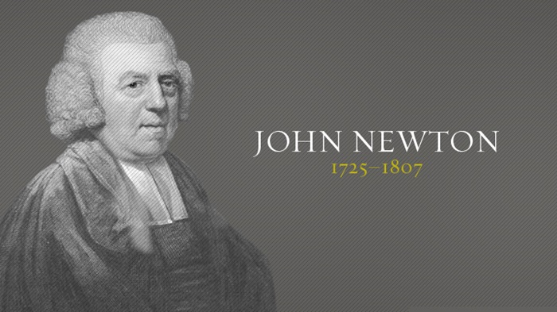
1 John 1:9 (NIV)
If we confess our sins, he is faithful and just and will forgive us our sins and purify us from all unrighteousness.
UPWARD PEACE- PEACE WITH GOD.
Notes:
Isaiah 40.31
Those who wait for the Lord shall renew
their strength,
they shall mount up with wings like eagles,
they shall run and not be weary
they shall walk and not faint.

Slide 11
II. INWARD PEACE- PEACE OF GOD
This is the peace that Comes when we face Dark times.
“The peace of God, which transcends all understanding, will guard your hearts and your minds in Christ Jesus.”
Philippians 4:7 (NIV)
Do you have that inner peace of God?
Notes:
Isaiah 40.31
Those who wait for the Lord shall renew
their strength,
they shall mount up with wings like eagles,
they shall run and not be weary
they shall walk and not faint.

Slide 12
Philippians 4:6 (NIV)
“Do not be anxious about anything, but in everything, by prayer and petition, with thanksgiving present your requests to God, and the peace of God, which transcends all understanding, will guard your hearts and your minds in Christ Jesus.”
THIS IS INWARD PEACE- PEACE OF GOD
Notes:
Isaiah 40.31
Those who wait for the Lord shall renew
their strength,
they shall mount up with wings like eagles,
they shall run and not be weary
they shall walk and not faint.

Slide 13
Horatio Gates Spafford (October 20, 1828, Troy, New York – October 16, 1888, Jerusalem) was a prominent American lawyer and Presbyterian church elder. He is best known for penning the Christian hymn It Is Well With My Soul, following a family tragedy in which his four daughters died aboard the S.S. Ville du Havre
Notes:
Isaiah 40.31
Those who wait for the Lord shall renew
their strength,
they shall mount up with wings like eagles,
they shall run and not be weary
they shall walk and not faint.

Slide 14
It Is Well With My Soul,
When peace like a river, attendeth my way, When sorrows like sea billows roll Whatever my lot, thou hast taught me to say It is well, it is well, with my soul
It is well With my soul It is well, it is well with my soul
Isaiah 26:3
“God will keep in perfect peace him whose mind is steadfast, because he trusts in you.”
Notes:
Isaiah 40.31
Those who wait for the Lord shall renew
their strength,
they shall mount up with wings like eagles,
they shall run and not be weary
they shall walk and not faint.

Slide 15
III. OUTWARD PEACE- PEACE WITH ONE ANOTHER
This comes when we face our friends.
Philippians 4:1-3
Therefore, my brothers and sisters, you whom I love and long for,my joy and crown, stand firm in the Lord in this way, dear friends! ² I plead with Euodia and I plead with Syntyche to be of the same mind in the Lord. ³ Yes, and I ask you, my true companion, help these women since they have contended at my side in the cause of the gospel, along with Clement and the rest of my co-workers, whose names are in the book of life.
Notes:
Isaiah 40.31
Those who wait for the Lord shall renew
their strength,
they shall mount up with wings like eagles,
they shall run and not be weary
they shall walk and not faint.

Slide 16
The prince of peace.
Peace is all about relationships. And the way we treat one another mirrors our relationship with God.
Will you be at peace with your loved ones?
Acronym for peace in your home, church and marriage.
Notes:
Isaiah 40.31
Those who wait for the Lord shall renew
their strength,
they shall mount up with wings like eagles,
they shall run and not be weary
they shall walk and not faint.

Slide 17
PLAN YOUR ACTION
EMPATHIZE WITH THEIR FEELINGS
ATTACK THE PROBLEM, NOT THE PERSON
COOPERATE AS MUCH AS POSSIBLE
Emphasize reconciliation not resolution
Notes:
Isaiah 40.31
Those who wait for the Lord shall renew
their strength,
they shall mount up with wings like eagles,
they shall run and not be weary
they shall walk and not faint.

Slide 18
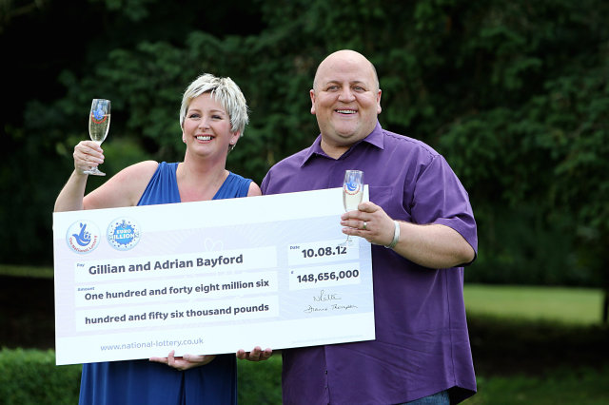
We can have a lot of things in life, but if we don't have PEACE, we're never going to truly enjoy our lives the way God intended.
Notes:
Isaiah 40.31
Those who wait for the Lord shall renew
their strength,
they shall mount up with wings like eagles,
they shall run and not be weary
they shall walk and not faint.

Slide 19
I. UPWARD PEACE- PEACE WITH GOD.
II. INWARD PEACE- PEACE OF GOD
III. OUTWARD PEACE- PEACE WITH ONE ANOTHER
Notes:
Isaiah 40.31
Those who wait for the Lord shall renew
their strength,
they shall mount up with wings like eagles,
they shall run and not be weary
they shall walk and not faint.

Slide 20
Let the Holy Spirit do his wonderful work within you.
Isaiah 26:3
“God will keep in perfect peace him whose mind is steadfast, because he trusts in you.”
Galatians 5:22 (NIV)
But the fruit of the Spirit is PEACE...
Notes:
Isaiah 40.31
Those who wait for the Lord shall renew
their strength,
they shall mount up with wings like eagles,
they shall run and not be weary
they shall walk and not faint.

Slide 21
Prayer
Notes:
Isaiah 40.31
Those who wait for the Lord shall renew
their strength,
they shall mount up with wings like eagles,
they shall run and not be weary
they shall walk and not faint.

