Slide 1
2 Corinthians 3:2-3 2 You yourselves are our letter, written on our hearts, known and read by everybody. 3 You show that you are a letter from Christ, the result of our ministry, written not with ink but with the Spirit of the living God, not on tablets of stone but on tablets of human hearts.

Slide 3
Therefore, since through God’s mercy we have this ministry, we do not lose heart. ² Rather, we have renounced secret and shameful ways; we do not use deception, nor do we distort the word of God. On the contrary, by setting forth the truth plainly we commend ourselves to everyone’s conscience in the sight of God. ³ And even if our gospel is veiled, it is veiled to those who are perishing.
2 Corinthians 4:1-3 (NIV)

Slide 4
Is there really more than one gospel? Some would say, “Of course not! There’s only one gospel.” And in a sense they are right when they are speaking of a body of truth. The Apostle Paul referred to this in 1 Corinthians 15:1-4

Slide 5
1 Corinthians 15:1-4
Now, brothers and sisters, I want to remind you of the gospel I preached to you, which you received and on which you have taken your stand. ² By this gospel you are saved, if you hold firmly to the word I preached to you. Otherwise, you have believed in vain.
³ For what I received I passed on to you as of first importance: that Christ died for our sins according to the Scriptures, ⁴ that he was buried, that he was raised on the third day according to the Scriptures,

Slide 6
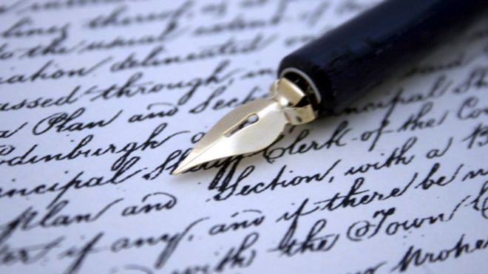

Slide 7
EVERY CHRISTIAN WHETHER HE/SHE LIKES IT OR NOT, IS AN ADVERTISEMENT FOR CHRISTIANITY. The honour of Christ is in the hands of His followers.

Slide 8
I. The Gospel According To You
The church doesn’t need to write but to live
“You are a letter …written not with ink but with the Spirit of the living God,..”

Slide 9
We talk about a cross, but our life does not reflect a life at the cross.

Slide 10
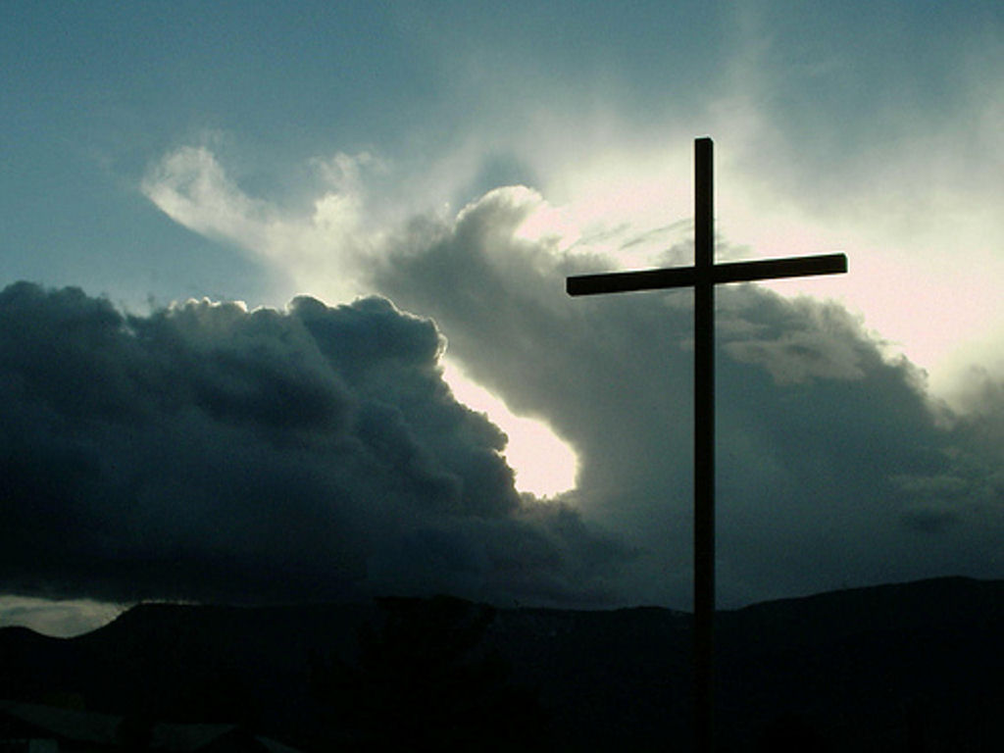
II. An Insufficient Cross
Satan hates the cross. He trembles over the effect it has on his kingdom.

Slide 11
³⁷ When the people heard this, they were cut to the heart and said to Peter and the other apostles, “Brothers, what shall we do?”
³⁸ Peter replied, “Repent and be baptized, every one of you, in the name of Jesus Christ for the forgiveness of your sins. And you will receive the gift of the Holy Spirit. ³⁹ The promise is for you and your children and for all who are far off—for all whom the Lord our God will call.”
Acts 2:37-39 (NIV)

Slide 12
Those who want to impress people by means of the flesh are trying to compel you to be circumcised. The only reason they do this is to avoid being persecuted for the cross of Christ. Galatians 6:12

Slide 13
For Christ did not send me to baptize, but to preach the gospel—not with wisdom and eloquence, lest the cross of Christ be emptied of its power.
¹⁸ For the message of the cross is foolishness to those who are perishing, but to us who are being saved it is the power of God.
1 Corinthians 1:17-18 (NIV)
The real power of God comes from the preaching of the cross.

Slide 14
²⁸ “Come to me, all you who are weary and burdened, and I will give you rest. ²⁹ Take my yoke upon you and learn from me, for I am gentle and humble in heart, and you will find rest for your souls. ³⁰ For my yoke is easy and my burden is light.”
Matthew 11:28-30 (NIV)
The answer to all our fears, troubles and heart aches, all our guilt and oppression is in our being yoked to Jesus.

Slide 15
⁹ “Then you will be handed over to be persecuted and put to death, and you will be hated by all nations because of me. ¹⁰ At that time many will turn away from the faith and will betray and hate each other, ¹¹ and many false prophets will appear and deceive many people. ¹² Because of the increase of wickedness, the love of most will grow cold, ¹³ but the one who stands firm to the end will be saved. ¹⁴ And this gospel of the kingdom will be preached in the whole world as a testimony to all nations, and then the end will come.
Matthew 24:9:14 (NIV)

Slide 16
III. Don’t Run From the Cross
“Whoever wants to be my disciple must deny themselves and take up their cross daily and follow me.
Luke 9:23 (NIV)
And whoever does not carry their cross and follow me cannot be my disciple.
Luke 14:27 (NIV)

Slide 17
III. Don’t Run From the Cross
The basic requirement in being a disciple of Jesus is denying oneself and taking up their cross.

Slide 18
II. Don’t Run From the Cross
¹⁷ Join together in following my example, brothers and sisters, and just as you have us as a model, keep your eyes on those who live as we do. ¹⁸ For, as I have often told you before and now tell you again even with tears, many live as enemies of the cross of Christ.
Philippians 3:17-18 (NIV)

Slide 19
II. Don’t Run From the Cross
“If we surrender ourselves to the cross He will open the fountain of forgiveness, healing and deliverance.”

Slide 20
Writing starts in the brain first then to the heart, then to the hands.
Are we living letters filled with the character of the writer, bringing a message of hope to the readers, like the Corinthians?

