Slide 1

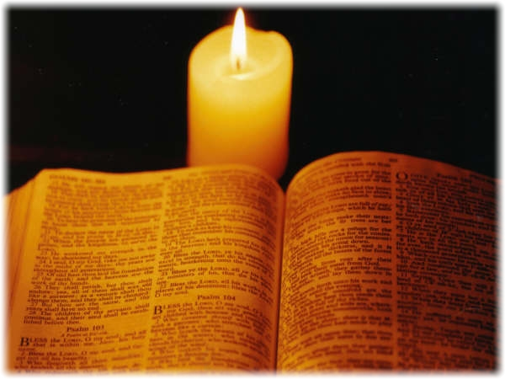
Notes:
Isaiah 40.31
Those who wait for the Lord shall renew
their strength,
they shall mount up with wings like eagles,
they shall run and not be weary
they shall walk and not faint.

Slide 2
Galatians 5: 22-23 (NIV)
²² But the fruit of the Spirit is love, joy, peace, forbearance, kindness, goodness, faithfulness, ²³ gentleness and self-control. Against such things there is no law.
Notes:
Isaiah 40.31
Those who wait for the Lord shall renew
their strength,
they shall mount up with wings like eagles,
they shall run and not be weary
they shall walk and not faint.

Slide 3
Galatians 5:22 (NIV)
But the fruit of the Spirit is JOY.
Notes:
Isaiah 40.31
Those who wait for the Lord shall renew
their strength,
they shall mount up with wings like eagles,
they shall run and not be weary
they shall walk and not faint.

Slide 4
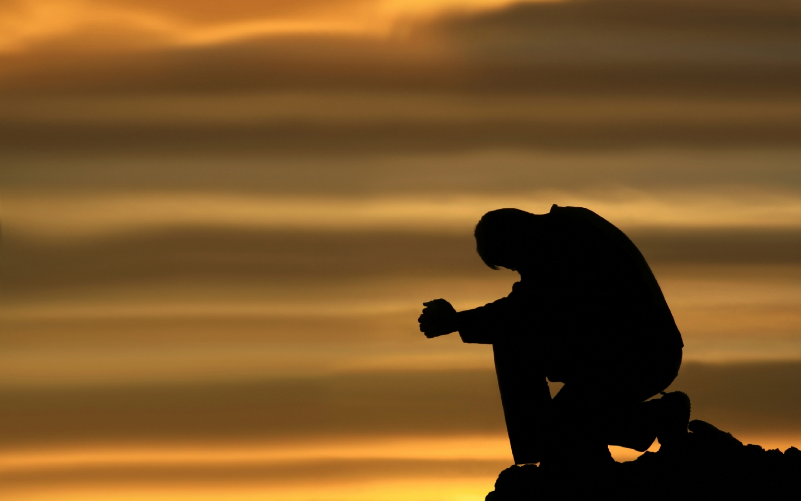
Prayer
Notes:
Isaiah 40.31
Those who wait for the Lord shall renew
their strength,
they shall mount up with wings like eagles,
they shall run and not be weary
they shall walk and not faint.

Slide 5
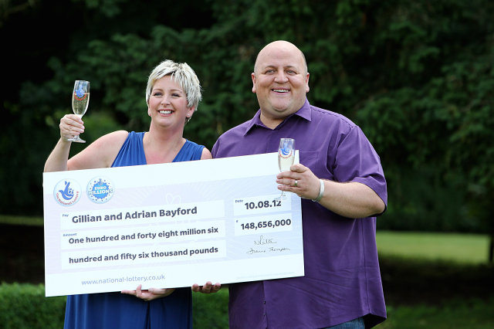


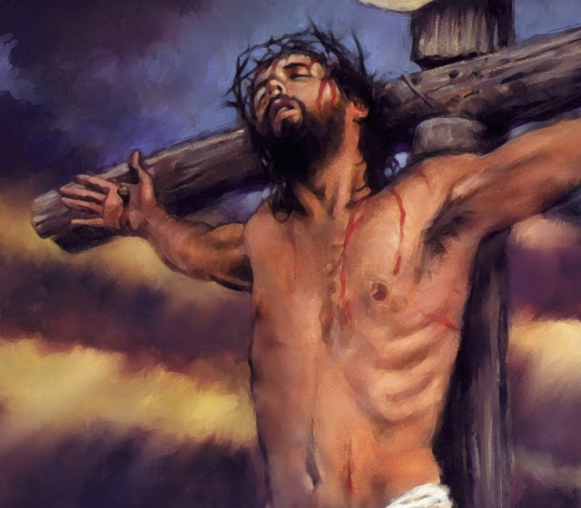
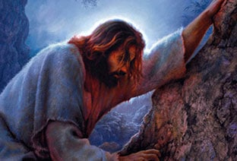
Notes:
Offering: Great Is He

Slide 6
I. Happiness/Pleasure or Joy
Happiness is conditional.
JOY on the other hand is not conditional.
The Hebrew word for joy means “to leap or spin around with pleasure.”
In the New Testament it refers to “gladness, bliss, and celebration.”
The meaning of the Greek word chara, translated JOY is exuberant and overflowing.
Notes:
Isaiah 40.31
Those who wait for the Lord shall renew
their strength,
they shall mount up with wings like eagles,
they shall run and not be weary
they shall walk and not faint.

Slide 7
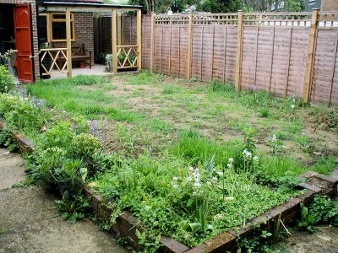
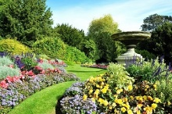
II. Joy requires effort
We must get rid of the things that steal our joy
We need to be aware of the ‘pests” that ruin and steal joy away from us.
Notes:
Isaiah 40.31
Those who wait for the Lord shall renew
their strength,
they shall mount up with wings like eagles,
they shall run and not be weary
they shall walk and not faint.

Slide 8
1) Unfulfilled Expectations
Is your life going the way you want it to?
A spirit of discontentment can rob us of our joy.
“I know what it is to be in need, and I know what it is to have plenty. I have learned the secret of being content in any and every situation, whether well fed or hungry, whether living in plenty or in want.”
Philippians 4:12 (NIV)
Notes:
Isaiah 40.31
Those who wait for the Lord shall renew
their strength,
they shall mount up with wings like eagles,
they shall run and not be weary
they shall walk and not faint.

Slide 9
1) Unfulfilled Expectations
“... I have learned the secret of being content in any and every situation, ... ¹³ I can do all this through him who gives me strength.”
Philippians 4:12-13 (NIV)
Contentment does not come from having everything we want, but wanting what we have.
Notes:
Isaiah 40.31
Those who wait for the Lord shall renew
their strength,
they shall mount up with wings like eagles,
they shall run and not be weary
they shall walk and not faint.

Slide 10
2) Unresolved conflict.
When we allow unresolved conflict to go on with another, our JOY disappears.
Philippians 4:1-2 (NIV)
Therefore, my brothers and sisters, you whom I love and long for, my joy and crown, stand firm in the Lord in this way, dear friends!
² I plead with Euodia and I plead with Syntyche to be of the same mind in the Lord.
“be of the same mind in the Lord”.
Notes:
Isaiah 40.31
Those who wait for the Lord shall renew
their strength,
they shall mount up with wings like eagles,
they shall run and not be weary
they shall walk and not faint.

Slide 11
‘The Church and the individual Christian can only stand fast when they stand in Christ”
William Barclay, ‘The letters to the Philippians Colossians and Thessalonians’, the Saint Andrew Press, Edinburg, p88
People will never love each other, unless they love Christ.
Rejoice in the Lord always. I will say it again: Rejoice!
Philippians 4:4
Notes:
Isaiah 40.31
Those who wait for the Lord shall renew
their strength,
they shall mount up with wings like eagles,
they shall run and not be weary
they shall walk and not faint.

Slide 12
Turn your eyes upon Jesus
O soul, are you weary and troubled?
No light in the darkness you see?
There’s light for a look at the Savior,
And life more abundant and free!
Refrain:
Turn your eyes upon Jesus,
Look full in His wonderful face,
And the things of earth will grow strangely dim,
In the light of His glory and grace.
Notes:
Isaiah 40.31
Those who wait for the Lord shall renew
their strength,
they shall mount up with wings like eagles,
they shall run and not be weary
they shall walk and not faint.

Slide 13
3) Unconfessed Sin
This one is responsible for killing more joy than any of the others mentioned.
Psalm 32:1-5 (NIV)
¹ Blessed is the one whose transgressions are forgiven, whose sins are covered.
² Blessed is the one whose sin the Lord does not count against them and in whose spirit is no deceit.
³ When I kept silent, my bones wasted away
through my groaning all day long…
Notes:
Isaiah 40.31
Those who wait for the Lord shall renew
their strength,
they shall mount up with wings like eagles,
they shall run and not be weary
they shall walk and not faint.

Slide 14
Psalm 32:1-5 (NIV)
⁴ For day and night your hand was heavy on me;
my strength was sapped as in the heat of summer. ⁵ Then I acknowledged my sin to you and did not cover up my iniquity. I said, “I will confess my transgressions to the Lord.”
And you forgave the guilt of my sin.
Rejoice in the Lord and be glad, you righteous; sing, all you who are upright in heart!
Psalm 32:11 (NIV)
Notes:
Isaiah 40.31
Those who wait for the Lord shall renew
their strength,
they shall mount up with wings like eagles,
they shall run and not be weary
they shall walk and not faint.

Slide 15
Our joy is directly related to our closeness with God.
JOY is the ability to live in God’s presence.
God is the source of our joy!
Notes:
Isaiah 40.31
Those who wait for the Lord shall renew
their strength,
they shall mount up with wings like eagles,
they shall run and not be weary
they shall walk and not faint.

Slide 16
Do you have some unsatisfied expectations that have led to a spirit of discontentment?
Are you involved in some conflict with someone?
Is God’s hand heavy upon you right now because of some sin that you’ve not confessed and repented of?
Notes:
Isaiah 40.31
Those who wait for the Lord shall renew
their strength,
they shall mount up with wings like eagles,
they shall run and not be weary
they shall walk and not faint.

Slide 17
Don’t keep silent any longer
Cleanse me with hyssop, and I will be clean;
wash me, and I will be whiter than snow.
⁸ Let me hear joy and gladness; let the bones you have crushed rejoice.
Psalm 51:7-8 (NIV)
Notes:
Isaiah 40.31
Those who wait for the Lord shall renew
their strength,
they shall mount up with wings like eagles,
they shall run and not be weary
they shall walk and not faint.

Slide 18
Let the Holy Spirit do his wonderful work within you.
Galatians 5:22 (NIV)
But the fruit of the Spirit is JOY.
Notes:
Isaiah 40.31
Those who wait for the Lord shall renew
their strength,
they shall mount up with wings like eagles,
they shall run and not be weary
they shall walk and not faint.

Slide 19
Prayer
Notes:
Isaiah 40.31
Those who wait for the Lord shall renew
their strength,
they shall mount up with wings like eagles,
they shall run and not be weary
they shall walk and not faint.

