Slide 1
I Peter 2:11-12 (NIV)
“Dear friends, I urge you, as aliens and strangers in the world, to abstain from sinful desires, which war against your soul. Live such good lives among the pagans that, though they accuse you of doing wrong, they may see your good deeds and glorify God on the day he visits us”.

Slide 3
Jesus said, “What good is it for a man to gain the whole world, yet forfeit his soul?”
(Mark 8:36).
“As aliens and strangers in the world”,…

Slide 4
I. Abstain from sinful desires.
The phrase “sinful desires” in verse 11 refers to the temptations that arise because we are still living in the flesh and the reality of sin remains with us until we die.
If you are a Christian, you are living in a war zone.

Slide 5
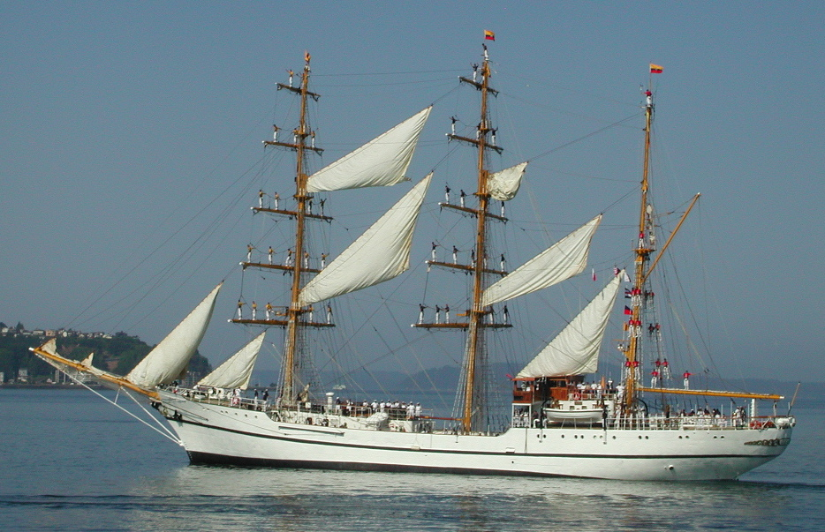
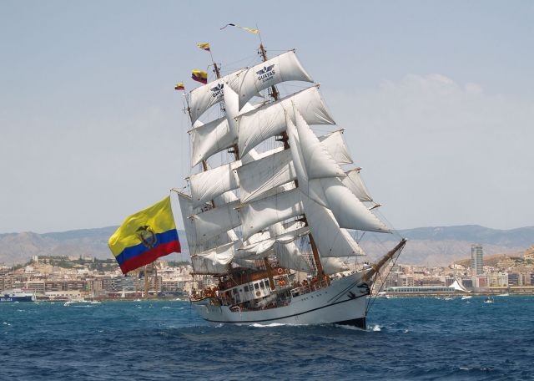
BAE Guayas (BE-21)
The Guayas is a sail training ship of the Ecuadorian Navy

Slide 6
Here are some practical suggestions:
A. Be honest about your struggles.
B. Cry out to God for his mercy.
C. Ask a friend to hold you accountable.
D. Don’t give up just because you struggle.
E. Look for small victories each day.

Slide 7
II. Live good lives because God must be glorified
One translation says, “Live an exemplary life.”
Another says, “Conduct yourselves honourably.”
The NASB says, “Keep your behaviour excellent.”
Greek text uses a word that means winsome,
lovely, attractive or praiseworthy.

Slide 8
II. Live good lives because God must be glorified
Peter adds a reason for living an excellent life. Do it so that “they may see your good deeds.”
The word translated “see” = more than a glance or a passing look.
Every day we are either drawing people to Jesus or
we are pushing them farther away.

Slide 9
III. Don’t be surprised when you are unfairly attacked.
Our text reminds us that we are to live morally excellent lives even “though they accuse you of doing wrong.”
Peter’s answer is simple:
Don’t be surprised when your faith is attacked unfairly.
Live so that no one can make an honest attack on you,
do good works anyway, and leave it all in God’s hands.

Slide 10
IV. Remember the Day of Visitation.
In the Old Testament, the “Day of Visitation”
refers to any time God visits the earth
either in judgment or blessing.
Here is Peter’s advice:
Live so that unbelievers will glorify God on that day.
on the day he visits us.

Slide 11
But how can unbelievers glorify God?
1) Some unbelievers will see Christ in us
and will become believers as a result of our testimony.
They will join us in joyfully glorifying God.
2) Others will watch us but will not believe the gospel.
They will have no excuse in that day,
but will be forced to glorify God anyway.

Slide 12
Philippians 2:9-11 (NIV)
“¹⁰ Therefore God exalted him to the highest
Place and gave him the name that is above every name, ¹⁰ that at the name of Jesus every knee should bow, in heaven and on earth and under the earth,
¹¹ and every tongue acknowledge that Jesus Christ is Lord, to the glory of God the Father.”

Slide 13
Phil. 3:20-21 (NIV)
"Our citizenship is in heaven. And we eagerly await a Saviour from there, the Lord Jesus Christ, who, by the power that enables him to bring everything under his control, will transform our lowly bodies so that they will be like his glorious body."

Slide 14
Live good lives because we are aliens,…
Live good lives because sin wars against the soul
Live good lives because God must be glorified

Slide 15
Romans 12:1-2 (NIV)
Therefore, I urge you, brothers and sisters, in view of God’s mercy, to offer your bodies as a living sacrifice, holy and pleasing to God—this is your true and proper worship. ² Do not conform to the pattern of this world, but be transformed by the renewing of your mind. Then you will be able to test and approve what God’s will is—his good, pleasing and perfect will.

Slide 16
I Peter 2:11-12 (NIV)
“Dear friends, I urge you, as aliens and strangers in the world, to abstain from sinful desires, which war against your soul. Live such good lives among the pagans that, though they accuse you of doing wrong, they may see your good deeds and glorify God on the day he visits us”.

