Slide 1
Notes:
Isaiah 40.31
Those who wait for the Lord shall renew
their strength,
they shall mount up with wings like eagles,
they shall run and not be weary
they shall walk and not faint.

Slide 2
Romans 5:1-5 (NIV)
Therefore, since we have been justified through faith, we have peace with God through our Lord Jesus Christ, ² through whom we have gained access by faith into this grace in which we now stand. And we boast in the hope of the glory of God. ³ Not only so, but we also glory in our sufferings, because we know that suffering produces perseverance; ⁴ perseverance, character; and character, hope. ⁵ And hope does not put us to shame, because God’s love has been poured out into our hearts through the Holy Spirit, who has been given to us.
Notes:
Isaiah 40.31
Those who wait for the Lord shall renew
their strength,
they shall mount up with wings like eagles,
they shall run and not be weary
they shall walk and not faint.

Slide 3
Galatians 5:22 (NIV)
But the fruit of the Spirit is Love.
Notes:
Isaiah 40.31
Those who wait for the Lord shall renew
their strength,
they shall mount up with wings like eagles,
they shall run and not be weary
they shall walk and not faint.

Slide 4
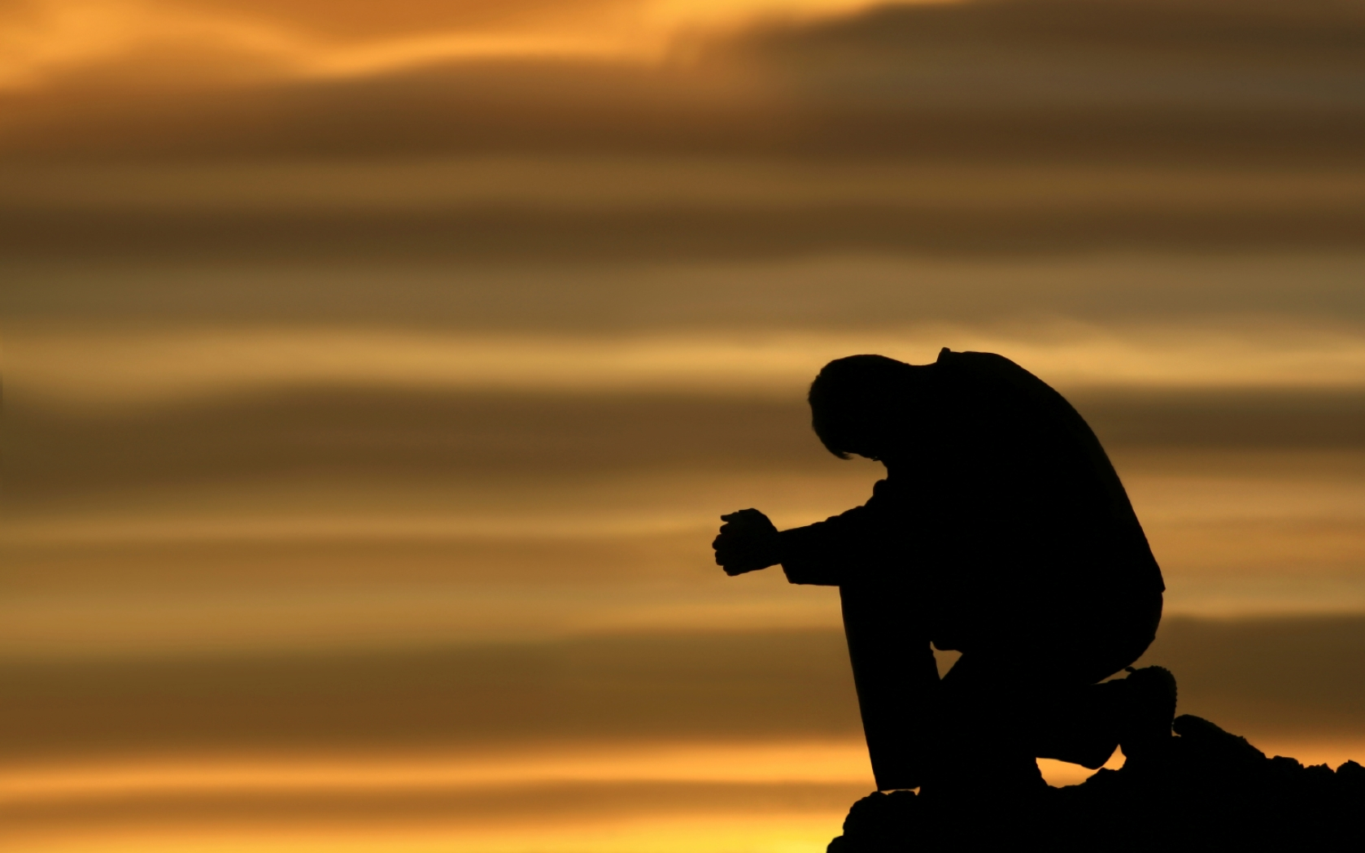
Prayer
Notes:
Isaiah 40.31
Those who wait for the Lord shall renew
their strength,
they shall mount up with wings like eagles,
they shall run and not be weary
they shall walk and not faint.

Slide 5
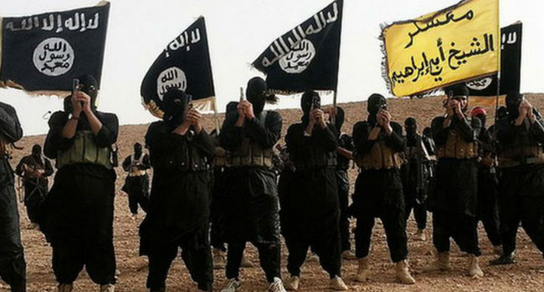
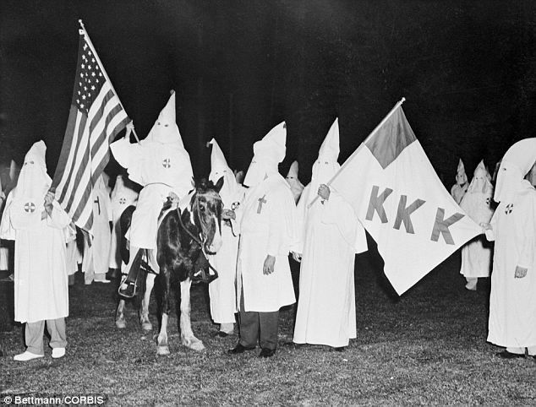
Notes:
Offering: Great Is He

Slide 6
Do you have a problem with hate?
Do you find it difficult to practice a spirit of goodwill toward others?
Christianity is built on love.
Notes:
Isaiah 40.31
Those who wait for the Lord shall renew
their strength,
they shall mount up with wings like eagles,
they shall run and not be weary
they shall walk and not faint.

Slide 7
Matthew 22:35-40
³⁵ One of them, an expert in the law, tested him with this question: ³⁶ “Teacher, which is the greatest commandment in the Law?”
³⁷ Jesus replied: “‘Love the Lord your God with all your heart and with all your soul and with all your mind.’³⁸ This is the first and greatest commandment. ³⁹ And the second is like it: ‘Love your neighbour as yourself.’ ⁴⁰ All the Law and the Prophets hang on these two commandments.”
Notes:
Isaiah 40.31
Those who wait for the Lord shall renew
their strength,
they shall mount up with wings like eagles,
they shall run and not be weary
they shall walk and not faint.

Slide 8
We have three obligations according to Jesus’ instructions:
a) To love God absolutely above all things.
b) To love self properly,
c) To love our neighbours as we love ourselves.
Notes:
Isaiah 40.31
Those who wait for the Lord shall renew
their strength,
they shall mount up with wings like eagles,
they shall run and not be weary
they shall walk and not faint.

Slide 9
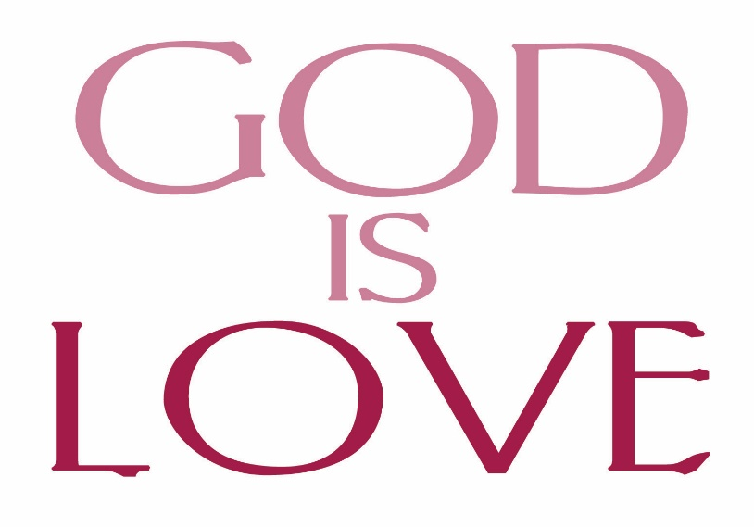
⁹ This is how God showed his love among us: He sent his one and only Son into the world that we might live through him. ¹⁰ This is love: not that we loved God, but that he loved us and sent his Son as an atoning sacrifice for our sins.
1 John 4:9-10 (NIV)
Notes:
Isaiah 40.31
Those who wait for the Lord shall renew
their strength,
they shall mount up with wings like eagles,
they shall run and not be weary
they shall walk and not faint.

Slide 10
And you also became God's people when you heard the true message, the Good News that brought you salvation. You believed in Christ, and God put his stamp of ownership on you by giving you the Holy Spirit he had promised.
Ephesians 1:13 (GNT)
This hope does not disappoint us, for God has poured out his love into our hearts by means of the Holy Spirit, who is God's gift to us.
Romans 5:5 (GNT)
Notes:
Isaiah 40.31
Those who wait for the Lord shall renew
their strength,
they shall mount up with wings like eagles,
they shall run and not be weary
they shall walk and not faint.

Slide 11
Paul declares that the Holy Spirit has entered our hearts to produce the fruit of LOVE.
Galatians 5:22 (NIV)
But the fruit of the Spirit is love.
Notes:
Isaiah 40.31
Those who wait for the Lord shall renew
their strength,
they shall mount up with wings like eagles,
they shall run and not be weary
they shall walk and not faint.

Slide 12
I. We need a proper definition of love
1) Eros from this word we get the words erotic and romantic, and it refers to the chemical reaction of a male and female.
It does not appear in the New Testament Scriptures. Love in this level is self-centred.
2) Philia. The highest word in the Greek language for human love, this word represents brotherly love.
The loveliness of the one who is loved serves as the basis for this love.
Notes:
Isaiah 40.31
Those who wait for the Lord shall renew
their strength,
they shall mount up with wings like eagles,
they shall run and not be weary
they shall walk and not faint.

Slide 13
3) Storge. This word represents family love.
4) Agape. This word Agape describes God’s attitude and action toward people.
Agape love is sacrificial, self-giving, unmerited love. It is love toward the unlovable. It is love whose source is in the heart of the lover.
Notes:
Isaiah 40.31
Those who wait for the Lord shall renew
their strength,
they shall mount up with wings like eagles,
they shall run and not be weary
they shall walk and not faint.

Slide 14
II. The Holy Spirit reveals God’s love for us and creates our love for God.
The word Agape represents the attitude that we should have toward God and which as his children we should practice toward others.
1) God loved us when we were dead in sin (Ephesians 2:1)
2) God’s love is unmerited on our part (Romans 5:8)
But God demonstrates his own love for us in this: While we were still sinners, Christ died for us.
Notes:
Isaiah 40.31
Those who wait for the Lord shall renew
their strength,
they shall mount up with wings like eagles,
they shall run and not be weary
they shall walk and not faint.

Slide 15
III. The Holy Spirit encourages us to have an appropriate love for ourselves.
The Holy Spirit does not encourage us to fall in love with ourselves, but rather to have a proper love for ourselves.
1) Proper love for ourselves will enable us to accept ourselves as unique persons created by a loving God.
2) Proper love for ourselves will help us to forgive ourselves
3) Proper love for ourselves will encourage us to protect ourselves from self-destructive attitudes and habits.
Notes:
Isaiah 40.31
Those who wait for the Lord shall renew
their strength,
they shall mount up with wings like eagles,
they shall run and not be weary
they shall walk and not faint.

Slide 16
III. The Holy Spirit encourages us to have an appropriate love for ourselves.
4) Proper love for ourselves will cause us to dedicate ourselves to the highest and best that we know.
5) Proper love for ourselves will challenge us to develop ourselves.
Notes:
Isaiah 40.31
Those who wait for the Lord shall renew
their strength,
they shall mount up with wings like eagles,
they shall run and not be weary
they shall walk and not faint.

Slide 17
IV. The Holy Spirit enable us to love others.
1) To love our neighbours properly, we must accept them fully as being people for whom Jesus Christ died on the cross.
2) To love our neighbours properly, we must be willing to forgive their trespasses against us and against others.
Notes:
Isaiah 40.31
Those who wait for the Lord shall renew
their strength,
they shall mount up with wings like eagles,
they shall run and not be weary
they shall walk and not faint.

Slide 18
¹² Therefore, as God’s chosen people, holy and dearly loved, clothe yourselves with compassion, kindness, humility, gentleness and patience. ¹³ Bear with each other and forgive one another if any of you has a grievance against someone. Forgive as the Lord forgave you.¹⁴ And over all these virtues put on love, which binds them all together in perfect unity.
Colossians 3:12-14 (NIV)
Notes:
Isaiah 40.31
Those who wait for the Lord shall renew
their strength,
they shall mount up with wings like eagles,
they shall run and not be weary
they shall walk and not faint.

Slide 19
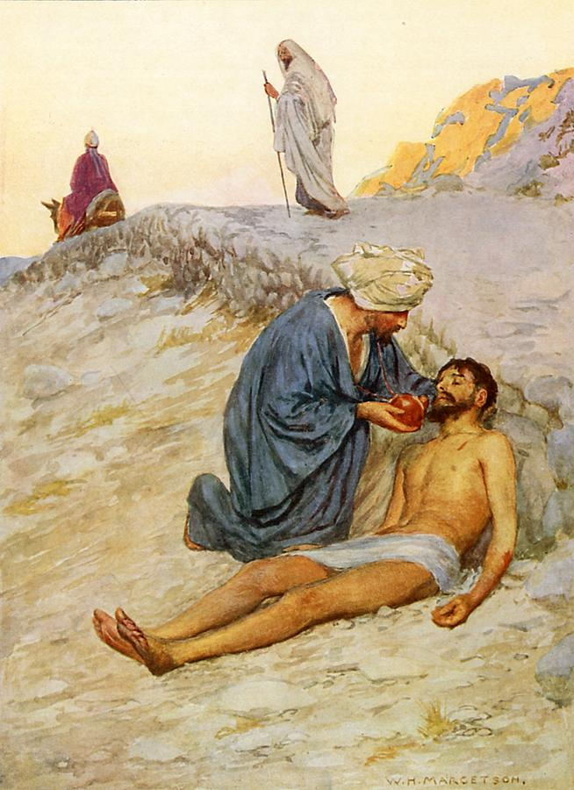
3) To truly love our neighbours, we must be willing to follow the example of the Good Samaritan and assist them in their time of misfortune. (Luke 10:25:37)
4) To love our neighbours, we must reveal God’s love to them by our lives and our words.
Notes:
Isaiah 40.31
Those who wait for the Lord shall renew
their strength,
they shall mount up with wings like eagles,
they shall run and not be weary
they shall walk and not faint.

Slide 20
“If you love me, keep my commands.
John 14:15 (NIV)
Notes:
Isaiah 40.31
Those who wait for the Lord shall renew
their strength,
they shall mount up with wings like eagles,
they shall run and not be weary
they shall walk and not faint.

Slide 21
We have three obligations according to Jesus’ instructions:
a) To love God absolutely above all things.
b) To love self properly,
c) To love our neighbours as we love ourselves.
“If you love me, keep my commands.
John 14:15 (NIV)
Notes:
Isaiah 40.31
Those who wait for the Lord shall renew
their strength,
they shall mount up with wings like eagles,
they shall run and not be weary
they shall walk and not faint.

Slide 22
Let the Holy Spirit do his wonderful work within you.
Galatians 5:22 (NIV)
But the fruit of the Spirit is love.
⁷ So, as the Holy Spirit says:
“Today, if you hear his voice, ⁸ do not harden your hearts as you did in the rebellion, during the time of testing in the wilderness,
Hebrews 3:7-8 (NIV)
Notes:
Isaiah 40.31
Those who wait for the Lord shall renew
their strength,
they shall mount up with wings like eagles,
they shall run and not be weary
they shall walk and not faint.

Slide 23
Prayer
Notes:
Isaiah 40.31
Those who wait for the Lord shall renew
their strength,
they shall mount up with wings like eagles,
they shall run and not be weary
they shall walk and not faint.

