Slide 1

Model godly character?
Minister grace and love?
Make good work?
Mould culture?
Be a Mouthpiece for truth and justice?
Be a Messenger of the gospel?

Slide 2
The Journey is on
Advice for our Spiritual Journey
⁶ As you therefore have received Christ Jesus the Lord, so walk in Him, ⁷ rooted and built up in Him and established in the faith, as you have been taught, abounding in it with thanksgiving.
Colossians 2:6-7 (NKJV)
Let’s Pray…

Slide 3
The Supremacy of Christ
“The Son is the image of the invisible God, the firstborn over all creation. ¹⁶ For in him all things were created:… ¹⁷ He is before all things, and in him all things hold together. ¹⁸ And he is the head of the body, the church; he is the beginning and the firstborn from among the dead, so that in everything he might have the supremacy…
Colossians 1:15-18 (NIV)
Advice for our Spiritual Journey

Slide 4
I. As you have received Christ Jesus the Lord..
The Colossians and (we) received Him as CHRIST:
=
Christ
Messiah
The Messiah (Christ is the Greek and Messiah is the Hebrew for “Anointed One”).
The baby born in Bethlehem is God’s anointed King, Prophet and Priest.

Slide 5
God’s anointed King
Philippians 2:9:10 (NIV)
Therefore God exalted him to the highest place and gave him the name that is above every name,¹⁰ that at the name of Jesus every knee should bow, in heaven and on earth and under the earth,
God’s anointed Prophet
John 1:14 (NIV)
“The Word became flesh and made his dwelling among us, we have seen his glory, the glory, the glory of the One and Only, who came from the Father, full of grace and truth”

Slide 6
God’s anointed Priest
1 Timothy 2:5 (NIV)
“For there is one God and one mediator between God and mankind, the man Christ Jesus”.

Slide 7
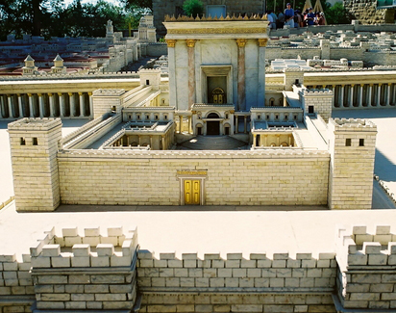
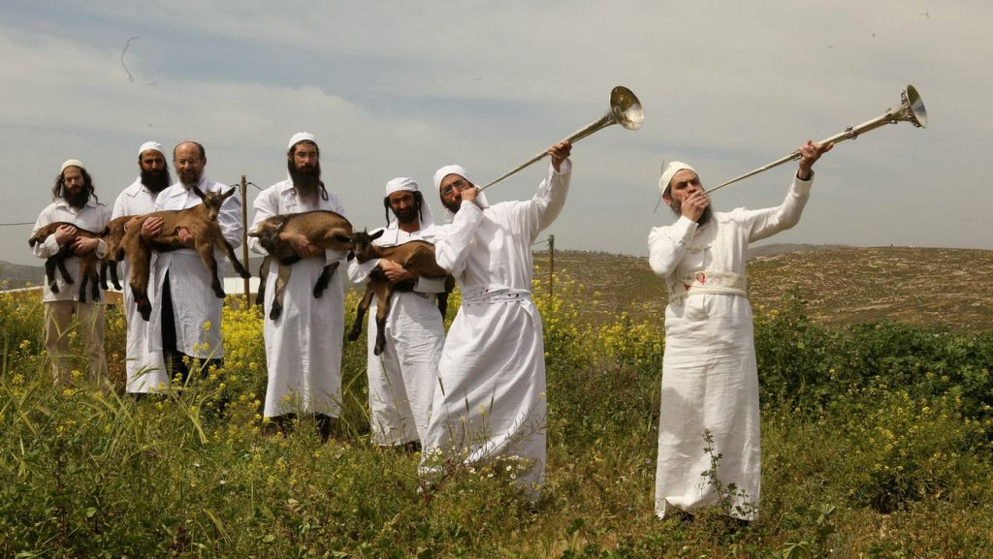
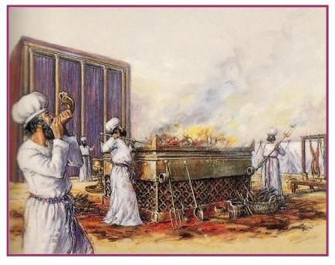
“…without the shedding of blood there is no forgiveness.” Hebrews 9:22

Slide 8
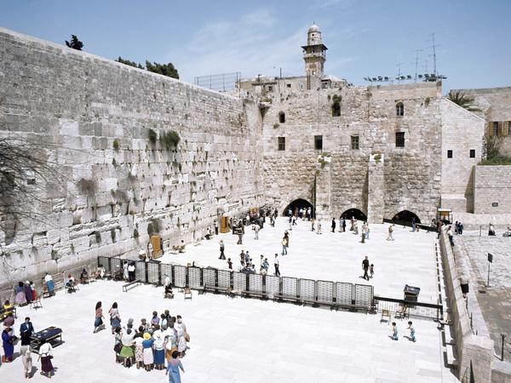
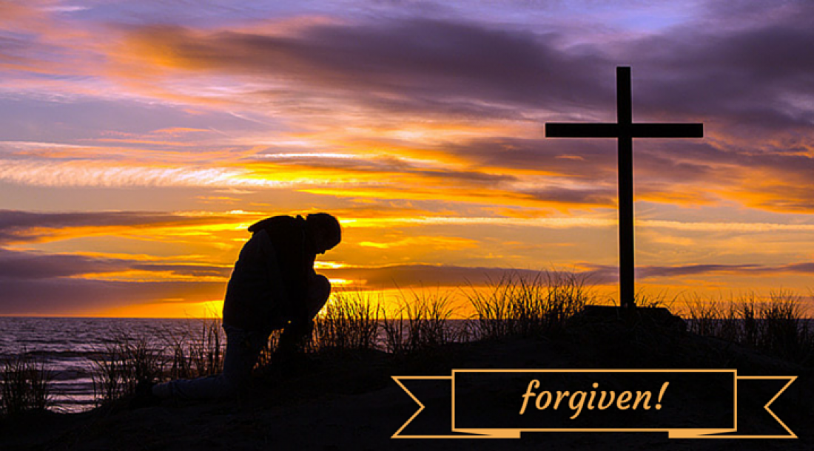
“But when this priest had offered for all time one sacrifice for sins, he sat down at the right hand of God,”
Hebrews 10:12 (NIV)
God’s anointed PRIEST

Slide 9
b) The Colossians and (we) received him as JESUS
“She will give birth to a son, and you are to give him the name Jesus, because he will save his people from their sins.” Matthew 1:21 (NIV)
Jesus
=
=
“Yahweh saves”.
Joshua
Jesus is the Greek form of the Hebrew name “Joshua”, that means, “Yahweh saves”.
“He will save his people from their sins”.

Slide 10
Ecclesiastes 7:20 says;
“Indeed, there is no one on earth who is righteous, no one who does what is right and never sins.”
“Christ Jesus came into the world to save sinners” 1 Timothy 1:15 (NIV)
The Bible promises “for, “Everyone who calls on the name of the Lord will be saved.” Romans 10:13 (NIV)
The Colossians and (we) received him as JESUS

Slide 11
c) The Colossians and (we) received Him as LORD
The word “Lord” refers to His deity. In the Old Testament this is the personal covenant name of God. This name describes His absolutely sovereignty as the creator of the universe.

Slide 12
Psalm 19:7-11 (NIV)
The law of the Lord is perfect, refreshing the soul.
The statutes of the Lord are trustworthy, making wise the simple. ⁸ The precepts of the Lord are right, giving joy to the heart. The commands of the Lord are radiant, giving light to the eyes. ⁹ The fear of the Lord is pure, enduring forever. The decrees of the Lord are firm, and all of them are righteous. ¹⁰ They are more precious than gold, than much pure gold; they are sweeter than honey, than honey from the honeycomb. ¹¹ By them your servant is warned; in keeping them there is great reward.

Slide 13
We received Christ Jesus the LORD. We must continue with Jesus alone, as He is revealed in His Word.

Slide 14
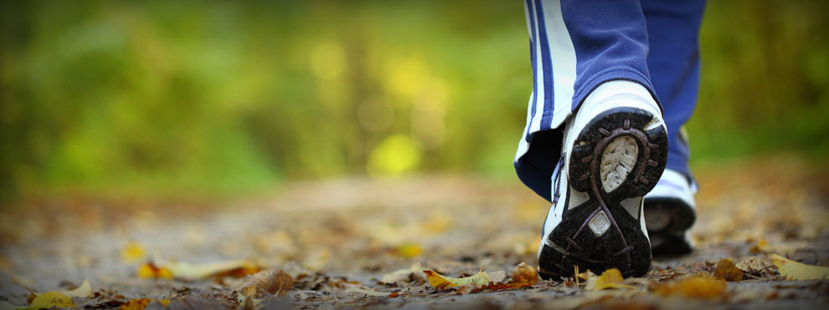
II. The expressions of our Commitment to Jesus Christ the Lord
The first metaphor is in the word WALK
“I, therefore, the prisoner of the Lord, beseech you to WALK worthy of the calling with which you were called” Ephesians 4:1 (NKJV)
WALK in Him
“And WALK in love, as Christ also has loved us and given Himself for us,…” Ephesians 5:2 (NKJV)

Slide 15

b) The second metaphor is “ROOTED”
Psalm 1:3 (NIV)
That person is like a tree planted by streams of water, which yields its fruit in season and whose leaf does not wither—whatever they do prospers.

Slide 16
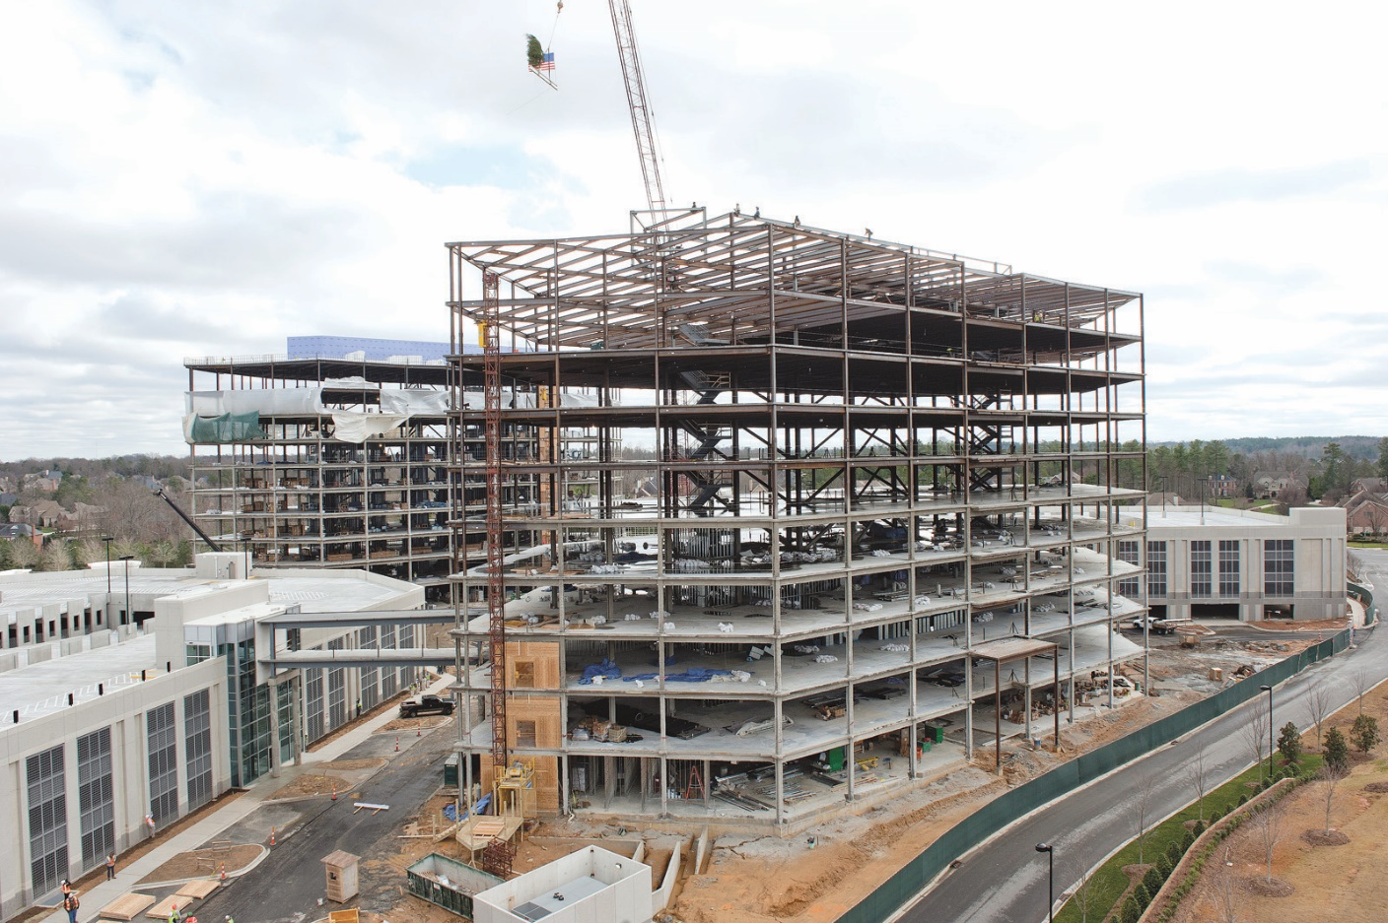
c) The next metaphor is “You are being built up in Him”
Building under construction
This is an ongoing process.

Slide 17
d) “Established” in the faith
“Establish”
=
“to confirm, guarantee, or make irrevocable.”
⁸ For it is by grace you have been saved, through faith—and this is not from yourselves, it is the gift of God— ⁹ not by works, so that no one can boast.
Ephesians 2:8-9 (NIV)

Slide 18
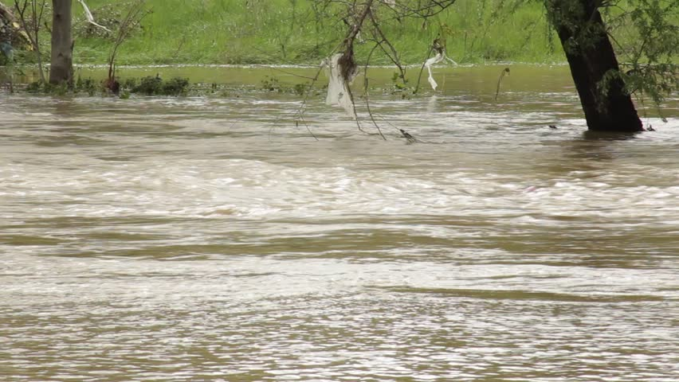
e) “Overflowing” river of ‘Gratitude’
“Overflowing with thankfulness,”
The distinguishing mark of the true church is an abounding and overflowing gratitude… “Thanksgiving is the end of all human conduct, whether observed in words or works.”
J. B. Lightfoot

Slide 19
The Journey is on
Advice for our Spiritual Journey
⁶ As you therefore have received Christ Jesus the Lord, so walk in Him, ⁷ rooted and built up in Him and established in the faith, as you have been taught, abounding in it with thanksgiving.
Colossians 2:6-7 (NKJV)

