Slide 1
John 1:35-39 (NIV)
³⁵ The next day John was there again with two of his disciples. ³⁶ When he saw Jesus passing by, he said, “Look, the Lamb of God!”
³⁷ When the two disciples heard him say this, they followed Jesus. ³⁸ Turning around, Jesus saw them following and asked, “What do you want?”
They said, “Rabbi” (which means “Teacher”), “where are you staying?”
³⁹ “Come,” he replied, “and you will see.”…

Slide 2
Matthew 4:18-22 (NIV)
¹⁸ As Jesus was walking beside the Sea of Galilee, he saw two brothers, Simon called Peter and his brother Andrew. They were casting a net into the lake, for they were fishermen. ¹⁹ “Come, follow me,” Jesus said, “and I will send you out to fish for people.” ²⁰ At once they left their nets and followed him.
²¹ Going on from there, he saw two other brothers, James son of Zebedee and his brother John. They were in a boat with their father Zebedee, preparing their nets. Jesus called them, ²² and immediately they left the boat and their father and followed him.

Slide 4
Jesus’ Disciples’ Call
I. Christ’s call to us to receive him personally.
The next day John saw Jesus coming toward him and said, “Look, the Lamb of God, who takes away the sin of the world!
John 1:29 (NIV)
Nathaniel made a great confession concerning Jesus.
He called him, “the Son of God ... King of Israel” (John 1:49).
They had to believe in him as a person.

Slide 5
II. Christ’s call to us for dedication and service.
“Now after that John was put in prison, Jesus came into Galilee, preaching the gospel”
(Mark 1:14; KJV)

Slide 6
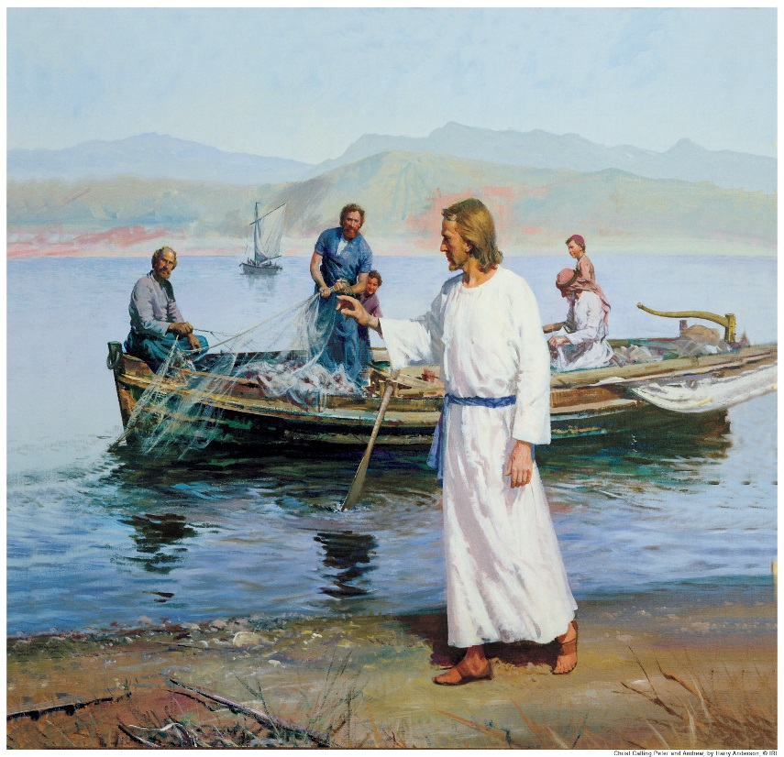
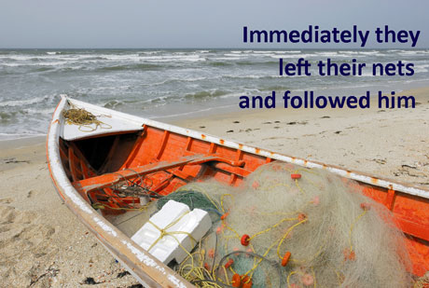
The fact that the disciples immediately left their nets and followed Jesus indicates two things.
First, Jesus possessed a tremendous personal appeal.
Second, the previous experience with Jesus in Judea had left its
imprint on them and they were now ready to follow him wherever he
would lead.

Slide 7
Jesus takes First place
Verse 20:
Immediately they left their nets and followed him.
Verse 22:
immediately they left the boat and their father and followed him.
One of the things that Jesus wants us to do is to love our families and to work hard at our jobs. But if it ever does clash, Jesus calls us to be clear where our highest commitment is.

Slide 8
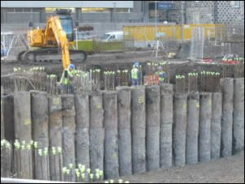
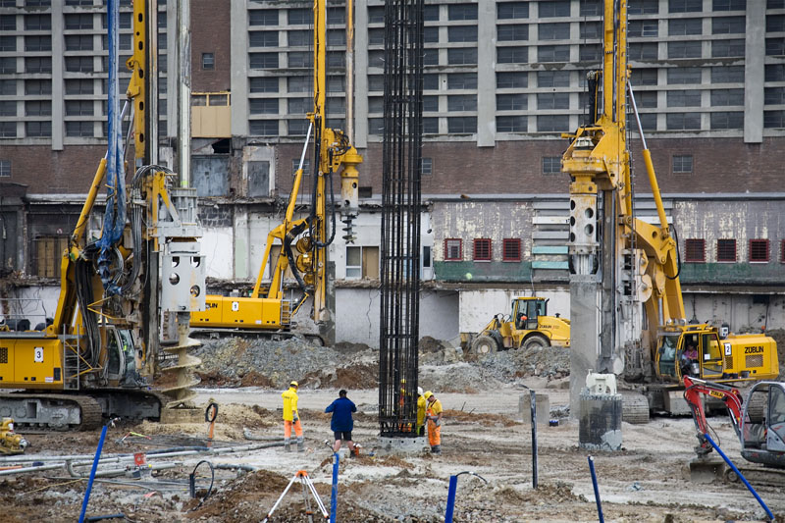
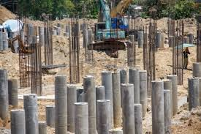
Jesus’ Disciples’ Call
III. Each call is distinctive.

Slide 9
Jesus Called People
God’s call comes continuously
We can reject the call, but we cannot ignore it.
The first call comes to everyone for the same purpose—​for personal salvation.
The second call may vary in intent as well as in method.
Let us never turn a deaf ear to the Master’s call!

