Slide 1
Model godly character?
Minister grace and love?
Make good work?
Mould culture?
Be a Mouthpiece for truth and justice?
Be a Messenger of the gospel?

Slide 2
Be a Messenger of the gospel?
‘How beautiful on the mountains are the feet of those who bring good news, who proclaim peace, who bring good tidings, who proclaim salvation, who say to Zion, “Your God reigns!”’
Isaiah 52:7
How does the word ‘evangelism’ make you feel?
“Muggers for Jesus.”
“Silent witnesses”

Slide 3
How might I be a messenger of the Gospel on my frontline?
Being a Wise Messenger of the Gospel
Colossians 4:2-6 (NIV)

Slide 4
Colossians 4:2-6 (NIV)
² Devote yourselves to prayer, being watchful and thankful. ³ And pray for us, too, that God may open a door for our message, so that we may proclaim the mystery of Christ, for which I am in chains. ⁴ Pray that I may proclaim it clearly, as I should. ⁵ Be wise in the way you act toward outsiders; make the most of every opportunity. ⁶ Let your conversation be always full of grace, seasoned with salt, so that you may know how to answer everyone.

Slide 5
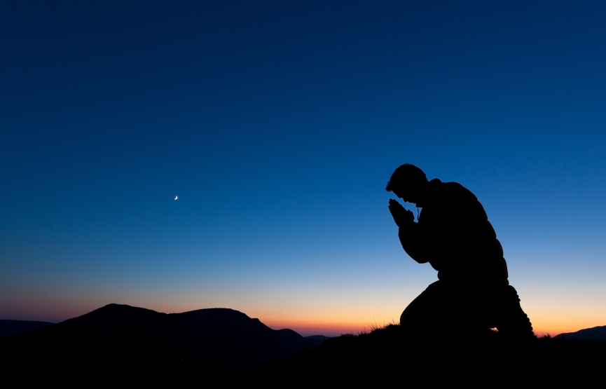
Let’s Pray

Slide 6
1) God wants people saved.
2) It is God who saves people, not us.
3) We have some role in this, however small.
Alexander Maclaren says that the remarks on these verses touch “the two extremes of life, the first of them having reference to the hidden life of prayer, and the second and third to the outward, busy life of the market place and street…Continual prayer is to blend with unwearied action

Slide 7
I. Praying devotedly (4:2-4)
“Devote yourselves to prayer…”
When we read from the KJV verse 2 starts saying; “Continue in prayer…”
The apostle Paul commends here two things in prayer:
First, perseverance; and secondly, eagerness or earnest attention to prayer.
Calvin

Slide 8
“…being watchful and thankful”
Being watchful” literally means “keeping awake” which suggests that Christians are to be in constant spiritual alertness.
Matthew 26:40-41 (NIV)
Then he returned to his disciples and found them sleeping. “Couldn’t you men keep watch with me for one hour?” he asked Peter. ⁴¹ “Watch and pray so that you will not fall into temptation. The spirit is willing, but the flesh is weak.”

Slide 9
“…being …thankful”
Philippians 4:6 (NIV)
Do not be anxious about anything, but in every situation, by prayer and petition, with thanksgiving, present your requests to God.
And pray for us, too,…
The great apostle Paul shows humility because the Lord has appointed this exercise of love between us that we pray for each other.
Torrance, David and Torrance Thomas, Calvin’s Commentaries. Erdmans Publishing Company, Grand Rapids, Michigan, 1974, p357.

Slide 10
Pray that I may proclaim it clearly, as I should…
How should the Gospel be proclaimed?

Slide 11
The Romans Road to Salvation:
1) Every person is a sinner (Romans 3:23).
2) God’s penalty for sin is spiritual death (Romans 6:23).
3) In His great love, God has made provision for the salvation of all (Romans 5:8).
4) Each person must put his or her trust in God’s Son, Jesus Christ (Romans 10:9-10, 13).

Slide 12
Ephesians 6:19 (NIV)
“Pray also for me, that whenever I speak, words may be given me so that I will fearlessly make known the mystery of the gospel,”
We are called just to open our mouth to proclaim the Gospel, for it is not on our own strength or wisdom, this is truly a divine work.
Matthew 10:20 (NIV)
“for it will not be you speaking, but the Spirit of your Father speaking through you.”

Slide 13
II. Acting wisely (4:5)
In verse 5 Paul is saying
“Walk with wisdom toward outsiders”
“Wisdom” in the Old Testament comes from the word “skill”. If we read Exodus 36:1-2 and Exodus 32:3 and 6, “wisdom” is used to describe the craftsmen who built the tabernacle.
Wisdom
=
Skill

Slide 14
Exodus 36:1-2 (NKJV)
“And Bezalel and Aholiab, and every gifted artisan in whom the Lord has put wisdom and understanding, to know how to do all manner of work for the service of the sanctuary, shall do according to all that the Lord has commanded.” ² Then Moses called Bezalel and Aholiab, and every gifted artisan in whose heart the Lord had put wisdom, everyone whose heart was stirred, to come and do the work.
Wisdom
Skill
=
Proverbs 9:10 says;
“The fear of the Lord is the beginning of wisdom, and knowledge of the Holy One is understanding.”

Slide 15
“Making the most of the opportunity” (4:5)
Is literally, “redeeming [or, buying up] the opportunity.”
A wise witness is on the alert to buy up opportunities to share Christ with lost people.

Slide 16
III. Speaking graciously (4:6)
“Let your conversation be always full of grace, seasoned with salt, so that you may know how to answer everyone.”
1) God wants people saved.
2) It is God who saves people, not us.
3) We have some role in this, however small.

Slide 17
Barclay translates Colossians 4:6 this way: “Let your speech always be with gracious charm, seasoned with the salt of wit, so that you will know the right answer to give in every case.”
He explains: “Here is an interesting injunction. It is all too true that Christianity in the minds of many is connected with a kind of sanctimonious dullness and an outlook in which laughter is almost a heresy. . . The Christian must commend his message with the charm and the wit which were in Jesus himself.”

Slide 18
“Let your conversation be always …, seasoned with salt”
A recipe often calls for "a pinch of salt."
Just a pinch of salt can do much to reduce bitterness and bring peace to our world.

Slide 19
We are to speak INTELLIGENTLY
“So that you may know how to answer everyone”
• How can a loving God allow evil and suffering to exist?
• Don’t miracles contradict science?
• If evolution explains life, why is God needed?
• How could a loving God torture people in hell?
• Isn’t it offensive to claim that Jesus is the only way to heaven?

Slide 20
“In the midst of a generation screaming for answers, Christians are stuttering.”
Howard Hendricks
“Always be prepared to give an answer to everyone who asks you to give the reason for the hope that you have. But do this with gentleness and respect, keeping a clear conscience, so that those who speak maliciously against your good behavior in Christ may be ashamed of their slander”
(1 Peter 3:15-16).

Slide 21
Read All About It (Emeli Sande)
You've got the words to change a nation But you're biting your tongue You've spent a life time stuck in silence Afraid you'll say something wrong If no one ever hears it how we gonna learn your song?
So come on, come on Come on, come on You've got a heart as loud as lightning So why let your voice be tamed? Maybe we're a little different There's no need to be ashamed You've got the light to fight the shadows So stop hiding it away Come on, come on

Slide 22
Read All About It
I wanna sing, I wanna shout I wanna scream 'til the words dry out So put it in all of the papers, I'm not afraid They can read all about it Read all about it, oh Oh oh oh Oh oh oh Oh oh oh Oh oh oh At night we're waking up the neighbors While we sing away the blues Making sure…

Slide 23
1) God wants people saved.
2) It is God who saves people, not us.
3) We have some role in this, however small.
“Muggers for Jesus.”
“Silent witnesses”
Being a Wise Messenger of the Gospel

Slide 24
Being a Wise Messenger of the Gospel
² Devote yourselves to prayer, being watchful and thankful. ³ And pray for us, too, that God may open a door for our message, so that we may proclaim the mystery of Christ, for which I am in chains. ⁴ Pray that I may proclaim it clearly, as I should. ⁵ Be wise in the way you act toward outsiders; make the most of every opportunity. ⁶ Let your conversation be always full of grace, seasoned with salt, so that you may know how to answer everyone.
Colossians 4:2-6 (NIV)

