Slide 1

Colossians 1:9-14
“A Christian life that pleases God”.

Slide 2
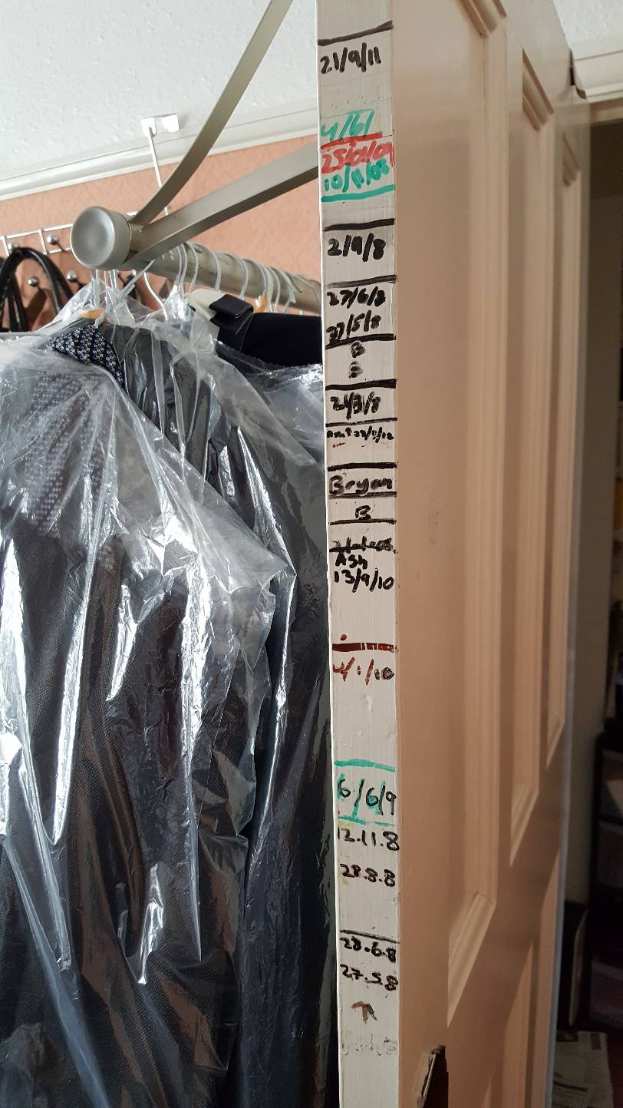
It’s a growth chart”
But what about our spiritual lives?
How can we measure it?

Slide 3
Be a Mouthpiece for truth and justice?
Colossians 1:9-14
“A Christian life that pleases God”.

Slide 4
Colossians 1:9-14 (NIV)
⁹ For this reason, since the day we heard about you, we have not stopped praying for you. We continually ask God to fill you with the knowledge of his will through all the wisdom and understanding that the Spirit gives, ¹⁰ so that you may live a life worthy of the Lord and please him in every way: bearing fruit in every good work, growing in the knowledge of God, ¹¹ being strengthened with all power according to his glorious might so that you may have great endurance and patience,

Slide 5
Colossians 1:9-14 (NIV)
¹² and giving joyful thanks to the Father, who has qualified you to share in the inheritance of his holy people in the kingdom of light. ¹³ For he has rescued us from the dominion of darkness and brought us into the kingdom of the Son he loves, ¹⁴ in whom we have redemption, the forgiveness of sins.

Slide 6

Let’s Pray

Slide 7
“A Christian life that pleases God”.
) A Christian life that is filled with the knowledge of God’s will.
“For this reason, since the day we heard about you, we have not stopped praying for you. We continually ask God to fill you with the knowledge of his will through all the wisdom and understanding that the Spirit gives”
Colossians 1:9 (NIV)
A Christian life that is filled with the knowledge of God’s will.

Slide 8
The Greek word for "knowledge" in this passage is:
epignósis
“The knowledge that grasps and penetrates into the object”
A Christian life that is filled with the knowledge of God’s will.
“Such knowledge of God’s will is the foundation of all Christian character and conduct”
Frank E. Gaebelein, The Expositor’s Bible Commentary, with the NIV Volume 11, The Zodervan Corporation: Grand Rapids, Michigan 1978, p177

Slide 9
a) The knowledge of how God wants us to live requires spiritual wisdom.
Colossians 2:23 (NIV)
“Such regulations indeed have an appearance of wisdom, with their self-imposed worship, their false humility and their harsh treatment of the body, but they lack any value in restraining sensual indulgence.”

Slide 10
Proverbs 9:10 says;
“The fear of the Lord is the beginning of wisdom, and knowledge of the Holy One is understanding.”
Exodus 31:3 and 6
Exodus 36:1-2.
Wisdom
=
Skill

Slide 11
b) The knowledge of how God wants us to live requires spiritual understanding.
“Wisdom” refers to knowing how God’s Word commands us to live, whereas “understanding” refers to insight, perception, or the ability to discern between things.
How do you become filled or controlled by the knowledge of God’s will in all spiritual wisdom and understanding?

Slide 12
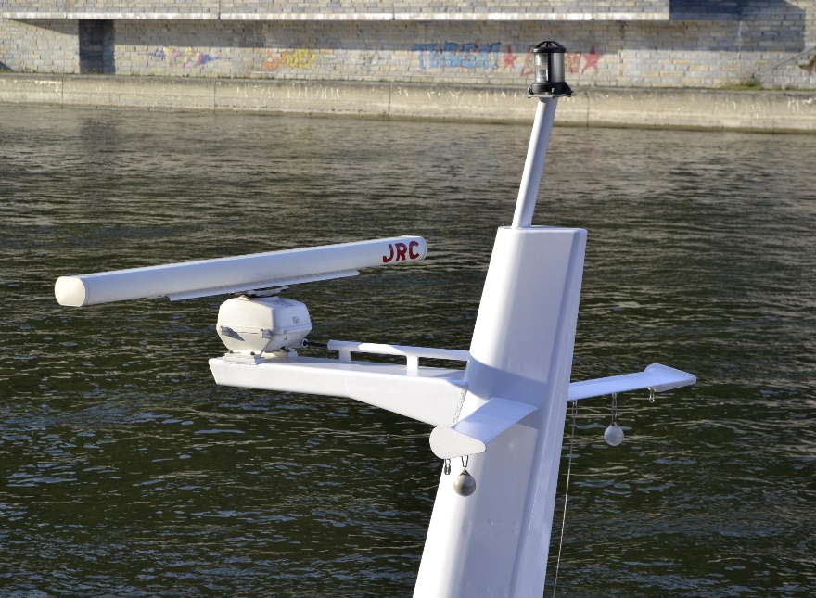
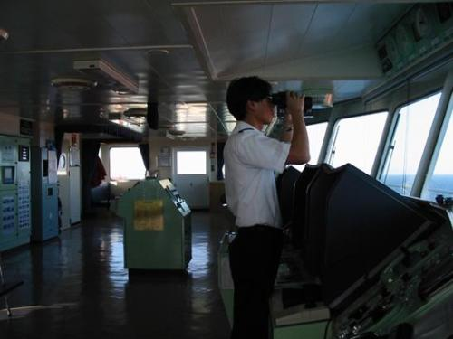
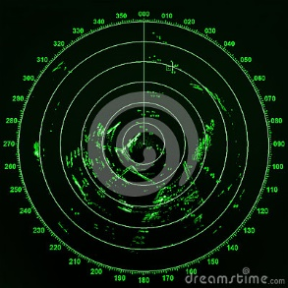
1.) Radar
2.) Lookout person

Slide 13



1.) Prayerfully to read
and meditate on
the Word of God.
2.) By reading church history
and Christian biographies.
To possess the knowledge of God in all wisdom and with spiritual understanding requires two things:
“Prayer” (James 1:5) and “reading the Bible” (Ephesians 3:3-5)

Slide 14
“A Christian life that pleases God”.
2.) Christians who live a life worthy of the Lord.
“so that you may live a life worthy of the Lord and please him in every way:…”
Colossians 1:10 (NIV)
A Christian life that is filled with the knowledge of God’s will.
The knowledge of the Lord will lead Christians to a walk that is worthy of the Lord.

Slide 15
S. B. Gordon was a great preacher. He said, “In every heart there is the throne.” He said, “When self is on that throne, Christ is on the cross. But,” he said, “when self is on the cross, Christ is on the throne.”
It pleases Him when we surrender our lives to Him.
Luke 6:46
“Why do you call me, ‘Lord, Lord,’ and do not do what I say?

Slide 16
a.) We please the Lord when we bear fruit in every good work.
“bearing fruit in every good work,…”
“What rain and sunshine are to nurture of plants, the knowledge of God is to the growth and maturing of the spiritual life”
Frank E. Gaebelein, The Expositor’s Bible Commentary, with the NIV Volume 11, The Zodervan Corporation: Grand Rapids, Michigan 1978, p178
John 15:5 (NIV)
“I am the vine; you are the branches. If you remain in me and I in you, you will bear much fruit; apart from me you can do nothing.
Are we being fruitful?

Slide 17
b.) We please the Lord when we increase in the knowledge of God.
“Growing in the knowledge of God,..”
Christians should strive to be filled with the knowledge of God.
John 14:21 (NIV)
Whoever has my commands and keeps them is the one who loves me. The one who loves me will be loved by my Father, and I too will love them and show myself to them.”
Are we daily increasing in this knowledge of God?

Slide 18
c.) We please the Lord when we are strengthened with His power to be steadfast and patient.
being strengthened with all power according to his glorious
might so that you may have great endurance and patience,
Christians are engaged in moral conflict with the cosmic powers of a dark world.
Ephesians 6:12 (NIV)
For our struggle is not against flesh and blood, but against the rulers, against the authorities, against the powers of this dark world and against the spiritual forces of evil in the heavenly realms.

Slide 19
d.) We please the Lord when we joyously give thanks to Him for His great salvation.
and giving joyful thanks to the Father, who has qualified you to share in the inheritance of his holy people in the kingdom of light.
God has “qualified” believers “to share in the inheritance of the saints”
This Canaan, “is not in the distance, beyond death; it is about us today, in our home, in our family, in our business,…in all that makes up mortal life.”
Frank E. Gaebelein, The Expositor’s Bible Commentary, with the NIV Volume 11, The Zodervan Corporation: Grand Rapids, Michigan 1978, p179

Slide 20

“A Christian life that pleases God”.
But what about our spiritual lives?
How can we measure it?

Slide 21
To the man in my life who I admire.
When I was 15 I thought you were out to 'ruin my life'
with all your rules,
however 10 years on each of those rules have made me
the person I am today.
I have no idea what the next month would consist of,
but I do know that the three things you have
always wanted us to follow as your children
will forever be in our hearts.
- Trust and obey our Heavenly Father - Study study study - Obey our parents
I love you Papi! Happy Father's Day

Slide 22
“A Christian life that pleases God”.
) A Christian life that is filled with the knowledge of God’s will.
2.) Christians who live a life worthy of the Lord.
a.) When we bear fruit in every good work.
b.) When we increase in the knowledge of God.
c.) When we are strengthened with His power to be steadfast and patient.
d.) When we joyously give thanks to Him for His great salvation.

