Slide 1
Matthew 26:36-42 (NIV)
36 Then Jesus went with his disciples to a place called Gethsemane, and he said to them, “Sit here while I go over there and pray.” 37 He took Peter and the two sons of Zebedee along with him, and he began to be sorrowful and troubled. 38 Then he said to them, “My soul is overwhelmed with sorrow to the point of death. Stay here and keep watch with me.” 39 Going a little farther, he fell with his face to the ground and prayed, “My Father, if it is possible, may this cup be taken from me. Yet not as I will, but as you will.”

Slide 2
⁴⁰ Then he returned to his disciples and found them sleeping. “Couldn’t you men keep watch with me for one hour?” he asked Peter.
41 “Watch and pray so that you will not fall into temptation. The spirit is willing, but the flesh is weak.” 42 He went away a second time and prayed, “My Father, if it is not possible for this cup to be taken away unless I drink it, may your will be done.”
Text: “…,may Your will be done” (Matt. 26:42).

Slide 4
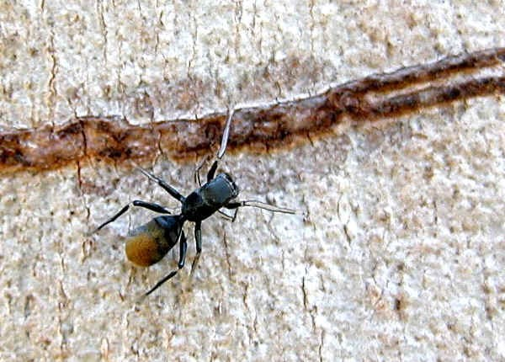

Slide 5
I. God had a will for Jesus—​and he has a will for every life.
“Why were you searching for me?” he asked. “Didn’t you know I had to be in my Father’s house?”.
Luke 2:49
John Wesley once said, “To find God’s will is man’s greatest discovery and to do God’s will is man’s greatest achievement.”

Slide 6
II. People can pervert the purposes of God.
“I will not do that which is your plan for me.”
I will do it My Way
What about our temptations to pervert God’s purposes for us?
Are there safeguards we can set up to help us avoid the pitfalls of disobedience?

Slide 7
III. How can we know God’s will?
There is an intentional will of God.
“All of us, then, who are mature should take such a view of things. And if on some point you think differently, that too God will make clear to you.”
Philippians 3:15
God will make clear to us

Slide 8
a) You must be willing to do it
Anyone who chooses to do the will of God will find out whether my teaching comes from God or whether I speak on my own.
John 7:17 (NIV)
"If any man will do His will [and the phrase means 'wants to do it'], he shall know of the doctrine whether it be of God, or whether I speak of myself."
John 7:17

Slide 9
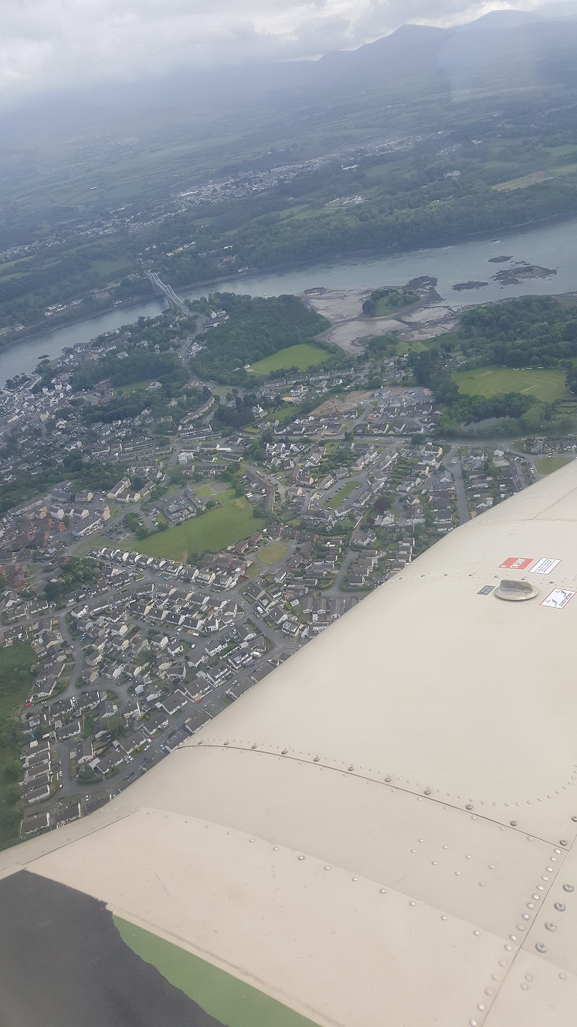
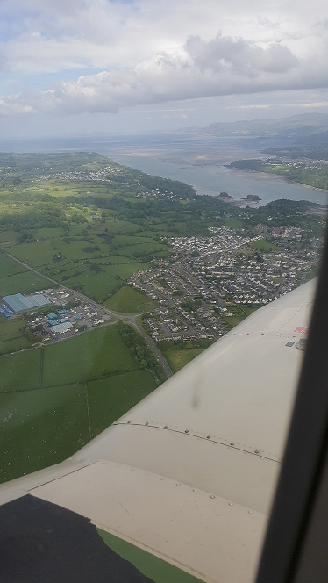
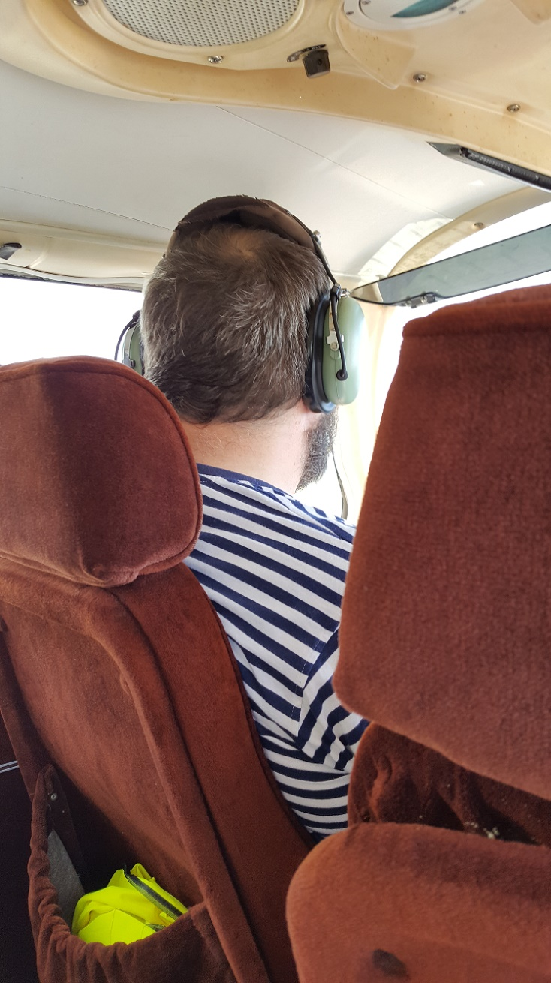
Willing is the prerequisite of knowing?

Slide 10
b) Nothing can be the will of God that is contrary
to the Word of God.
“For my Father’s will is that everyone who looks to the Son and believes in him shall have eternal life, and I will raise them up at the last day.”
John 6:40 (NIV)

Slide 11
The Bible teaches us very clearly that the Father’s will is for all of us to be saved…
“Finally, brothers and sisters, whatever is true, whatever is noble, whatever is right, whatever is pure, whatever is lovely, whatever is admirable—if anything is excellent or praiseworthy—think about such things.
Philippians 4:8

Slide 12
c) A daily and even hourly fellowship with the Lord.
I will instruct you and teach you in the way you should go; I will counsel you with my loving eye on you.
Psalm 32:8 (NIV)
Martin Luther once said:
“I am so busy now that I find if I do not spend two or three hours each day in prayer, I cannot get through the day. If I should neglect prayer but a single day, I should lose a great deal of the fire of faith.”

Slide 14
a) Ants are well-organized
b) Unselfish unity
c) Spirit of sharing
d) Amazing sense of discipline
e) Ants are persistent
f) Ants have teamwork

Slide 15
g) Action in time
Lazy people should learn a lesson from the way ants live. ⁷ They have no leader, chief, or ruler, ⁸ but they store up their food during the summer, getting ready for winter. ⁹ How long is the lazy man going to lie around? When is he ever going to get up?
Proverbs 6:6-8 (GNT)
h) Ants are strong and hardworking

Slide 16
Cast your burden on the LORD, and he will sustain you; he will never permit the righteous to be moved.
Psalm 55:22

Slide 17
One of the best ways to guarantee that we will fulfill God’s purposes for us is to remain close to him in daily fellowship and therefore find infinite resources available for the doing of His will.

Slide 18
Preacher Dwight L. Moody once said, “The only way to keep a broken vessel full is to keep it always under the tap.”
We’re all broken vessels and we
need the Lord’s filing in order to
cope with life! We just need to stay
under His tap!
Text: “… may Your will be done” (Matt. 26:42).

