Slide 1
¹⁵ God also said to Abraham, “As for Sarai your wife, you are no longer to call her Sarai; her name will be Sarah. ¹⁶ I will bless her and will surely give you a son by her. I will bless her so that she will be the mother of nations; kings of peoples will come from her.”
¹⁷ Abraham fell facedown; he laughed and said to himself, “Will a son be born to a man a hundred years old? Will Sarah bear a child at the age of ninety?” ¹⁸ And Abraham said to God, “If only Ishmael might live under your blessing!”
¹⁹ Then God said, “Yes, but your wife Sarah will bear you a son, and you will call him Isaac. I will establish my covenant with him as an everlasting covenant for his descendants after him.
Genesis 17:15-19 (NIV)

Slide 2
Some time later God tested Abraham. He said to him, “Abraham!”
“Here I am,” he replied.
² Then God said, “Take your son, your only son, whom you love—Isaac—and go to the region of Moriah. Sacrifice him there as a burnt offering on a mountain I will show you.”
Genesis 22:1-2 (NIV)
A father’s faith

Slide 3
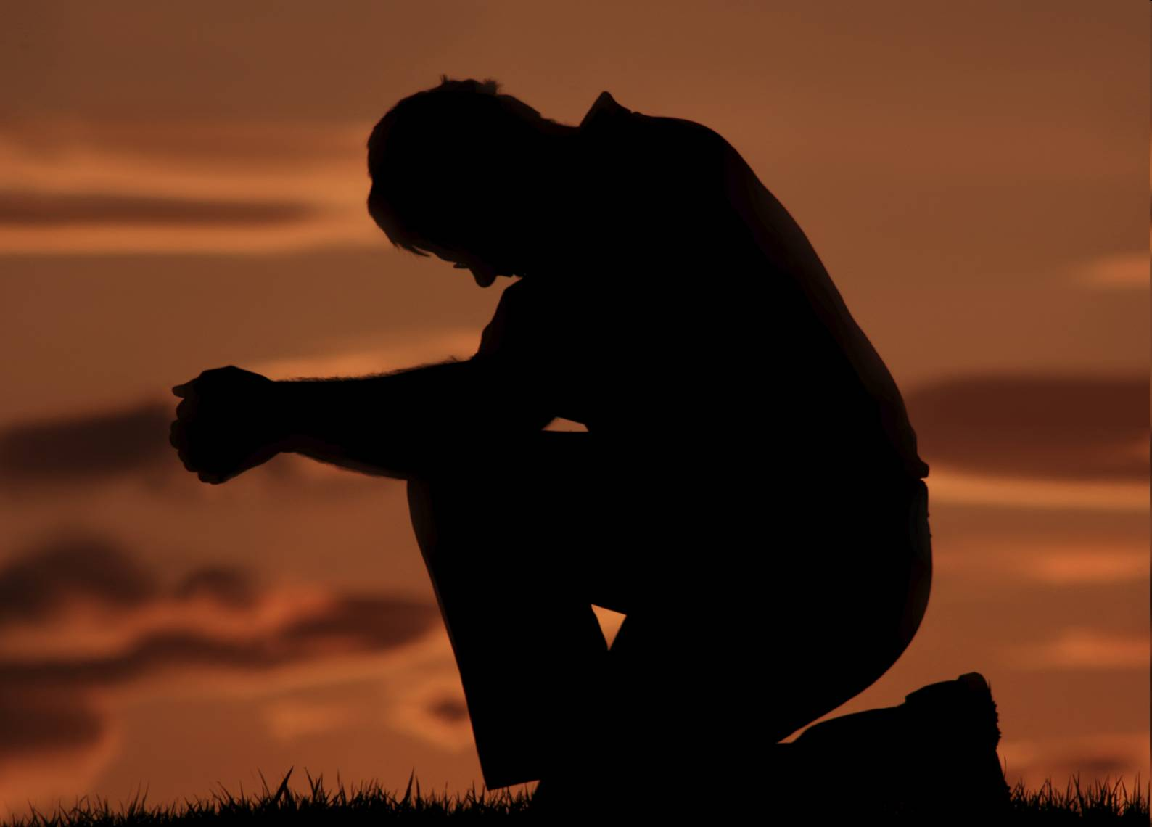

Slide 4
A father’s faith
I. Abraham was a meek and humble man.
³ (Now Moses was a very humble man, more humble than anyone else on the face of the earth.)
Numbers 12:3 (NIV)
Humility or meekness denotes that Abraham was:
a) Obedient to God.
b) Concerned about the welfare of others

Slide 5
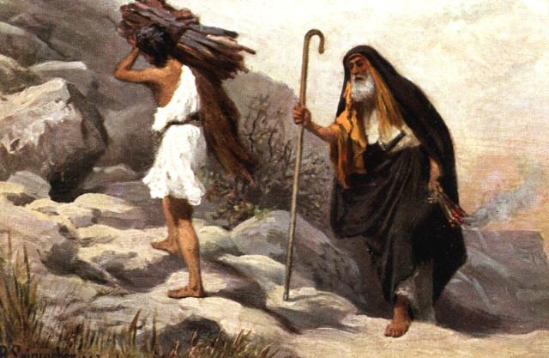
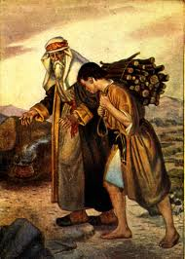
II. Abraham was a loving father.
Abraham loved his son deeply.
Abraham and Isaac
trudging forlornly up the mountainside

Slide 6
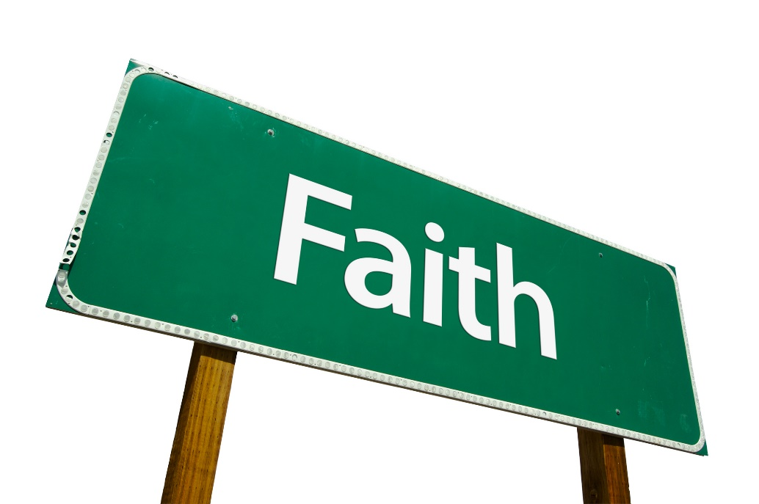
III. Abraham was a father who gave pre-eminence to the Lord.
“STRONG FAITH IS OFTEN EXERCISED WITH STRONG TRIALS AND PUT UPON HARD SERVICES”
Matthew Henry Commentary, p 41

Slide 7
III. Abraham was a father who gave pre-eminence to the Lord.
Now it came to pass after these things that God tested Abraham, and said to him, “Abraham!”
And he said, “Here I am.”
Genesis 22:1 (NKJV)
a) The test of Abraham’s faith.
² Then He said, “Take now your son, your only son Isaac, whom you love, and go to the land of Moriah, and offer him there as a burnt offering on one of the mountains of which I shall tell you.”
Genesis 22:2 (NIV)

Slide 8
III. Abraham was a father who gave pre-eminence to the Lord.
b) The results: God first, son second.
⁵ He said to his servants, “Stay here with the donkey while I and the boy go over there. We will worship and then we will come back to you.”
Genesis 22:5 (NIV)

Slide 9
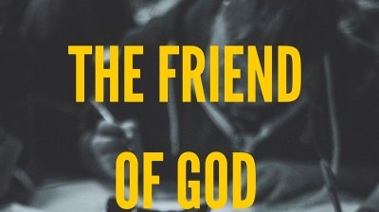
A father’s faith
I. Abraham was a meek and humble man.
II. Abraham was a loving father.
III. Abraham was a father who gave pre-eminence to the Lord.

Slide 10
⁶ Be glad about this, even though it may now be necessary for you to be sad for a while because of the many kinds of trials you suffer. ⁷ Their purpose is to prove that your faith is genuine. Even gold, which can be destroyed, is tested by fire; and so your faith, which is much more precious than gold, must also be tested, so that it may endure. Then you will receive praise and glory and honour on the Day when Jesus Christ is revealed.
1 Peter 1:6-7 (GNT)

Slide 11
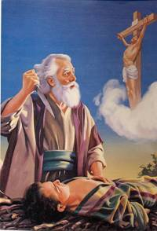
This obedience of Abraham in offering up Isaac is a lively representation of
1) The love of God to us.
The Lord says,
“It was my will that he should suffer; his death was a sacrifice to bring forgiveness….”
Isaiah 53:10 (GNT)

Slide 12
This obedience of Abraham in offering up Isaac is a lively representation of
2) Our duty to God.
Luke 14:26 (GNT)
“Those who come to me cannot be my disciples unless they love me more than they love father and mother, wife and children, brothers and sisters, and themselves as well.

Slide 13
“Abraham believed God, and it was credited to him as righteousness,” and he was called God’s friend.
James 2:23 (NIV)

Slide 14
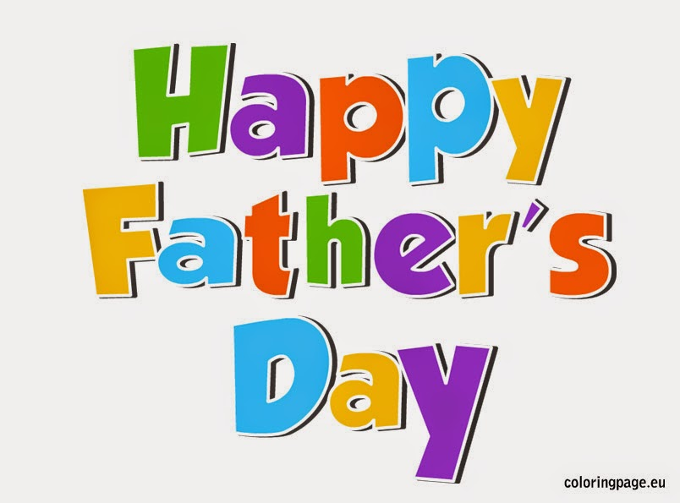
Whoever fears the Lord has a secure fortress, and for their children it will be a refuge.
Proverbs 14:26 (NIV)

