Slide 1
The Call of Ezekiel
“The word of the Lord came to Ezekiel the priest, the son of Buzi, by the Kebar River in the land of the Babylonians. There the hand of the Lord was on him”
Ezekiel 1:3 NIV

Slide 3
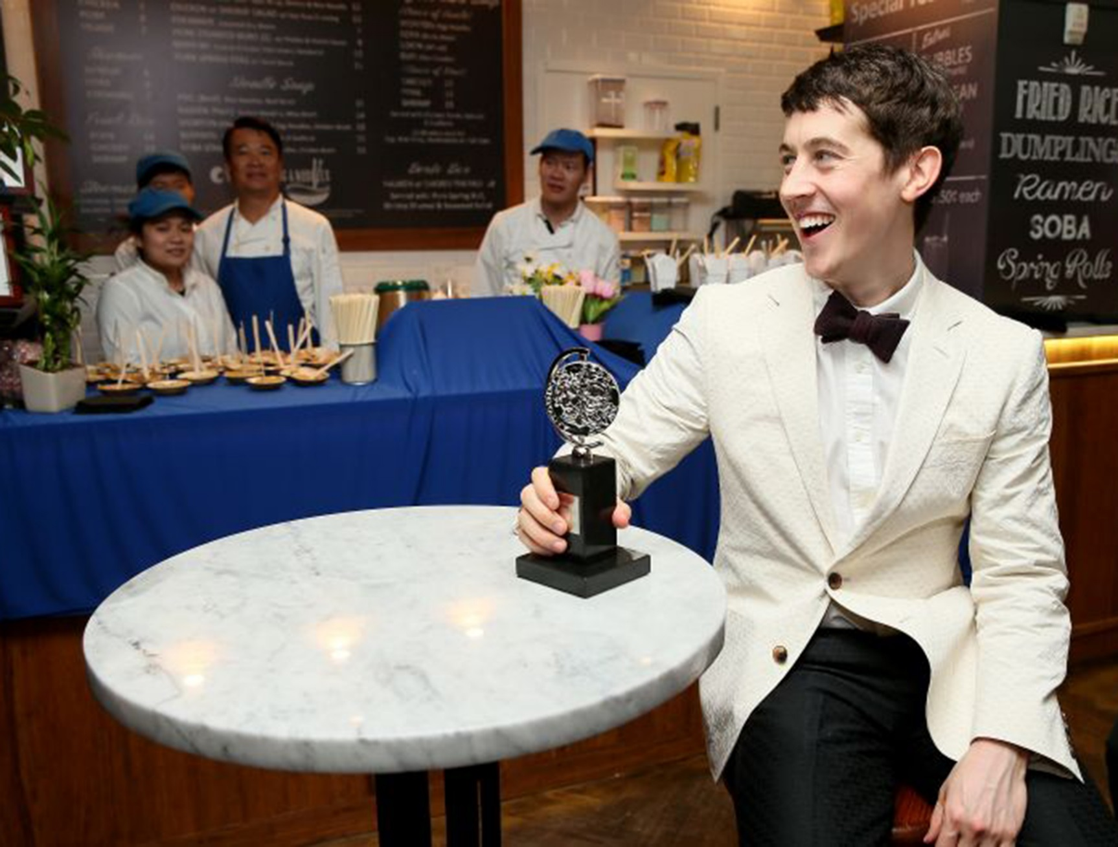
Tony Awards 2015: Best actor winner Alex Sharp was rejected by the UK's 'good drama schools'
Alex Sharp,
who was eventually accepted by the Juilliard School in New York, won the Tony for his first professional role – the lead in The Curious Incident of the Dog in the Night-Time, which won a further four awards on the night.

Slide 4
I. God equipped Ezekiel with courage.
⁶ And you, son of man, do not be afraid of them or their words. Do not be afraid, though briers and thorns are all around you and you live among scorpions. Do not be afraid of what they say or be terrified by them, though they are a rebellious people. ⁷ You must speak my words to them, whether they listen or fail to listen, for they are rebellious.
Ezekiel 2:6-7 (NIV)

Slide 5
II. God encourages Ezekiel to be a man of integrity.
“But you, son of man, listen to what I say to you. Do not rebel like that rebellious people; open your mouth and eat what I give you.”
Ezekiel 2:8 (NIV)
“Then he said to me, ‘Son of man, eat this scroll I am giving you and fill your stomach with it.’ So I ate it, and it tasted as sweet as honey in my mouth.”
Ezekiel 3:3 (NIV)

Slide 6
God encourages us to be people of integrity.
God calls his people to be sanctified, to be holy, to be different. The witness we have among people in our community is a sermon in itself. It gives us credibility or it robs us of it.
“You are to be holy to me because I, the Lord, am holy, and I have set you apart from the nations to be my own”. Leviticus 20:26 (NIV)

Slide 7
God encourages us to be people of integrity.
We cannot speak with authority against a sin
if we are involved in it.
People are watching to see
if we are people of integrity or not.

Slide 8
III. God evaluated Ezekiel’s success not on numbers,
but on obedience .
⁷ You must speak my words to them, whether they listen or fail to listen, for they are rebellious. ⁸ But I will make you as unyielding and hardened as they are. ⁹ I will make your forehead like the hardest stone, harder than flint. Do not be afraid of them or terrified by them, though they are a rebellious people.”
Ezekiel 3:7-9 (NIV)

Slide 9
“God is faithful, and He expects His people to be faithful.”
Vance Havner
The majority of the exiles were gripped with a sense of despair. Many things had happened to shake their faith. They feared that God had either completely cast them off or that his power was inferior to that of the gods of the Babylonians.
T.T. Crabtree

Slide 10
Ezekiel 18:20-23
The one who sins is the one who will die. The child will not share the guilt of the parent, nor will the parent share the guilt of the child. The righteousness of the righteous will be credited to them, and the wickedness of the wicked will be charged against them.
²¹ “But if a wicked person turns away from all the sins they have committed and keeps all my decrees and does what is just and right, that person will surely live; they will not die. ²² None of the offenses they have committed will be remembered against them. Because of the righteous things they have done, they will live. ²³ Do I take any pleasure in the death of the wicked? declares the Sovereign Lord. Rather, am I not pleased when they turn from their ways and live?...

Slide 11
Ezekiel 18:31-32 (NIV)
³¹ Rid yourselves of all the offenses you have committed, and get a new heart and a new spirit. Why will you die, people of Israel? ³² For I take no pleasure in the death of anyone, declares the Sovereign Lord. Repent and live!

Slide 12
We, like Ezekiel, should “eat the book.” By so doing we will give God a better opportunity to speak to us, and we will have a message for the people of our day. We are not called to be a success; we are called to be faithful.
I. God equipped Ezekiel with courage.
II. God encouraged Ezekiel to be a man of integrity.
III. God evaluated Ezekiel’s success not on numbers,
but on obedience .

Slide 13
Ezekiel 18:31-32 (NIV)
³¹ Rid yourselves of all the offenses you have committed, and get a new heart and a new spirit. Why will you die, people of Israel? ³² For I take no pleasure in the death of anyone, declares the Sovereign Lord. Repent and live!

