Slide 1

Mould culture?
“Being Changed by Christ to mould our Culture”

Slide 2
Colossians 3:1-11 (NIV)
Living as Those Made Alive in Christ
Since, then, you have been raised with Christ, set your hearts on things above, where Christ is, seated at the right hand of God. ² Set your minds on things above, not on earthly things. ³ For you died, and your life is now hidden with Christ in God. ⁴ When Christ, who is your life, appears, then you also will appear with him in glory.
⁵ Put to death, therefore, whatever belongs to your earthly nature: sexual immorality, impurity, lust, evil desires and greed, which is idolatry. ⁶ Because of these, the wrath of God is coming

Slide 3
Colossians 3:1-11 (NIV)
⁷ You used to walk in these ways, in the life you once lived. ⁸ But now you must also rid yourselves of all such things as these: anger, rage, malice, slander, and filthy language from your lips. ⁹ Do not lie to each other, since you have taken off your old self with its practices ¹⁰ and have put on the new self, which is being renewed in knowledge in the image of its Creator. ¹¹ Here there is no Gentile or Jew, circumcised or uncircumcised, barbarian, Scythian, slave or free, but Christ is all, and is in all.

Slide 4
Let’s Pray…

Slide 5
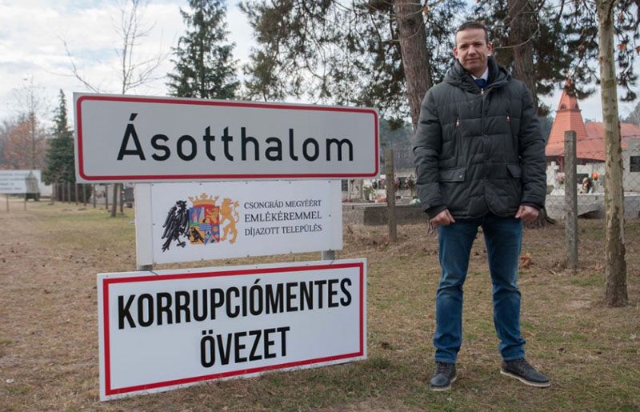
The village of Asotthalom is close to the Hungary-Serbia border
The mayor Mr Laszlo Toroczkai said;
"We primarily welcome people from western Europe - people who wouldn't like to live in a multicultural society,“…we are Christians, It's very important for the village to preserve its traditions.

Slide 6
1. New minds (Colossians 3:1-4)
“Since, then, you have been raised with Christ, set your hearts on things above, where Christ is, seated at the right hand of God. ² Set your minds on things above, not on earthly things.”
Colossians 3:1-2 (NIV)
“Seek the things that are above”

Slide 7

How does this hidden life become real to us?
Paul encourage believers to know the Lord. How?
We have words here in the Bible
“His divine power has given us everything we need for life and godliness through our knowledge of Him…”
2 Peter 1:3 (NIV)

Slide 8
“We must be dead to the world that we may live to Christ.”
T.H.L. Parker, Calvin’s New Testament Commentaries, Eerdmans Publishing 1974, p346
³ For you died, and your life is now hidden with Christ in God. ⁴ When Christ, who is your life, appears, then you also will appear with him in glory.
Colossian 3:3-4 (NIV)

Slide 9
New minds in Jesus Christ
“There will be this difference-from now on the Christian will see everything in the light and against the background of eternity…He will no longer live as if this world was all that mattered; he will see this world against the background of the large world of eternity”
Barclay, William, The letter to the Philippians, Colossians and Thessalonians. The Daily Study Bible. Philadelphia: Westminster, 1959, p177.
Christ is the essence of the Christian life.

Slide 10
2. New life (Colossians 3:5-10)
Put to death, therefore, whatever belongs to your earthly nature: sexual immorality, impurity, lust, evil desires and greed, which is idolatry.
Colossians 3:5 (NIV)
‘Put to death’

Slide 11
a) “Sexual immorality.”
“Put off all sexual immorality.”
b) Impurity.
It is the word for “uncleanness.”
c) Lust.
This refers to erotic passions which are aroused
If a man looks after a woman and
lusts after her in his heart.
d) Evil desires.
e) Greed.

Slide 12

“Because of these, the wrath of God is coming”…
Colossians 3:6 (NIV)
His judicial reaction to evil

Slide 13
Romans 1:18 (NIV)
The wrath of God is being revealed from heaven against all the godlessness and wickedness of people, who suppress the truth by their wickedness,
There is a future wrath of God:
Romans 2:5 (NIV)
But because of your stubbornness and your unrepentant heart, you are storing up wrath against yourself for the day of God’s wrath, when his righteous judgment will be revealed.
Romans 2:8
Romans 3:5 and 9:22

Slide 14
There is a Wrath of God in the Present:
Therefore God gave them over in the sinful desires of their hearts to sexual impurity for the degrading of their bodies with one another…²⁶ Because of this, God gave them over to shameful lusts. Even their women exchanged natural sexual relations for unnatural ones. ²⁷ In the same way the men also abandoned natural relations with women and were inflamed with lust for one another. Men committed shameful acts with other men, and received in themselves the due penalty for their error. ²⁸ Furthermore, just as they did not think it worthwhile to retain the knowledge of God, so God gave them over to a depraved mind, so that they do what ought not to be done.
Romans 1:24, 25-28 (NIV)

Slide 15
There is a Wrath of God in the Present:
He removes the restraints within society against evil and lets it have its way.
Romans 6 says, “the wages of sin is death.”
“You used to walk in these ways, in the life you once lived.”
Colossians 3:7 (NIV)

Slide 16
New life
“For sin shall no longer be your master, because you are not under the law, but under grace.”
Romans 6:14 (NIV)
A change has come. You are no longer what you once were.
But now you must also rid yourselves of all such things as these: anger, rage, malice, slander, and filthy language from your lips. ⁹ Do not lie to each other, since you have taken off your old self with its practices
Colossians 3:8-9 (NIV)

Slide 17
How to live this new life when we struggle with sin every day?
a) By fixing our thoughts on Christ.
b) By applying the gospel.
“The Gospel is essentially a reproductive organism, a plant whose seed is in itself”.
Lightfoot, J.B. St Paul’s Epistles to the Colossians and to Philemon, London: Macmillan, 1879, p135.

Slide 18
c) By depending on the Holy Spirit.
“and have put on the new self, which is being renewed in knowledge in the image of its Creator.”
Colossians 3:10 (NIV)
And we all, who with unveiled faces contemplate the Lord’s glory, are being transformed into his image with ever-increasing glory, which comes from the Lord, who is the Spirit.
2 Corinthians 3:18 (NIV)

Slide 19
3. New community (Colossians 3:11)
“Here there is no Gentile or Jew, circumcised or uncircumcised, barbarian, Scythian, slave or free, but Christ is all, and is in all.”
Colossians 3:11 (NIV)
The Oneness of the body

Slide 20
Martin Luther said;
“The more we give ourselves to God the more He gives Himself to us. If we give only a little of ourselves to Him then he is able to give only a little of Himself to us”
How much of ourselves are we prepared to entrust to Jesus and the Holy Spirit?

Slide 21
The village of Asotthalom
As we seek to ‘mould culture’ on our frontlines.
The Lord calls us to put to death sin in our lives.

Slide 22
a) By fixing our thoughts on Christ.
b) By applying the gospel.
c) By depending on the Holy Spirit.
⁷ Submit yourselves, then, to God. Resist the devil, and he will flee from you. ⁸ Come near to God and he will come near to you. Wash your hands, you sinners, and purify your hearts, you double-minded…¹⁰ Humble yourselves before the Lord, and he will lift you up.
James 4:7-8, 10 (NIV)

Slide 23
“Being Changed by Christ to mould our Culture”

