Slide 1
Hebrews 12:26-27 (NIV)
At that time his voice shook the earth, but now he has promised, “Once more I will shake not only the earth but also the heavens.²⁷ The words “once more” indicate the removing of what can be shaken—that is, created things—so that what cannot be shaken may remain.

Slide 3

Christian Aid Week
This year’s Christian Aid Week focussed on refugees. Christian Aid’s support for refugees have been there since 1945…

Slide 4
Hebrews 12:26 (NIV)
At that time his voice shook the earth, but now he has promised, “Once more I will shake not only the earth but also the heavens.

Slide 5
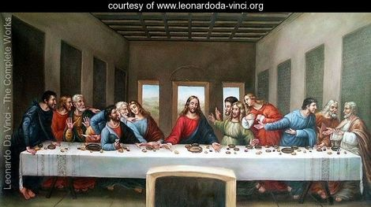
All that can be shaken will be shaken
I. Let’s see an example.
Luke 22:21-22 (NIV)
²¹ But the hand of him who is going to betray me is with mine on the table. ²² The Son of Man will go as it has been decreed. But woe to that man who betrays him!”

Slide 6
Luke 22:23 (NIV)
“They began to question among themselves which of them it might be who would do this.”
Luke 22:24 (NIV)
²⁴ A dispute also arose among them as to which of them was considered to be greatest.

Slide 7
Luke 22:25-27 (NIV)
²⁵ Jesus said to them, “The kings of the Gentiles lord it over them; and those who exercise authority over them call themselves Benefactors. ²⁶ But you are not to be like that. Instead, the greatest among you should be like the youngest, and the one who rules like the one who serves. ²⁷ For who is greater, the one who is at the table or the one who serves? Is it not the one who is at the table? But I am among you as one who serves.

Slide 8
II. The purpose of sifting
Romans 3:10-11 (NIV)
¹⁰ By the grace God has given me, I laid a foundation as a wise builder, and someone else is building on it. But each one should build with care. ¹¹ For no one can lay any foundation other than the one already laid, which is Jesus Christ.
Luke 22:31 (NIV)
“Simon, Simon, Satan has asked to sift all of you as wheat.”

Slide 9
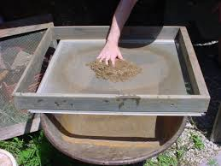
The word “sift” is translated from the Greek word siniazo
Sift = siniazo
It means “to sift, shake in a sieve; fig. by inward agitation to try one’s faith to the verge of overthrow”
Luke 22:32 (NIV)
“But I have prayed for you, Simon, that your faith may not fail. And when you have turned back, strengthen your brothers.”

Slide 10
JUDAS VERSUS PETER

Slide 11
JUDAS
Matthew 27:3-5 (NIV)
³ When Judas, who had betrayed him, saw that Jesus was condemned, he was seized with remorse and returned the thirty pieces of silver to the chief priests and the elders. ⁴ “I have sinned,” he said, “for I have betrayed innocent blood.”
“What is that to us?” they replied. “That’s your responsibility.”
⁵ So Judas threw the money into the temple and left. Then he went away and hanged himself.

Slide 12
Mark 4:16-17
¹⁶ And these are they likewise which are sown on stony ground; who, when they have heard the word, immediately receive it with gladness; ¹⁷ And have no root in themselves, and so endure but for a time: afterward, when affliction or persecution ariseth for the word's sake, immediately they are offended.

Slide 13
If we look at situations only from our limited point of view.
Two things could happen:
First, in the midst of God’s process we will be easy prey to offense.
Second, we can easily be deceived by the enemy.
What are we to do?

Slide 14
III. We are to depend on God’s character
Genesis 3:1 (NIV)
Now the serpent was more crafty than any of the wild animals the Lord God had made. He said to the woman, “Did God really say, ‘You must not eat from any tree in the garden’?”

Slide 15
God had said;
Genesis 2:16-17 (NIV)
And the Lord God commanded the man, “You are free to eat from any tree in the garden; ¹⁷ but you must not eat from the tree of the knowledge of good and evil, for when you eat from it you will certainly die.”
Eve was deceived and believed a lie about God’s character

Slide 16
III. We are to depend on God’s character
When we go through difficult situations faith says; “I trust You even though I don’t understand”
When we depend on God’s character we become humble.
1 Peter 5:5 (NIV)
In the same way, you who are younger, submit yourselves to your elders. All of you, clothe yourselves with humility toward one another, because, “God opposes the proud but shows favour to the humble.”

Slide 17
Philippians 3:3 (NIV)
For it is we who are the circumcision, we who serve God by his Spirit, who boast in Christ Jesus, and who put no confidence in the flesh
Galatians 1:6 (NIV)
God sends the Spirit of His Son into our hearts, the Spirit who calls out, ‘Abba Father’…

Slide 18
The best translation of the word ‘Abba’ is not ‘Daddy’ but ‘Dear’.
Professor C.F.D Moule (and many other scholarly Bible expositors).
The Abba cry is the cry of obedience and utter trust.
When the Spirit prompt us to cry ‘Abba, Father’, His real aim is to prompt us to reach the same level of commitment and surrender to the will of God that Jesus demonstrated.

Slide 19
All that can be shaken will be shaken
—so that what cannot be shaken may remain.
The Abba cry is the cry of obedience and utter trust.
It says:
‘Dear Father, I don’t understand all that You are doing, but because I am secure in Your love I offer You my deepest adoration, my fullest loyalty and my dependent trust.’

