Slide 1
Then the eleven disciples went to Galilee, to the mountain where Jesus had told them to go (v.16)

Slide 2
The Great Commission
All authority in heaven and on earth has been given to me. Therefore go and make disciples of all nations, baptizing them in the name of the Father and of the Son and of the Holy Spirit, and teaching them to obey everything I have commanded you. And surely I am with you always, to the very end of the age (vv.19,20)

Slide 3
Dying and Rising

Slide 4
Dying and Rising
Easter is about what happened to Jesus, but it’s also about what happens to us!

Slide 5
Praise be to the God and Father of our Lord Jesus Christ! In his great mercy he has given us new birth into a living hope through the resurrection of Jesus Christ from the dead (1 Pet.1:3)

Slide 6
....baptising them in the name of the Father and of the Son and of the Holy Spirit (v.19)

Slide 7
Don't you know that all of us who were baptised into Christ Jesus were baptised into his death? We were therefore buried with him through baptism into death in order that, just as Christ was raised from the dead through the glory of the Father, we too may live a new life (Rom.6:3,4)

Slide 8
What does it mean to become a Christian?
Our part: Repentance and Faith

Slide 9
“If ever a monk could be saved by his monkery, such a monk was I” (Martin Luther)

Slide 10
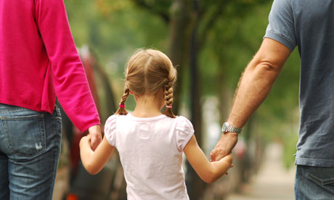

Slide 11
What does it mean to become a Christian?
God’s part: Forgiveness and the gift of the Holy Spirit

Slide 12
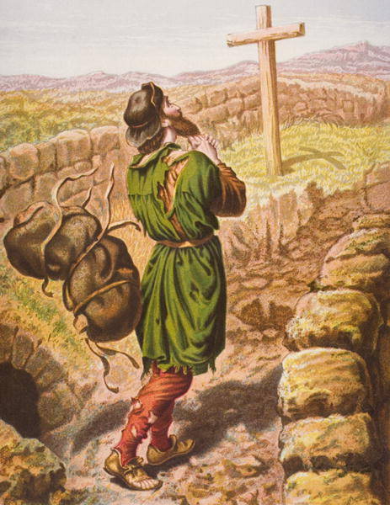
Just as if I'd never sinned'

Slide 13
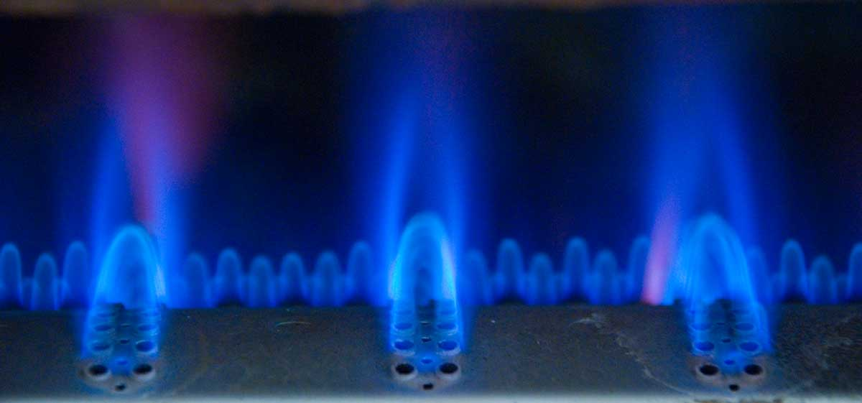

Slide 14
All authority in heaven and on earth has been given to me. Therefore go and make disciples of all nations, baptizing them in the name of the Father and of the Son and of the Holy Spirit, and teaching them to obey everything I have commanded you. And surely I am with you always, to the very end of the age (vv.19,20)

