Slide 1
^{Matthew 24: 10-14 (NKJV)}
¹⁰ And then many will be offended, will betray one another, and will hate one another. ¹¹ Then many false prophets will rise up and deceive many. ¹² And because lawlessness will abound, the love of many will grow cold. ¹³ But he who endures to the end shall be saved. ¹⁴ And this gospel of the kingdom will be preached in all the world as a witness to all the nations, and then the end will come.

Slide 2
Luke 17:1 (NKJV)
Then He said to the disciples,
“It is impossible that no offenses should come,
but woe to him through whom they do come!”

Slide 3
^{Let’s pray…}

Slide 4
^{Matthew 24: 9 (NIV)}
“Then they will deliver you to tribulation, and will kill you, and you will be hated by all nations because of My name.

Slide 5
How does Jesus see the Church responding in the End Times?
^{Matthew 24: 10-14 (NKJV)}
¹⁰ And then many will be offended, will betray one another, and will hate one another. ¹¹ Then many false prophets will rise up and deceive many. ¹² And because lawlessness will abound, the love of many will grow cold. ¹³ But he who endures to the end shall be saved. ¹⁴ And this gospel of the kingdom will be preached in all the world as a witness to all the nations, and then the end will come.

Slide 6
Who are these offended?
… And because lawlessness will abound, the love of many will grow cold….
The Greek word for love in this verse is agape
agape and phileo.

Slide 7
Phileo = defines a love found among friends.
(You treat me kindly and I’ll do the same)
Agape = is the love of God sheds abroad in the hearts
of His children
(It is not based on performance or
even whether it is returned.
It is a love that gives even when rejected.)

Slide 8
Luke 17:1 (NKJV)
Then He said to the disciples,
“It is impossible that no offenses should come,
but woe to him through whom they do come!”

Slide 9
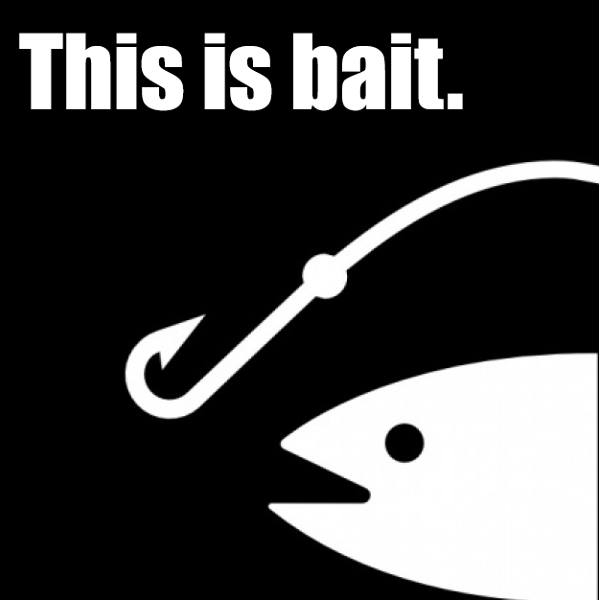
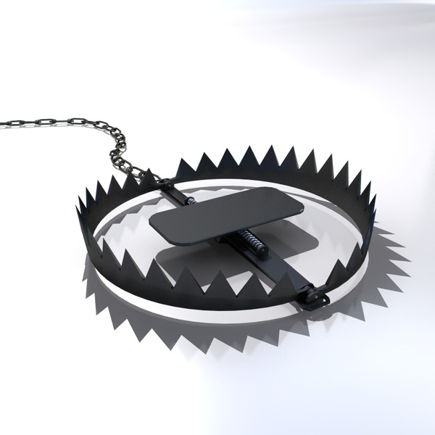
I. We need to be aware about “The deceptive Trap”
Offence:
Is a tool of the devil to bring people into captivity.

Slide 10
II. The problem: Great expectations
The outcome: Walls of Protection
Proverbs 18:19 (NKJV)
A brother offended is harder to win than a strong city, And contentions are like the bars of a castle.

Slide 11
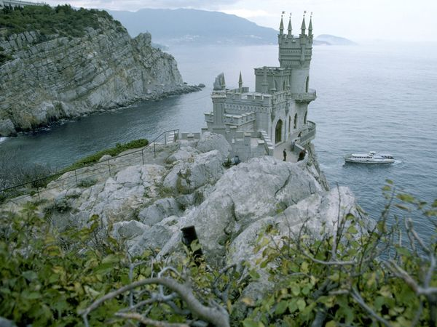
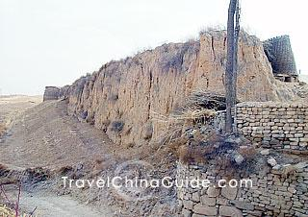
The outcome: Walls of Protection
We open our lives only
to those we believe are
on our side.

Slide 12
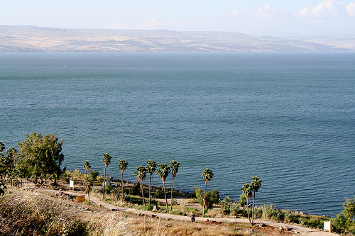
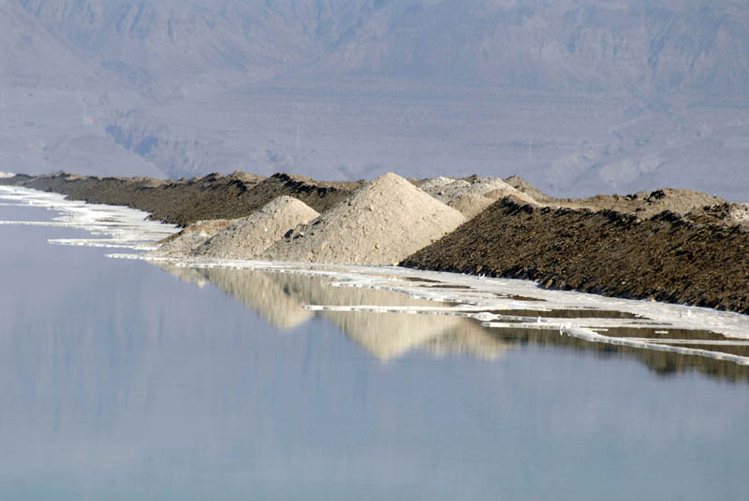
UNCONDITIONAL LOVE GIVES OTHERS THE RIGHT TO HURT US.
The sea of Galilee
The Dead Sea
An offended Christian is one who takes in life but because of fear, cannot release life.

Slide 13
2 Corinthians 10:4-5 (NKJV)
⁴ For the weapons of our warfare are not carnal but mighty in God for pulling down strongholds, ⁵casting down arguments and every high thing that exalts itself against the knowledge of God, bringing every thought into captivity to the obedience of Christ,
THE KNOWLEDGE OF GOD’S WORD WITHOUT LOVE IS A DESTRUCTIVE FORCE BECAUSE IT PUFFS US UP WITH PRIDE AND LEGALISM.

Slide 14
When we are Not having a right correlation between our mind and heart is dangerous because this causes us to justify ourselves rather than repent and forgiveness.
He says; “Then many false prophets will rise up and deceive many”
(Matthew 24:11)

Slide 15
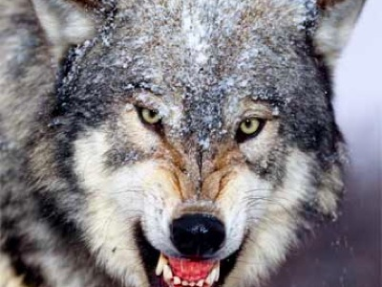
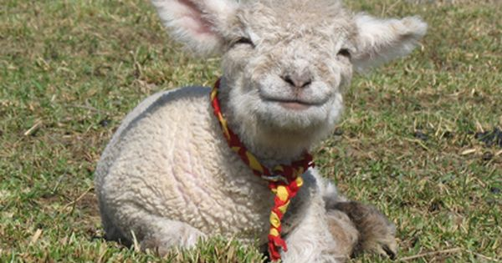
Matthew 7:15
“Watch out for false prophets. They come to you in sheep’s clothing, but inwardly they are ferocious wolves.
Wolves always go after the wounded and young sheep, not the healthy strong ones.

Slide 16
2 Timothy 3:1-5 (NKJV)
But know this, that in the last days perilous times will come: ² For men will be lovers of themselves, lovers of money, boasters, proud, blasphemers, disobedient to parents, unthankful, unholy, ³ unloving, unforgiving, slanderers, without self-control, brutal, despisers of good, ⁴ traitors, headstrong, haughty, lovers of pleasure rather than lovers of God, ⁵ having a form of godliness but denying its power. And from such people turn away!

Slide 17
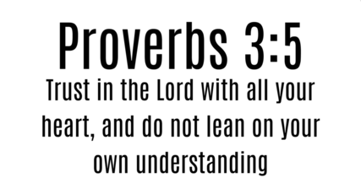
III. What to do?
We are to trust in the Lord.

Slide 18
Trust in the Lord
Trust in the Lord with all your heart And lean not on your own understanding Trust in the Lord with all your heart And lean not on your own understanding
This is what it says In Proverbs three verse five Don't rely on what you've got Learn to rely on the Lord

Slide 19
How, can I develop my faith?
Psalm 18:32-33 (NKJV)
It is God who arms me with strength, And makes my way perfect. ³³ He makes my feet like the feet of deer, And sets me on my high places.

Slide 20
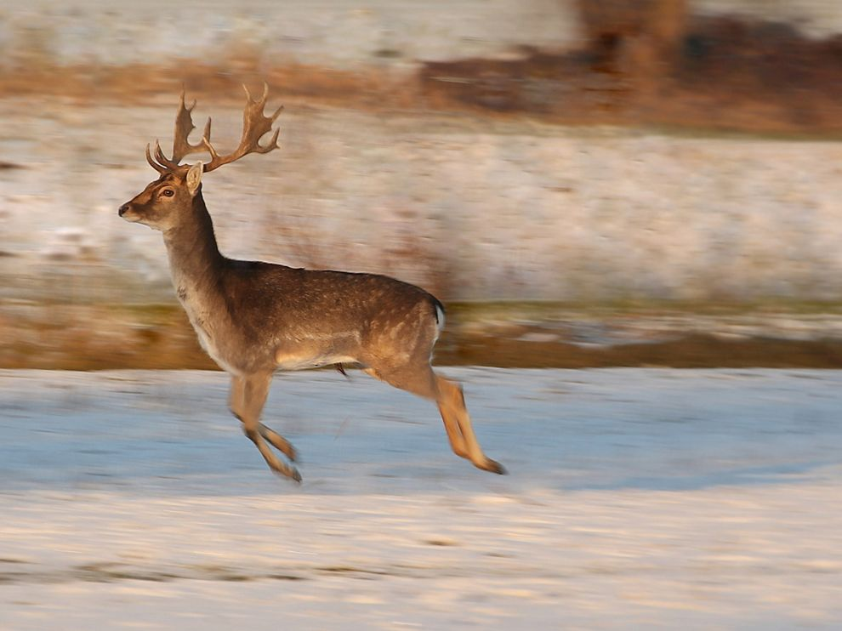
The deer has an amazing ability when climbing a steep mountain slope, of ensuring that its back feet align on the exact spot where its front feet were positioned.
What the deer experiences in the natural realm, we can experience in the spiritual realm.

Slide 21

Do you really want to be free from an unforgiving heart?
Do you really want to climb higher with God than you have ever gone before?
Habakkuk 3:19 (NIV)
The Sovereign Lord is my strength; he makes my feet like the feet of a deer, he enables me to tread on the heights

Slide 22
Luke 17:1 (NKJV)
Then He said to the disciples,
“It is impossible that no offenses should come,
but woe to him through whom they do come!”
^{Matthew 24: 10 (NKJV)}
And then many will be offended, will betray one another, and will hate one another.
But he who endures to the end shall be saved.

Slide 23
Habakkuk 3:19 (NASB)
The Lord God is my strength, And He has made my feet like hinds’ feet, And makes me walk on my high places.

