Slide 1


Slide 2

“I know what to do, I know the best people, I always win, knock on wood.
It’s what I do. I beat people. I win”

Slide 3
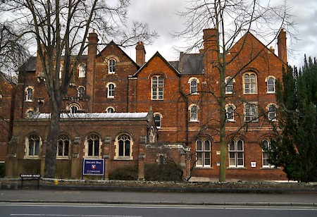
Oxford Wycliffe hall theological college
“Thanks to Oxford’s Wycliffe hall theological college as it launches to adopt gender-neutral language. They’re invited to replace “son” with “child” and stop calling God “He”. Scoff if you like but this may not be a point of political correctness so much as theology. By any sophisticated account, God is unlikely to be gendered in a recognisable way. God has not had a beard, he is not a man.

Slide 4

The Big Picture
Proclaiming Christ as Lord
Model godly character?

Slide 5
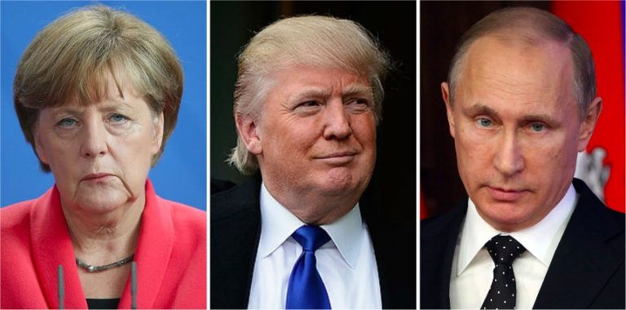
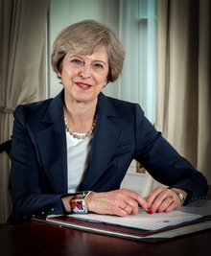
How do I fit in this big picture?
Oxford Wycliffe hall theological college

Slide 6
How do I fit in this big picture?
Make good work?
Let’s read from Colossians 3:17-4:1

Slide 7
Colossians 3:17-4:1 (NKJV)
¹⁷ And whatever you do in word or deed, do all in the name of the Lord Jesus, giving thanks to God the Father through Him.
The Christian Home
¹⁸ Wives, submit to your own husbands, as is fitting in the Lord. ¹⁹ Husbands, love your wives and do not be bitter toward them. ²⁰ Children, obey your parents in all things, for this is well pleasing to the Lord. ²¹ Fathers, do not provoke your children, lest they become discouraged.

Slide 8
Colossians 3:17-4:1 (NKJV)
²² Bondservants, obey in all things your masters according to the flesh, not with eye service, as men-pleasers, but in sincerity of heart, fearing God. ²³ And whatever you do, do it heartily, as to the Lord and not to men, ²⁴ knowing that from the Lord you will receive the reward of the inheritance; for you serve the Lord Christ. ²⁵ But he who does wrong will be repaid for what he has done, and there is no partiality.
Masters, give your bondservants what is just and fair, knowing that you also have a Master in heaven.

Slide 9
Let’s pray…

Slide 10
Principles for those working for Christ
“Bondservants, obey in all things your masters according to the flesh, not with eye service, as men-pleasers, but in sincerity of heart, fearing God.”
Colossians 3:22 (NKJV)
Bondservants comes from the word doulos. And is defined as:
1. a slave, bondman, a man of servile condition
2. devoted to another to the disregard of
one’s own interests.
3. a servant, attendant.

Slide 11
The best definition for Bondservant is
“devoted to another to the disregard of one’s own interest”
“Every good endeavour”, by Timothy Keller
“The slavery of this ancient world was not race based, often times it was not life long, the slavery was not supply”
Often the slaves were treated respectably, the average was 10 years. A person could enter into slavery willingly.
Slaves can own slaves they were doctor, administrators.

Slide 12
The best definition for Bondservant is
“devoted to another to the disregard of one’s own interest”
“A Bondservant is to love as Christ love; to walk as Christ walked…Being a Bondservant is standing strong in the Word of God while seeking God first, above all else. Everything is secondary to your relationship with Him.”
Tim Aka

Slide 13
Principles for those working for Christ
I. My whole life belongs to Jesus.
Colossians 3:17 says;
“…whatever you do, whether in word or deed, do it all in the name of the Lord Jesus…
Colossians 3:23
“Whatever you do, work at it with all your heart, as working for the Lord, not for men”.
Obey you are not doing it to people, you will do it to the Lord…do it with all your heart…

Slide 14
What would change if they do this?
Colossians 3:24 (NIV)
“Since you know that you will receive an inheritance from the Lord as a reward. It is the Lord you are serving”
The bondservant has an inheritance in Christ
“There is neither Jew nor Greek, slave nor free, male nor female, for you are all one in Christ Jesus”
Galatians 3:28 (NIV)

Slide 15
Principles for those working for Christ
II. Relationships are two-way
Colossians 3:25
“But he who does wrong will be repaid for what he has done, and there is no partiality.”
If someone does something wrong to you do not worry, God is in charge.

Slide 16
Colossians 4:7-9 (NIV)
“Tychicus will tell you all the news about me. He is a dear brother, a faithful minister and fellow servant in the Lord. I am sending him to you for the expressing purpose that you may know about our circumstances and that he may encourage your hearts. He is coming with Onesimus, our faithful and dear brother who is one of you. They will tell you everything that is happening here.”

Slide 17
III. Motivation should be Christ-centred.
Verse 18 says; “…as is fitting in the Lord”
Verse 20; “…for this pleases the Lord”
Verse 23; “…reverence for the Lord”
4:1; “…because you know that you have a Master in heaven”
1 Corinthian 10:31 (NIV) said, do all for the glory of God.
So whether you eat or drink or whatever you do, do it all for the glory of God.

Slide 18




Romans 6:20 (NIV)
When you were slaves to sin, you were free from the control of righteousness.
What master do we have in our lives?

Slide 19
“Jesus said, "If you hold to my teaching, you are really my disciples. Then you will know the truth, and the truth will set you free." They answered him, "We are Abraham's descendants and have never been slaves of anyone. How can you say that we shall be set free?" Jesus replied, "I tell you the truth, everyone who sins is a slave to sin. Now a slave has no permanent place in the family, but a son belongs to it forever. So if the Son sets you free, you will be free indeed"
John 8:31-36

Slide 20
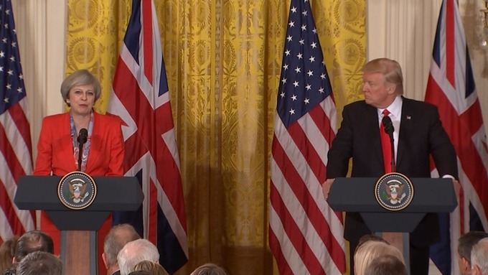




Slide 21
Principles for those working for Christ
I. My whole life belongs to Jesus.
II. Relationships are two-way
III. Motivation should be Christ-centred.

