Slide 3
The Lord’s Supper: On Being Involved
²³ Then he said to them all: “Whoever wants to be my disciple must deny themselves and take up their cross daily and follow me. ²⁴ For whoever wants to save their life will lose it, but whoever loses their life for me will save it. ²⁵ What good is it for someone to gain the whole world, and yet lose or forfeit their very self? ²⁶ Whoever is ashamed of me and my words, the Son of Man will be ashamed of them when he comes in his glory and in the glory of the Father and of the holy angels.
Luke 9:23-26 (NIV)
²⁶ For whenever you eat this bread and drink this cup, you proclaim the Lord’s death until he comes.
1 Corinthians 11:26 (NIV)

Slide 4
Let us Pray….

Slide 5
The Lord’s Supper: On Being Involved
The cross of Christ is God’s involvement.
“Then he said to them all: “Whoever wants to be my disciple must deny themselves and take up their cross daily and follow me.”
Luke 9:23 (NIV)
The cross reminds us that a Saviour who is willing to become involved at the point of death can never be content with disciples who are uncommitted.

Slide 6
II. Discipleship is our involvement.
“For whoever wants to save their life will lose it, but whoever loses their life for me will save it.”
Luke 9:24 (NIV)
Conversion is equivalent to involvement with Christ as Saviour. This is why Christ said to his disciples,
“I am the way, the truth, and the life.”

Slide 7
III. Communion is joint involvement.
Genuine Christian fellowship =
(koinonia).
a) Involvement by identification.
First Corinthians 11:26 says that as often as we do this we “proclaim the Lord’s death.”
“You desire truth in the inward parts, And in the hidden part You will make me to know wisdom.”
Psalm 51:6 (NKJV)

Slide 8
We cannot have true communion with God,
We cannot battle with the devil until
we have girded our waist with truth.
(koinonia).
What does Paul’s phrase, “Stand firm then, with the belt of truth buckled around your waist,…” Ephesians 6:14”, really mean?
No truth – no Communion with God.
No truth – no power over Satan.

Slide 9
b) Involvement by way of reminder.
“Search me, God, and know my heart; test me and know my anxious thoughts.”
Psalm 139:23 (NIV)
Mental health experts tells us that willing to face the truth about ourselves is an important part of our growth toward maturity.
“Defense mechanisms”
“Lying mechanisms”

Slide 11
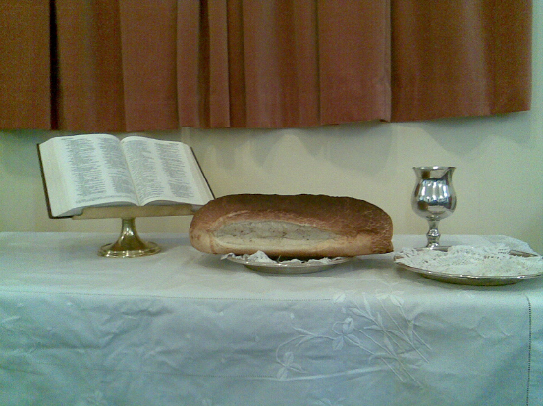
The cross of Christ is God’s involvement
II. Discipleship is our involvement.
III. Communion is joint involvement.
We cannot have true communion with God,
We cannot battle with the devil until
we have girded our waist with truth.

