Slide 1
Model godly character?
Minister grace and love?
Make good work?
Mould culture?
Be a Mouthpiece for truth and justice?
Be a Messenger of the gospel?

Slide 2
Modelling Godly Character
Galatians 5:13-26 (NIV)

Slide 3
Modelling Godly Character
I pray that your love will overflow more and more, and that you will keep on growing in knowledge and understanding. For I want you to understand what really matters, so that you may live pure and blameless lives until the day of Christ’s return. May you always be filled with the fruit of your salvation – the righteous character produced in your life by Jesus Christ – for this will bring much glory and praise to God.’
Philippians 1:9-11 (NLT)
Let’s pray…

Slide 4
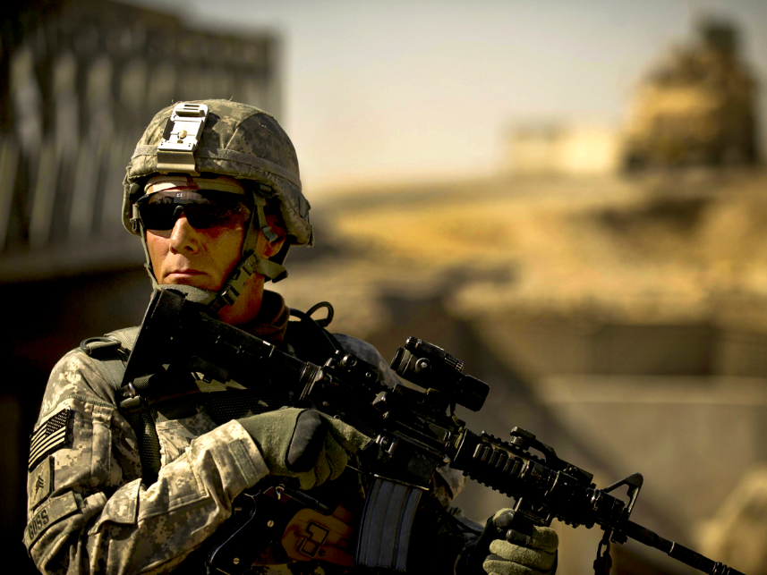
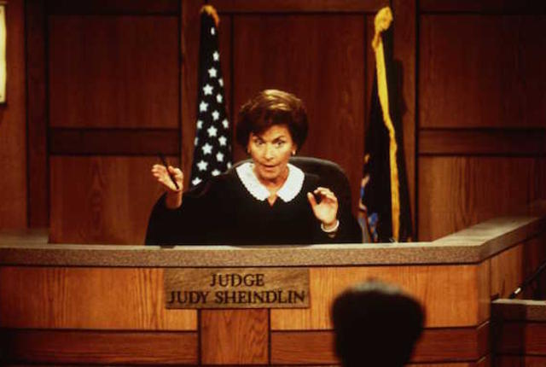
Character

Slide 5
Model godly character?
In tough times and easy ones, with difficult people and delightful people, how might you manifest the fruit of the Spirit – love, joy, peace, patience, kindness, goodness, faithfulness, gentleness and self-control?
Which one is a struggle for you?
Are you praying that you grow in the Christ-likeness of your responses?

Slide 6
Freedom
“Do not let yourselves be burdened again by a yoke of slavery”…
Galatians 5:1 (NIV)
For in Christ Jesus neither circumcision nor uncircumcision has any value. The only thing that counts is faith expressing itself through love.
Galatians 5:6 (NIV)
“In Christ Jesus neither circumcision avail anything, nor uncircumcision, but faith working through LOVE”

Slide 7
I. The abuse of Freedom
“You, my brothers and sisters, were called to be free. But do not use your freedom to indulge the flesh; rather, serve one another humbly in love.”
Galatians 5:13 (NIV)
“Biblical freedom” is a freedom from NOT freedom to
Freedom must be maintained, but it must not be abused. For the apostle Paul says;
“But do not use your freedom to indulge the sinful nature”

Slide 8
I. The abuse of Freedom
For the entire law is fulfilled in keeping this one command: “Love your neighbour as yourself.”
Galatians 5:14 (NIV)
If you bite and devour each other, watch out or you will be destroyed by each other.
Galatians 5:15 (NIV)
You will be destroyed

Slide 9
Those who belong to Christ Jesus have crucified the flesh with its passions and desires.
Galatians 5:24 (NIV)
Let us not become conceited, provoking and envying each other.
Galatians 5:26 (NIV)

Slide 10
II. What to do with our freedom?
So I say, walk by the Spirit, and you will not gratify the desires of the flesh.
Galatians 5:16 (NIV)
As we are saved by the Spirit we will be led by the Spirit.

Slide 11
II. What to do with our freedom?
You foolish Galatians! Who has bewitched you? Before your very eyes Jesus Christ was clearly portrayed as crucified. ² I would like to learn just one thing from you: Did you receive the Spirit by the works of the law, or by believing what you heard? ³ Are you so foolish? After beginning by means of the Spirit, are you now trying to finish by means of the flesh?
Galatians 3:1-3 (NIV)
As we are saved by the Spirit we will be led by the Spirit.
We are to surrender to the Spirit (Prayer, Bible study).

Slide 12
For the flesh desires what is contrary to the Spirit, and the Spirit what is contrary to the flesh. They are in conflict with each other, so that you are not to do whatever you want. ¹⁸ But if you are led by the Spirit, you are not under the law.
Galatians 5:17-18 (NIV)
“... But do not use your freedom to indulge the flesh; rather, serve one another humbly in love.”
Galatians 5:13 (NIV)

Slide 13
A literal translation of the end of Galatians 5:13 would read: “so use your freedom by making yourselves slaves to one another in love.”
Paul is calling for servanthood, not servitude.
“I do all this for the sake of the gospel, that I may share in its blessings.”
1 Corinthians 9:23 (NIV)

Slide 14
Let’s see an example in a short clip called:
Yes, I’m the mechanic
We saw a man talking with humility about how he runs his business as an expression of his faith and how he wants joy to be the signature of all he does.

Slide 15
Let us not become conceited, provoking and envying each other.
Galatians 5:26 (NIV)
Selwyn Hughes shared a few principles to recover the freedom we should enjoy in Jesus.
The first principle is DO NOT MINIMISE THE SIN
Never say; ‘It isn’t important’
“The wages of sin is death” Romans 6:23

Slide 16
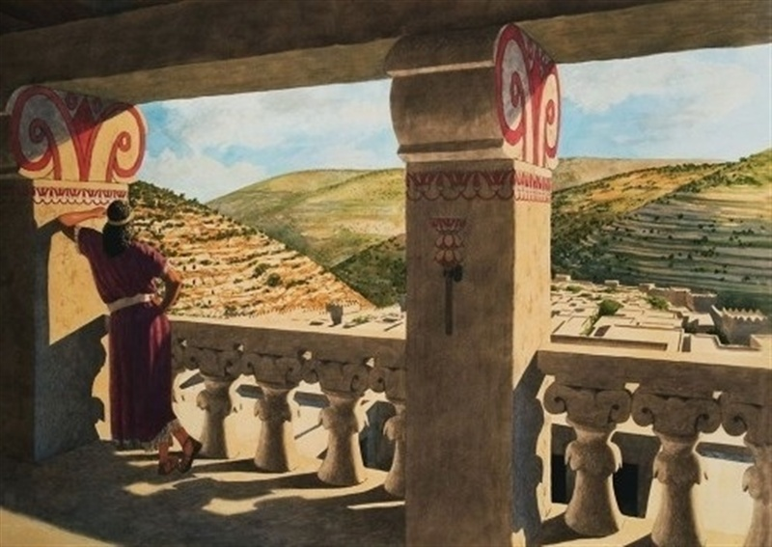
The next step is to go to God for REPENTANCE.
Let’s see an example with the King David in 2 Samuel 11:1-12:13
David and Bathsheba
When David recognized his sin then he was able to repent and be restored.

Slide 17
The next step is to go to God for REPENTANCE.
Have mercy on me, O God, according to your unfailing love; according to your great compassion blot out my transgressions.
Psalm 51:1 (NIV)
Love
Joy
Peace
Patience
kindness
Goodness
Faithfulness
Gentleness
Self-control

