Slide 1

The Big Picture
Colossians 1:15-20 (NIV)
Proclaiming Christ as Lord

Slide 2
1 Colossians 1:1-14 (NIV)
Paul, an apostle of Christ Jesus by the will of God, and Timothy our brother, ² To God’s holy people in Colossae, the faithful brothers and sisters in Christ: Grace and peace to you from God our Father.
Thanksgiving and Prayer
³ We always thank God, the Father of our Lord Jesus Christ, when we pray for you, ⁴ because we have heard of your faith in Christ Jesus and of the love you have for all God’s people— ⁵ the faith and love that spring from the hope stored up for you in heaven and about which you have already heard in the true message of the gospel ⁶ that has come to you.

Slide 3
In the same way, the gospel is bearing fruit and growing throughout the whole world—just as it has been doing among you since the day you heard it and truly understood God’s grace. ⁷ You learned it from Epaphras, our dear fellow servant, who is a faithful minister of Christ on our behalf, ⁸ and who also told us of your love in the Spirit.
⁹ For this reason, since the day we heard about you, we have not stopped praying for you. We continually ask God to fill you with the knowledge of his will through all the wisdom and understanding that the Spirit gives,

Slide 4
¹⁰ so that you may live a life worthy of the Lord and please him in every way: bearing fruit in every good work, growing in the knowledge of God, ¹¹ being strengthened with all power according to his glorious might so that you may have great endurance and patience, ¹² and giving joyful thanks to the Father, who has qualified you to share in the inheritance of his holy people in the kingdom of light. ¹³ For he has rescued us from the dominion of darkness and brought us into the kingdom of the Son he loves, ¹⁴ in whom we have redemption, the forgiveness of sins.
1 Colossians 1:1-14 (NIV)

Slide 5
Let’s pray…

Slide 6
The Big Picture
Proclaiming Christ as Lord
Christ is the Lord of creation and the Lord of the church.
Who is Jesus?
Jesus was a Jewish magician
Jesus was essentially a terrorist
Jesus was an itinerant, popular philosopher
Jesus was a simple Galilean teacher who taught in memorable parables

Slide 7
I. Christ is the Lord of Creation
“by Him everything was created,”
Colossians 1:16
a) His Relationship to God
“He is the image of the invisible God”
Colossians 1:15

Slide 8
I. Christ is the Lord of Creation
“For in him the whole fullness of deity dwells bodily, and you have come to fullness in him, who is the head of every ruler and authority”
Colossians 2:9–10
b) His relationship to the Cosmos:
“…the firstborn over all creation.” Colossians 1:15
“Thomas said to him, “My Lord and my God!”
John 20:28 (NIV).

Slide 9
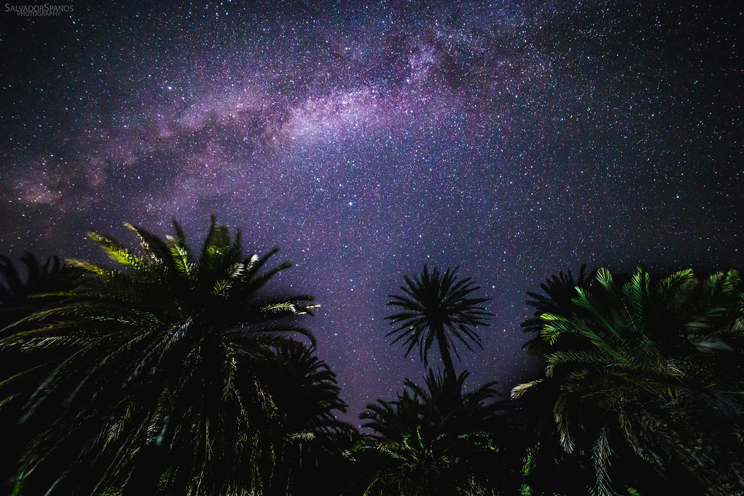
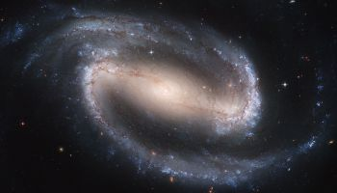
Christ is the cosmic Lord because he is the cosmic creator
Our galaxy alone, the Milky Way, has an estimated 135 billion stars and there are thought to be at least 100 billion other galaxies!

Slide 10
³ When I look at your heavens, the work of your fingers, the moon and the stars, which you have set in place, ⁴ what is man that you are mindful of him, and the son of man that you care for him?
⁵ Yet you have made him a little lower than the heavenly beings and crowned him with glory and honour.
Psalm 8:3-5 (ESV)
Such beings must not be venerated or feared since they, like everything else, stand under the authority of the sovereign Lord of creation.

Slide 11
Not only is Christ the creator, he is the one who holds it all together.
He is before all things, and in him all things hold together.
Colossians 1:17 (NIV)
The Son is the radiance of God’s glory and the exact representation of his being, sustaining all things by his powerful word. After he had provided purification for sins, he sat down at the right hand of the Majesty in heaven.
Hebrews 1:3 (NIV)

Slide 12
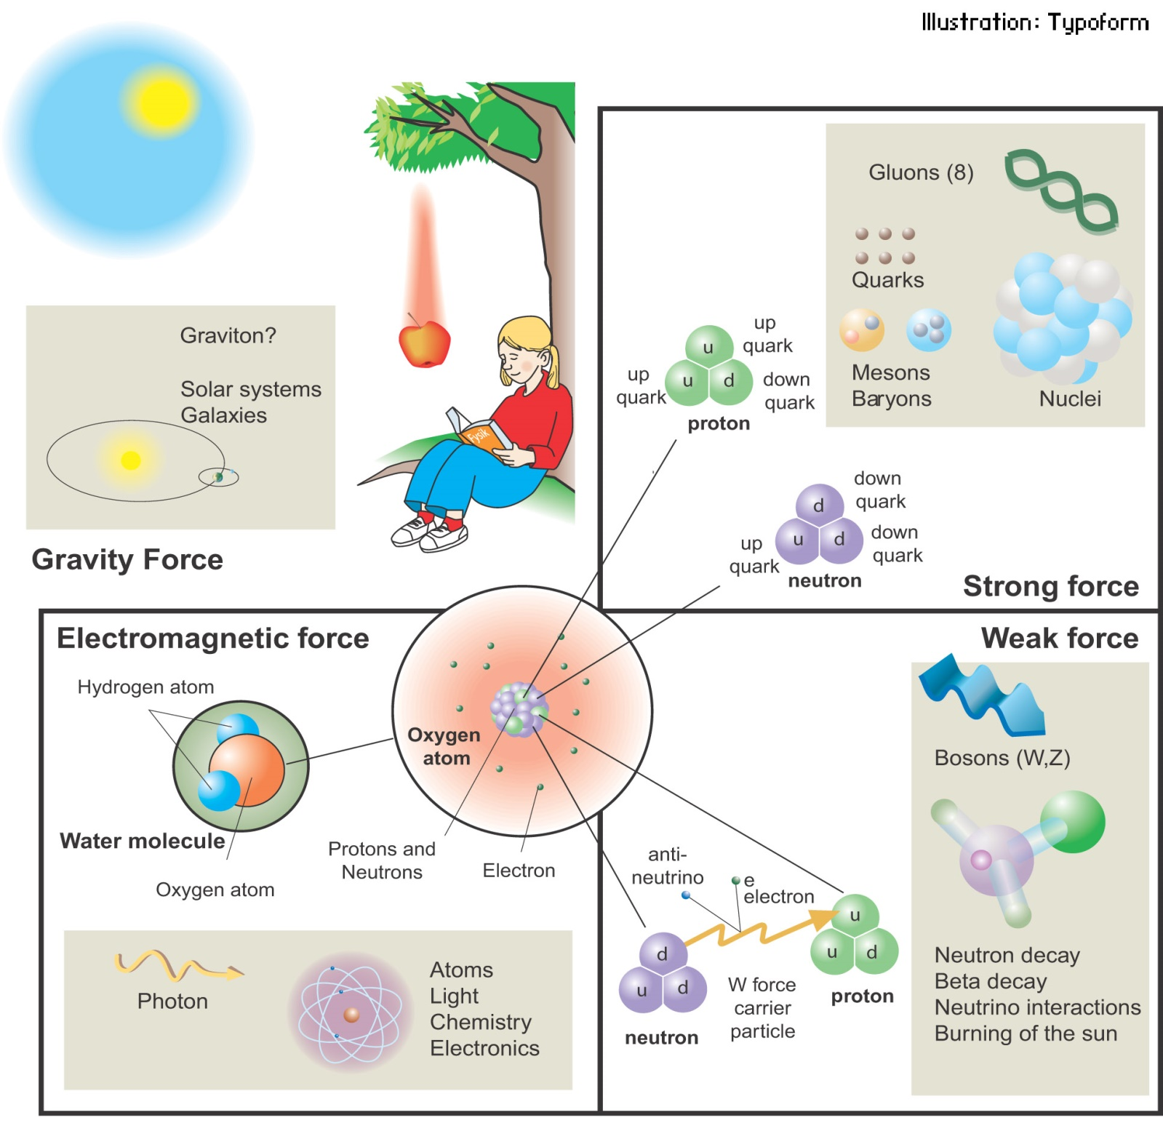
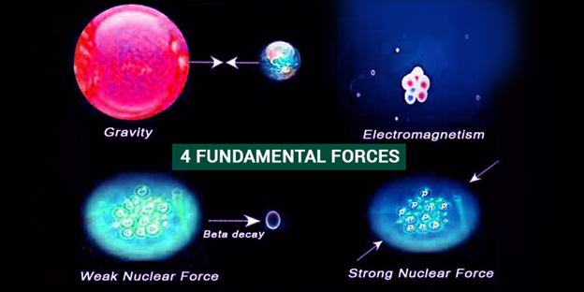
In the standard model of physics, there are four fundamental forces that account for all the known phenomena in the cosmos.

Slide 13
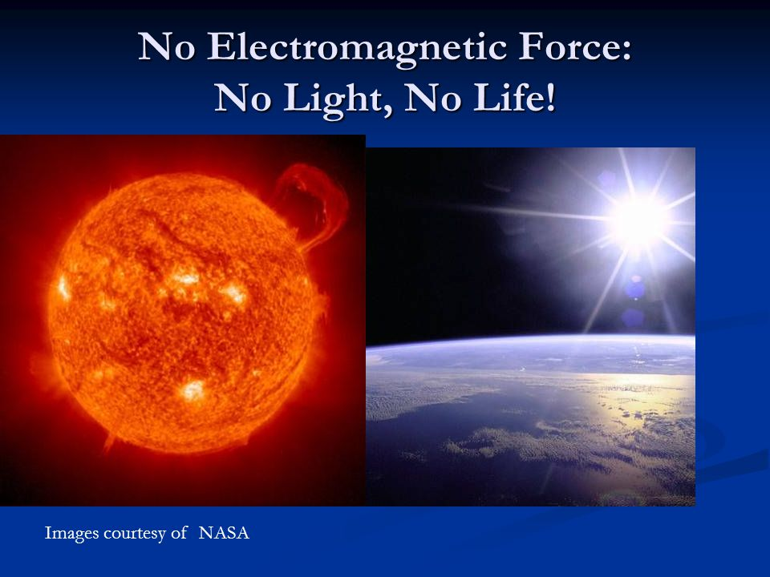
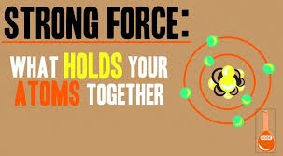
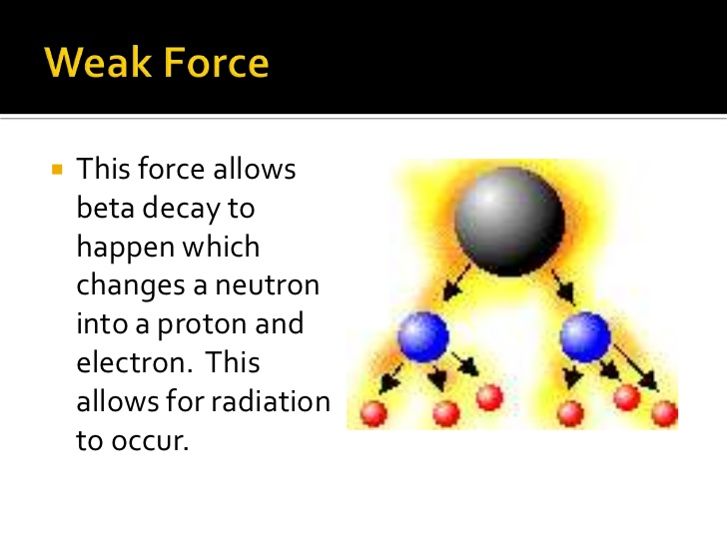
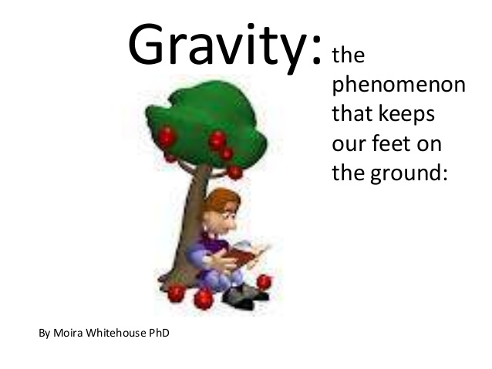

Slide 14
He is before all things, and in him all things hold together.
Colossians 1:17 (NIV)
Jesus Christ, the cosmic Lord, determines the functions and durations of all the cosmic forces and particles.
“all things are yours (the world, life, death, the present, the future) … all belong to you, and you belong to Christ, and Christ belongs to God”
1 Corinthians 3:22.

Slide 15

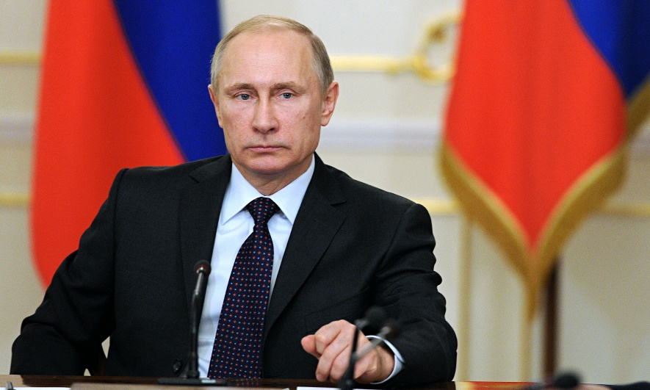
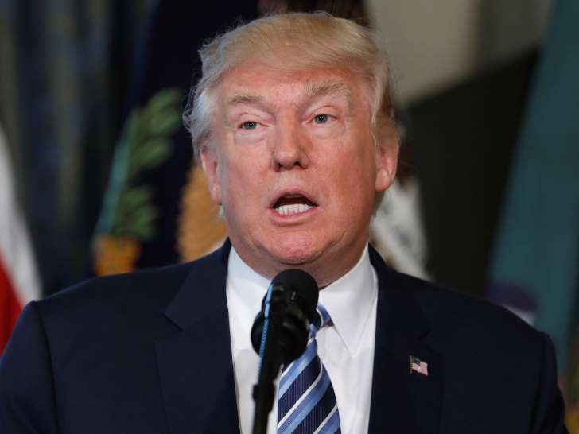

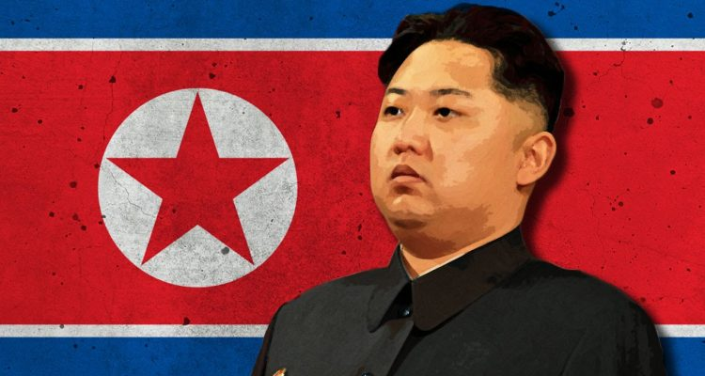
The Big Picture
The CHURCH

Slide 16
The Big Picture
The CHURCH

Slide 17
II. Christ is the Lord of Church
a) Christ is the Head of the Church
“And he is the head of the body, the church; he is the beginning and the firstborn from among the dead, so that in everything he might have the supremacy. ”
Colossians 1:18 (NIV)
Christ has the first Place in everything

Slide 18
Christ has the first Place in everything
¹⁹ For God was pleased to have all his fullness dwell in him, ²⁰ and through him to reconcile to himself all things, whether things on earth or things in heaven, by making peace through his blood, shed on the cross.
Colossians 1:19-20 (NIV)
How, then, as Christians, do we respond to this magnificent portrait of the Cosmic Christ?
We must confess him as Lord.

Slide 19
“in whom are hidden all the treasures of wisdom and knowledge.”
Colossians 2:3 (NIV)
1.) Our hearts swell with joyful thanksgiving to our heavenly Father.
“God has rescued us from the power of darkness and transferred us into the kingdom of his beloved Son”
(Colossians 1:12–13).

Slide 20
2. Our lives should reflect hope.
“the faith and love that spring from the hope stored up for you in heaven…”
Colossians 1:5 (NIV)
“When Christ, who is your life, appears, then you also will appear with him in glory.”
Colossians 3:4 (NIV)

Slide 21
3.) Christ is the centre of our lives:
“if you continue in your faith, established and firm, and do not move from the hope held out in the gospel…”
Colossians 1:23 (NIV)
He is the one we proclaim, admonishing and teaching everyone with all wisdom, so that we may present everyone fully mature in Christ.
Colossians 1:28 (NIV)

Slide 22
4. We willingly worship the Lord of all.
“Let the Word of Christ dwell in you richly as you teach and admonish one another with all wisdom, and as you sing psalms, hymns and spiritual songs with gratitude in your hearts to God. And whatever you do, whether in word or deed, do it all in the name of the Lord Jesus, giving thanks to God the Father through him.”
Colossians 3:16-17 (NIV)

Slide 23
Missional church:
⁵ Be wise in the way you act toward outsiders; make the most of every opportunity. ⁶ Let your conversation be always full of grace, seasoned with salt, so that you may know how to answer everyone.
Colossians 4:5-6 (NIV)

Slide 24
This is what the Sovereign Lord, the Holy One of Israel, says:
“In repentance and rest is your salvation, in quietness and trust is your strength,… Isaiah 30:15 (NIV)
Proclaiming Christ as Lord

