Slide 1

"What relevance does Easter have in the world today?
Easter Sunday is a religious holiday to some and a family holiday for others, but how did the bunny get involved?

Slide 2
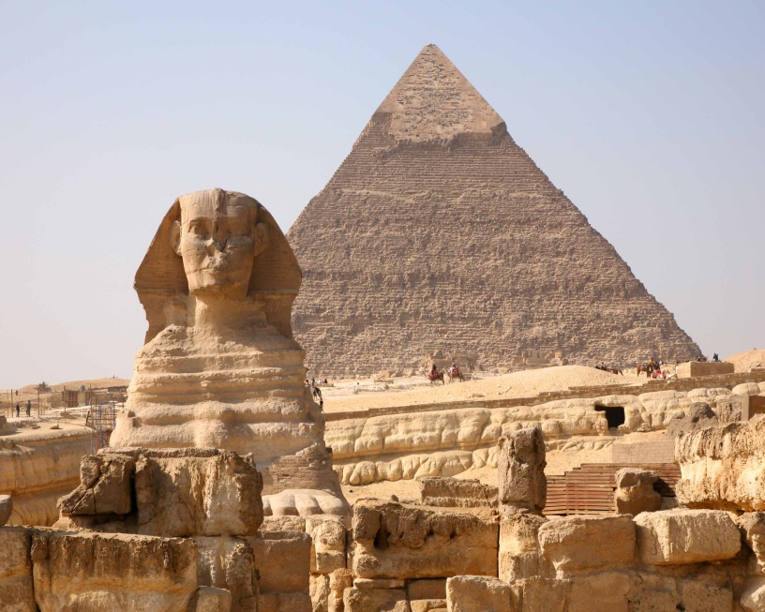
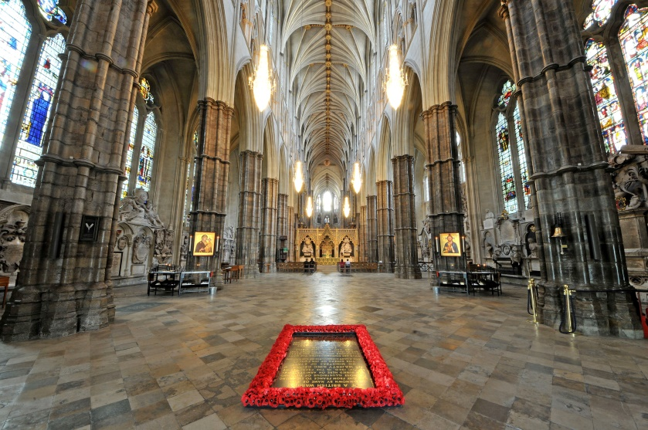
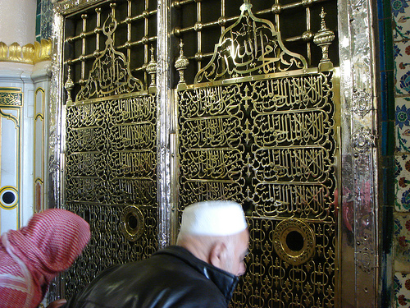
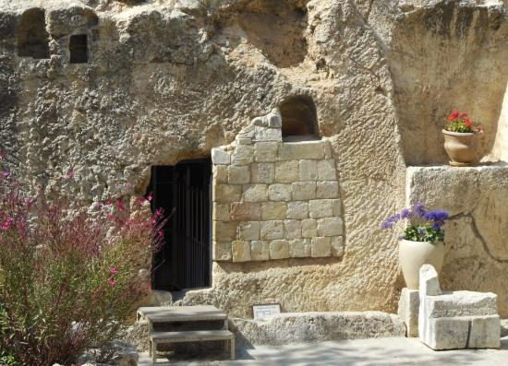

Slide 3
Matthew 28:1-7 (NIV)
After the Sabbath, at dawn on the first day of the week, Mary Magdalene and the other Mary went to look at the tomb. ² There was a violent earthquake, for an angel of the Lord came down from heaven and, going to the tomb, rolled back the stone and sat on it.³ His appearance was like lightning, and his clothes were white as snow.⁴ The guards were so afraid of him that they shook and became like dead men. ⁵ The angel said to the women, “Do not be afraid, for I know that you are looking for Jesus, who was crucified. ⁶ He is not here; he has risen, just as he said. Come and see the place where he lay. ⁷ Then go quickly and tell his disciples: ‘He has risen from the dead…

Slide 4
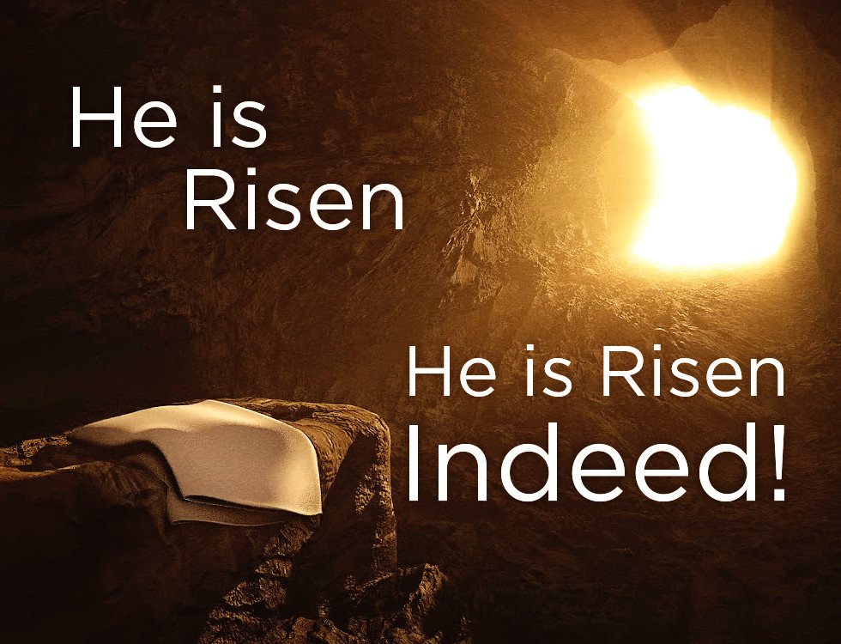

Slide 5
1Corinthians 15:1-4 (NIV)
¹Now, brothers, I want to remind you of the gospel I preached to you, which you received and on which you have taken your stand. ²By this gospel you are saved, if you hold firmly to the word I preached to you. Otherwise, you have believed in vain.
³For what I received I passed on to you as of first importance: that Christ died for our sins according to the Scriptures, ⁴that he was buried, that he was raised on the third day according to the Scriptures,

Slide 6
Let’s pray…

Slide 7
The Resurrection a present and eternal hope
3 kinds of people that denied the resurrection:
“Let’s eat and drink, for tomorrow we will die.”
God is everything
The belief that God and the material world are one and the same thing and that God is present in everything.

Slide 8
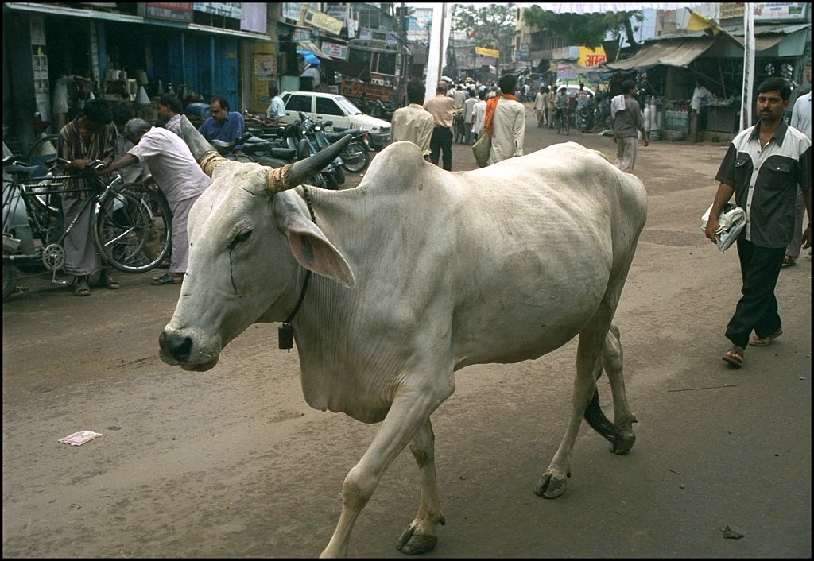
God is everything
Rom 1:25 (NIV)
²⁵They exchanged the truth of God for a lie, and worshiped and served created things rather than the Creator—who is forever praised. Amen.

Slide 9
The Resurrection a present and eternal hope
There are 3 elements in the Gospel,
3 elements of the resurrection gospel.
I. The Death of Jesus Christ
“For what I received I passed on to you as of first importance:
that Christ died for our sins according to the Scriptures,”
1 Corinthians 15:3 (NIV)

Slide 10
II. The Burial of Jesus Christ
“that he was buried,…”
1 Corinthians 15:4a (NIV)
He was assigned a grave with the wicked, and with the rich in his death, though he had done no violence, nor was any deceit in his mouth.
Isaiah 53:9 (NIV)

Slide 11
II. The Burial of Jesus Christ
“Later, Joseph of Arimathea asked Pilate for the body of Jesus. Now Joseph was a disciple of Jesus, but secretly because he feared the Jewish leaders. With Pilate’s permission, he came and took the body away. ³⁹ He was accompanied by Nicodemus, the man who earlier had visited Jesus at night. Nicodemus brought a mixture of myrrh and aloes, about seventy-five pounds. ⁴⁰ Taking Jesus’ body, the two of them wrapped it, with the spices, in strips of linen. This was in accordance with Jewish burial customs. ⁴¹ At the place where Jesus was crucified, there was a garden, and in the garden a new tomb, in which no one had ever been laid. ⁴² Because it was the Jewish day of Preparation and since the tomb was nearby, they laid Jesus there.”
John 19:38:42 (NIV)

Slide 12
III. The resurrection of Jesus Christ
“And if Christ has not been raised, your faith is futile; you are still in your sins. ¹⁸ Then those also who have fallen asleep in Christ are lost.¹⁹ If only for this life we have hope in Christ, we are of all people most to be pitied. ²⁰ But Christ has indeed been raised from the dead,…”
1 Corinthians 15:17-20 (NIV)

Slide 13
“If you declare with your mouth, “Jesus is Lord,” and believe in your heart that God raised him from the dead, you will be saved. ¹⁰ For it is with your heart that you believe and are justified, and it is with your mouth that you profess your faith and are saved.
Romans 10:9-10 (NIV)
Jesus’ resurrection makes it impossible for man’s story to end in chaos – it has to move inexorably towards light, towards life, towards love.
Carolo Carreto

Slide 14
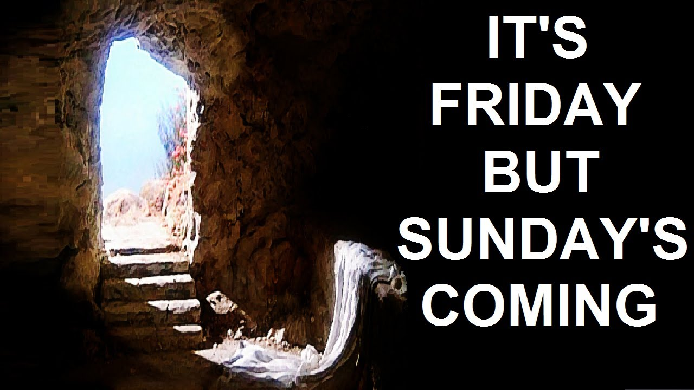
The Resurrection a present and eternal hope

