Slide 1
Matthew 21:1-11 NIV
The Triumphal Entry
¹As they approached Jerusalem and came to Bethphage on the Mount of Olives, Jesus sent two disciples, ²saying to them, "Go to the village ahead of you, and at once you will find a donkey tied there, with her colt by her. Untie them and bring them to me. ³If anyone says anything to you, tell him that the Lord needs them, and he will send them right away." ⁴This took place to fulfill what was spoken through the prophet: ⁵"Say to the Daughter of Zion, 'See, your king comes to you, gentle and riding on a donkey,
on a colt, the foal of a donkey."

Slide 2
⁶The disciples went and did as Jesus had instructed them. ⁷They brought the donkey and the colt, placed their cloaks on them, and Jesus sat on them. ⁸A very large crowd spread their cloaks on the road, while others cut branches from the trees and spread them on the road. ⁹The crowds that went ahead of him and those that followed shouted, "Hosanna to the Son of David!" "Blessed is he who comes in the name of the Lord!" "Hosanna in the highest!" ¹⁰When Jesus entered Jerusalem, the whole city was stirred and asked, "Who is this?" ¹¹The crowds answered, "This is Jesus, the prophet from Nazareth in Galilee."

Slide 3
^{Luke 19:41 – 44. (NIV)}
⁴¹ As he approached Jerusalem and saw the city, he wept over it. ⁴² and said, “If you, even you, had only known on this day what would bring you peace—but now it is hidden from your eyes.^{” 43} The days will come upon you when your enemies will build an embankment against you and encircle you and hem you in on every side. ⁴⁴ They will dash you to the ground, you and the children within your walls. They will not leave one stone on another, because you did not recognize the time of God’s coming to you.”

Slide 4
^{Let’s Pray…}

Slide 5
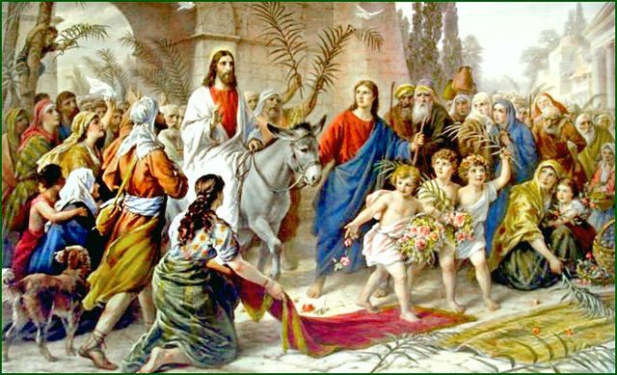
“Rejoice greatly, O Daughter of Zion! Shout, Daughter of Jerusalem! See, your king comes to you . . . gentle and riding on a donkey, on a colt, the foal of a donkey” (Zechariah 9:9 NIV).

Slide 6
Triumph and Tragedy
⁴¹ As he approached Jerusalem and saw the city, he wept over it ⁴² and said, “If you, even you, had only known on this day what would bring you peace—but now it is hidden from your eyes. Luke 19:41-42 NIV.

Slide 7
I. A day of Triumph
Preparation.
¹As they approached Jerusalem and came to Bethphage on the Mount of Olives, Jesus sent two disciples, ²saying to them, "Go to the village ahead of you, and at once you will find a donkey tied there, with her colt by her. Untie them and bring them to me. ³If anyone says anything to you, tell him that the Lord needs them, and he will send them right away." ⁴This took place to fulfill what was spoken through the prophet: ⁵"Say to the Daughter of Zion, 'See, your king comes to you, gentle and riding on a donkey,
on a colt, the foal of a donkey." ⁶The disciples went and did as Jesus had instructed them.
Matthew 21:1-6 (NIV)

Slide 8
I. A day of Triumph
Procession.
⁷They brought the donkey and the colt, placed their cloaks on them, and Jesus sat on them. ⁸A very large crowd spread their cloaks on the road, while others cut branches from the trees and spread them on the road. ⁹The crowds that went ahead of him and those that followed shouted, "Hosanna to the Son of David!" "Blessed is he who comes in the name of the Lord!" "Hosanna in the highest!" ¹⁰When Jesus entered Jerusalem, the whole city was stirred and asked, "Who is this?" ¹¹The crowds answered, "This is Jesus, the prophet from Nazareth in Galilee."
Matthew 21:7-11 (NIV)

Slide 9
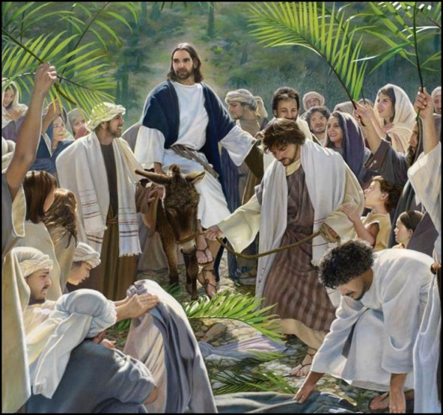
I. A day of Triumph
Procession.
Lift up your heads, O you gates; be lifted up, you ancient doors, that the King of glory may come in”
Psalm 24:7 (NIV)
“Who is this King of glory?”
“The Lord strong and mighty, the Lord mighty in battle”

Slide 10
I. A day of Triumph
Pharisees
³⁹ Some of the Pharisees in the crowd said to Jesus, “Teacher, rebuke your disciples!”
⁴⁰ “I tell you,” he replied, “if they keep quiet, the stones will cry out.”
Luke 19:39-40 (NIV)
The Pharisees then said among themselves, “Behold, the world is gone after him”
John 12:19.

Slide 11
II. A day of Tragedy
“Jerusalem, Jerusalem, you who kill the prophets and stone those sent to you, how often I have longed to gather your children together, as a hen gathers her chicks under her wings, and you were not willing.”
Matthew 23:37 (NIV).
Lost love
How often
…and you were not willing

Slide 12
II. A day of Tragedy
“As he approached Jerusalem and saw the city, he wept over it”. Luke 19:41 NIV.
Lost opportunity
“and said, “If you, even you, had only known on this day what would bring you peace—but now it is hidden from your eyes.”
Luke 19:42 (NIV).

Slide 13
III. A day of Tribulation
⁴³ The days will come upon you when your enemies will build an embankment against you and encircle you and hem you in on every side. ⁴⁴ They will dash you to the ground, you and the children within your walls. They will not leave one stone on another, because you did not recognize the time of God’s coming to you.”
Luke 19:43-44 (NIV).

Slide 14
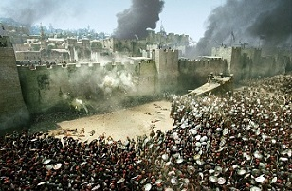
III. A day of Tribulation
The KJV translates what Jesus said,
“because thou knewest not the time of thy visitation.”
In AD 70 Titus and his Roman army capture Jerusalem.

Slide 15
III. A day of Tribulation
The Jewish historian Josephus summed up this day of tribulation in these words:
“But for the city, it was so thoroughly laid even with the ground by those who dug it up to the foundations, that there was left nothing to make those that come hither believe it had ever been inhabited” (Josephus, Antiquities 5.1).

Slide 16
“If you, even you, had only known on this day what would bring you peace…
a) Refuse His Love
b) Missing their
opportunity for blessing
c) Face the day of
tribulation.

Slide 17
Triumph and Tragedy
Are Jesus’ tears for you?
a) Refusing His Love
b) Missing the opportunity for blessing
c) Face the day of tribulation.

