Slide 1
Psalm 137 (NIV)
¹ By the rivers of Babylon we sat and wept
when we remembered Zion.
² There on the poplars
we hung our harps,
³ for there our captors asked us for songs,
our tormentors demanded songs of joy;
they said, “Sing us one of the songs of Zion!”
⁴ How can we sing the songs of the Lord
while in a foreign land?
⁵ If I forget you, Jerusalem,
may my right hand forget its skill.

Slide 2
Psalm 137 (NIV)
⁶ May my tongue cling to the roof of my mouth if I do not remember you,
if I do not consider Jerusalem my highest joy.
⁷ Remember, Lord, what the Edomites did
on the day Jerusalem fell.
“Tear it down,” they cried,
“tear it down to its foundations!”
⁸ Daughter Babylon, doomed to destruction,
happy is the one who repays you
according to what you have done to us.
⁹ Happy is the one who seizes your infants
and dashes them against the rocks.

Slide 3
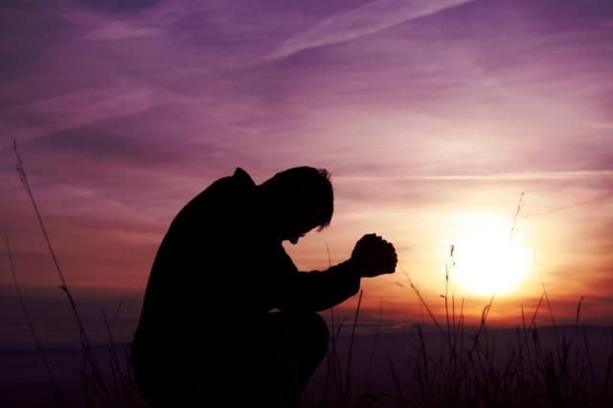
Let’s pray…

Slide 4
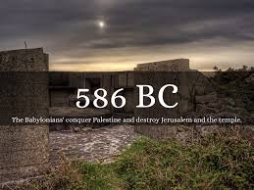
2 Chronicles 36:21 (NIV)
The land enjoyed its Sabbath rests; all the time of its desolation it rested, until the seventy years were completed in fulfilment of the word of the Lord spoken by Jeremiah.

Slide 5
Psalm 47:1 (NIV)
“Clap your hands, all you nations; shout to God with cries of joy.”
“The prospect of the righteous is joy,
but the hopes of the wicked come to nothing.”
Proverbs 10:28 (NIV)
Have you lost your joy?

Slide 6
WHEN JOY IS LOST (Psalm 137)
“Memory of Zion” (verse 1)
“By the rivers of Babylon we sat and wept when we remembered Zion.”
Zion is described as the city of David and as the city of God.

Slide 7
In the New Testament, Zion refers to God’s spiritual Kingdom
Hebrews 12:22 (NIV)
“But you have come to Mount Zion, to the city of the living God, the heavenly Jerusalem…”
By the rivers of Babylon we remember and cry.

Slide 8
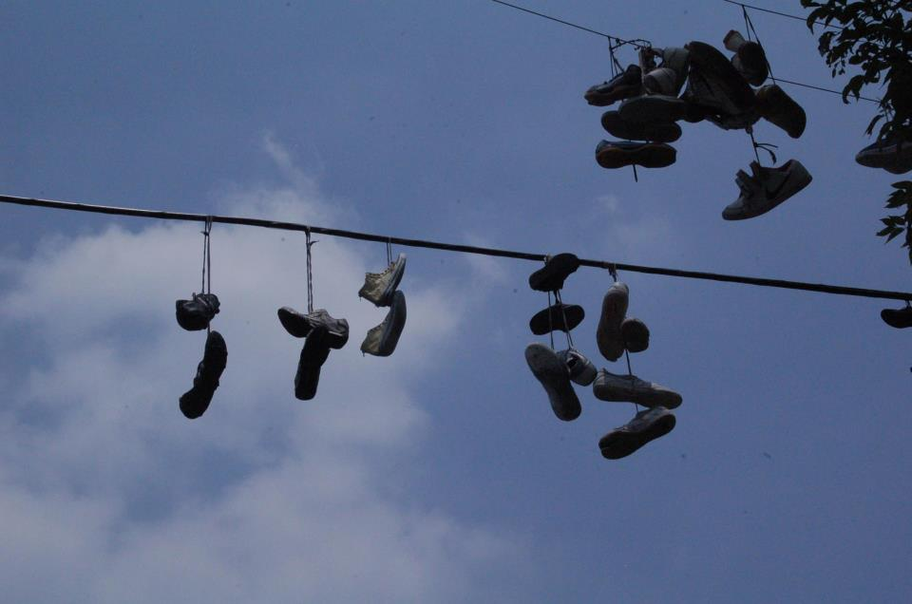
II. A description of the happiness they used to enjoy
Verse 2 says;
“There on the poplars we hung our harps,”

Slide 9
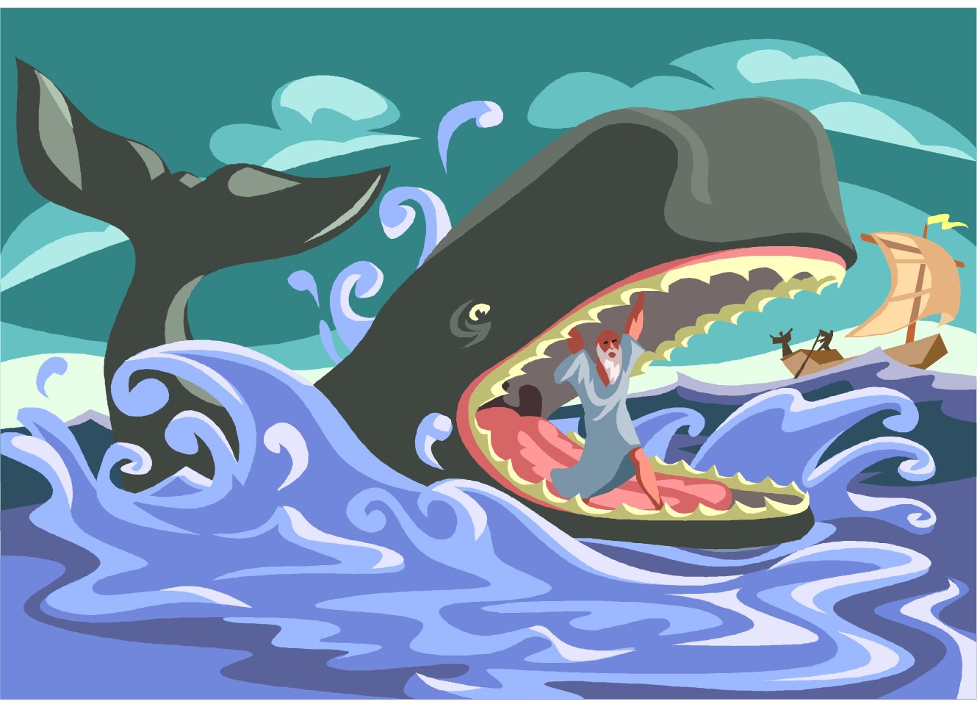
for there our captors asked us for songs, our tormentors demanded songs of joy; they said, “Sing us one of the songs of Zion!”
Psalm 137:3 (NIV)
They needed to be in the right place, they needed to be right with God.
Jonah

Slide 10
Repentance was required.
“How can we sing the songs of the Lord while in a foreign land?”
Psalm 137:4 (NIV)
There was a mourning over Jerusalem.
⁵ If I forget you, Jerusalem, may my right hand forget its skill. ⁶ May my tongue cling to the roof of my mouth if I do not remember you, if I do not consider Jerusalem my highest joy.
Psalm 137:5-6 (NIV)

Slide 11
III. An example of God’s judgement.
⁷ Remember, Lord, what the Edomites did
on the day Jerusalem fell.
“Tear it down,” they cried,
“tear it down to its foundations!”
⁸ Daughter Babylon, doomed to destruction,
happy is the one who repays you
according to what you have done to us.
⁹ Happy is the one who seizes your infants
and dashes them against the rocks.

Slide 12
The psalmist was not seeking personal revenge, but rather was asking God to take action.
The psalmist wishes for Babylon the same thing that happened to Jerusalem.
The people repented

Slide 13
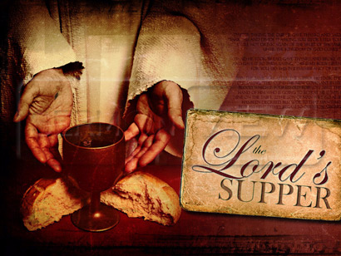
Have you lost your JOY?
Come back to the place of fellowship.

Slide 14
Psalm 32:1 says;
“Blessed is he whose transgressions are forgiven, whose sins are covered”
Come back, seek His face, he is a loving and merciful God.

