Slide 1
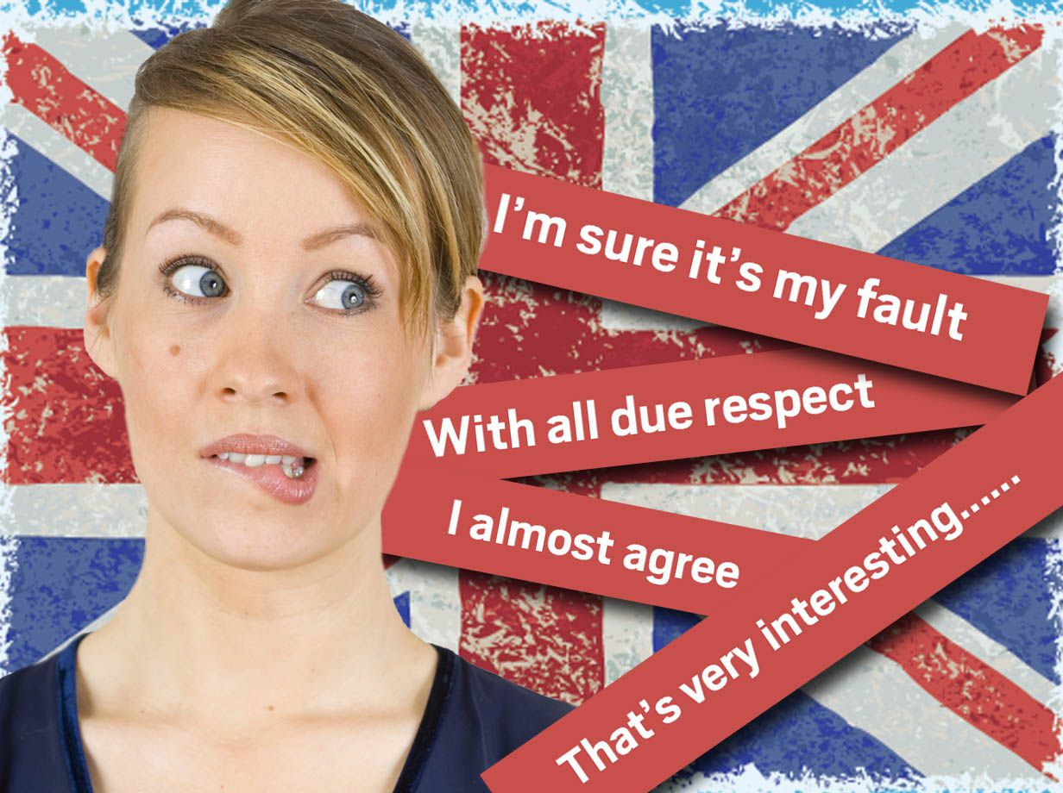
“What British people really mean”
When British people say it's 'quite good'
ↆ
it's really 'a bit disappointing'
"That's not bad"
ↆ
and really mean "That's good"

Slide 2
“What British people really mean”
“You must come for dinner”
ↆ
It’s not an invitation I am just being polite
“I hope to come to the meeting”
ↆ
they really mean “I am not coming”.

Slide 3
¹⁰ Humble yourselves before the Lord, and he will lift you up. ¹¹ Brothers and sisters, do not slander one another. Anyone who speaks against a brother or sister or judges them speaks against the law and judges it. When you judge the law, you are not keeping it, but sitting in judgment on it.
James 4:10-11 (NIV)
Gossip
¹²There is only one Lawgiver and Judge, the one who is able to save and destroy. But you—who are you to judge your neighbour?
James 4:12 (NIV)

Slide 4
“Necessary Humility”
Boasting About Tomorrow
¹³ Now listen, you who say, “Today or tomorrow we will go to this or that city, spend a year there, carry on business and make money.” ¹⁴ Why, you do not even know what will happen tomorrow. What is your life? You are a mist that appears for a little while and then vanishes. ¹⁵ Instead, you ought to say, “If it is the Lord’s will, we will live and do this or that.” ¹⁶ As it is, you boast in your arrogant schemes. All such boasting is evil. ¹⁷ If anyone, then, knows the good they ought to do and doesn’t do it, it is sin for them.
James 4:13-17 (NIV)

Slide 5
Let’s pray…

Slide 6



I. Certainty about the Future is FOOLISHNESS.

Slide 7
Psalm 14:1 says;
The fool says in his heart, "There is no God."
Certainty about the Future is FOOLISHNESS.
Why, you do not even know what will happen tomorrow. What is your life? You are a mist that appears for a little while and then vanishes.
James 4:14 (NIV)
The only certainty is that we do not know the future.

Slide 8
Certainty about the Future is FOOLISHNESS.
We cannot be certain about the future.
“James connects man’s life with a higher will than his own and seeks to correct the false approach to human activities by reminding his readers that God’s will is supreme and that their plans for the future must bear His stamp”
F. Davidson, A. M. Stibbs and E. F. Kevan, “The New Bible Commentary”, Inter-varsity Fellowship, London, 1969, p1126

Slide 9
II. Entrusting our Future to God is WISE.
James 4:15 (NIV)
“Instead, you ought to say, “If it is the Lord’s will, we will live and do this or that.”
What James is teaching here is that it is dangerous when people think they could live independently of God.
Proverbs 9:10 (NIV)
The fear of the LORD is the beginning of wisdom, and knowledge of the Holy One is understanding

Slide 10

In the future one thing is certain, death.
“Just as people are destined to die once, and after that to face judgment,”
Hebrews 9:27 (NIV)

Slide 11
a) We should recognise God in the affairs of the future, because He is the one who created heavens and earth.
Colossians 1:16-17 (NIV)
“For in him all things were created: things in heaven and on earth, visible and invisible, whether thrones or powers or rulers or authorities; all things have been created through him and for him. ¹⁷ He is before all things, and in him all things hold together.”

Slide 12
b) We should recognise God in the affairs of the future,
because God can only reveal His will to those who honour Him
Psalm 25:14 (NLT)
The Lord is a friend to those who fear him.
He teaches them his covenant.
“…Those who honour me I will honour, but those who despise me will be disdained.”
1 Samuel 2:30 (NIV)

Slide 13
“We should always say, or mean without saying, "All my plans must wait till the Lord sets before me an open door. If God permit, I will do this; but if the Lord will, I will stop, and do nothing. My strength shall be to sit still, unless the Master wishes me to go forward.”
C. Spurgeon.
Are you willing to be a friend of the Lord?

Slide 14
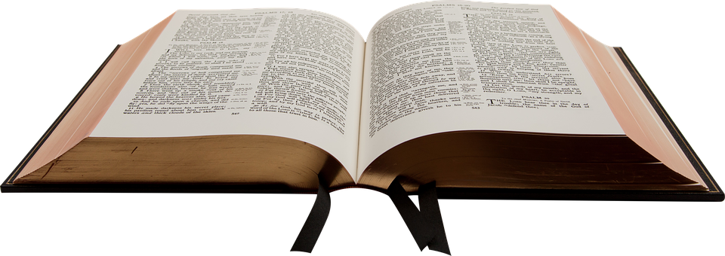
c) We should recognise God in the affairs of the future,
because is only then that we will be ready to do His will in our lives.
We are called to live our lives by every word that proceeds from the mouth of God.
We are to trust and obey.

Slide 15
1 Timothy 2:4 (NIV)
“who wants all people to be saved and to come to a knowledge of the truth”
Ezekiel 18:23 (NLT)
“Do you think that I like to see wicked people die? says the Sovereign Lord. Of course not! I want them to turn from their wicked ways and live.

Slide 16
Ezekiel 33:11 (NIV)
“Say to them, ‘As surely as I live, declares the Sovereign Lord, I take no pleasure in the death of the wicked, but rather that they turn from their ways and live. Turn! Turn from your evil ways! Why will you die,..”
His will is that people should be saved, and come to the knowledge of the truth.

Slide 17
III. Boasting about anything is EVIL
James 4:16 (NIV)
“As it is, you boast in your arrogant schemes. All such boasting is evil.”
“Evil”
ↆ
Harm
Hurt
Injury
Destruction

Slide 18
IV. Using the Present is our DUTY.
James 4:17 (NIV)
“If anyone, then, knows the good they ought to do and doesn’t do it, it is sin for them.”
“Sin consists not only in doing evil, but in failing to do the good we know”
F. Davidson, A. M. Stibbs and E. F. Kevan
It is sinful to delay our obedience to the Word of God.

Slide 19
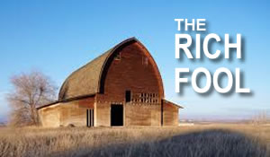
Ezekiel 33:11 (NIV)
“Say to them, ‘As surely as I live, declares the Sovereign Lord, I take no pleasure in the death of the wicked, but rather that they turn from their ways and live. Turn! Turn from your evil ways! Why will you die,..”
Do not procrastinate the day of your repentance

Slide 20
Penrallt Baptist Church
“Today or tomorrow we will go and do this or try that
Instead, we ought to say,
“If it is the Lord’s will, we will live and do this or that.”

Slide 21
“Humble yourselves before the Lord, and he will lift you up.”
James 4:10 (NIV)
Necessary Humility

