Slide 1
For we do not have a high priest who is unable to sympathize with our weaknesses, but we have one who has been tempted in every way, just as we are—
yet was without sin (Heb.4:15)

Slide 2
No temptation has overtaken you except what is common to mankind. And God is faithful; he will not let you be tempted beyond what you can bear. But when you are tempted, he will also provide a way out so that you can endure it. (1 Cor.10:13)

Slide 3
'Temptation often comes through a door that's been deliberately left open.'

Slide 4
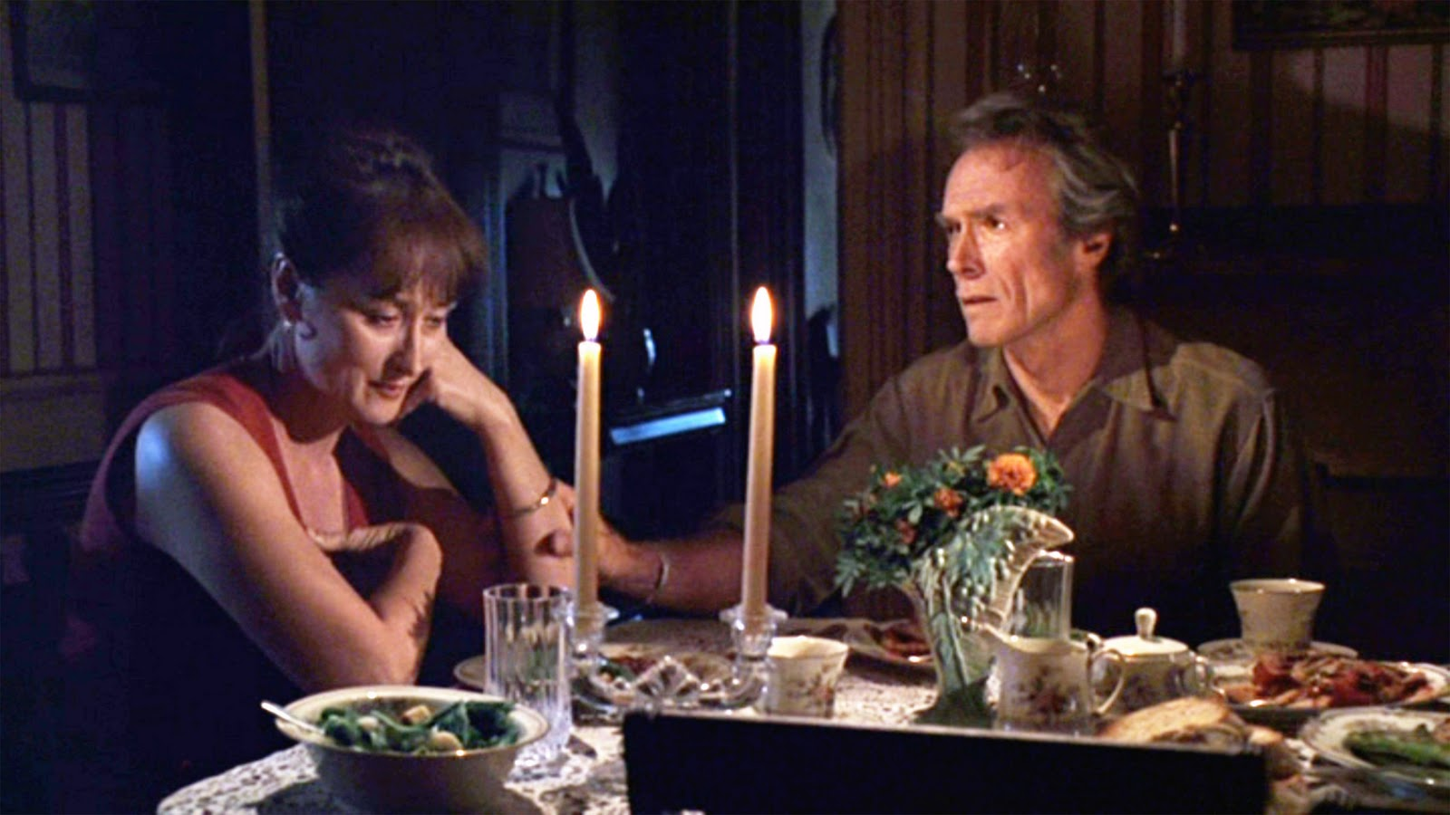

Slide 5
"Lord, make me holy, but not yet!" (Augustine)

Slide 6
'If you would master temptation, you must first let Christ master you!'

Slide 7
“If you are the Son of God, tell this stone to become bread.” (v.3)

Slide 8
It is written: ‘Man shall not live on bread alone.’
(v.4, quoting Deuteronomy 8:3)

Slide 9
I will give you all their authority and splendour; it has been given to me, and I can give it to anyone I want to.
If you worship me, it will all be yours.” (vv.6,7)

Slide 10
It is written: ‘Worship the Lord your God and serve him only.’
(v.8, quoting Deut.6:13)

Slide 11
If you are the Son of God, throw yourself down from here. For it is written: ‘He will command his angels concerning you to guard you carefully; they will lift you up in their hands, so that you will not strike your foot against a stone.’
(vv.9-11, quoting Psalm 91:11,12)

Slide 13
It is said: ‘Do not put the Lord your God to the test.’
(v.12, quoting Dt.6:16)

